Slide 1
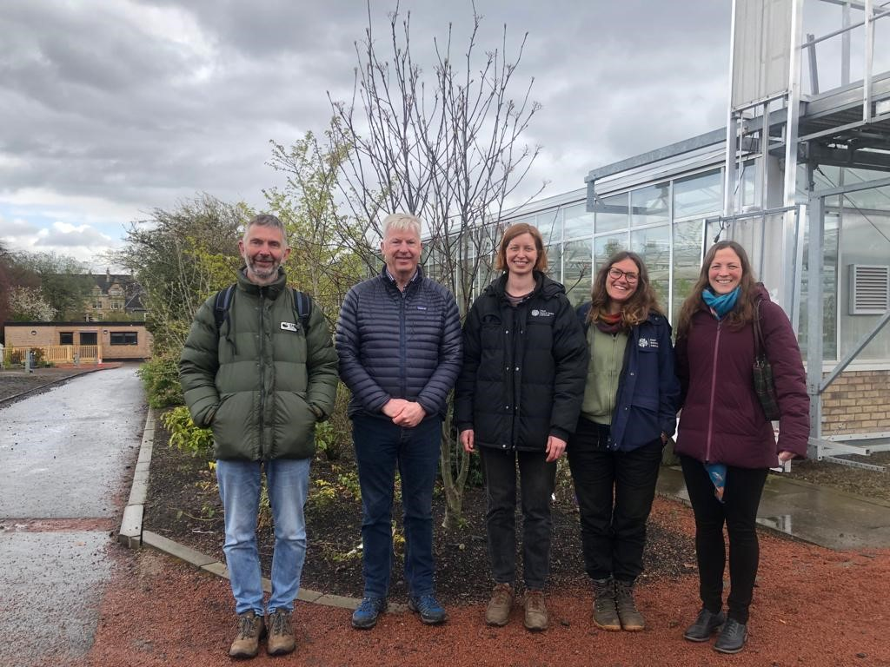
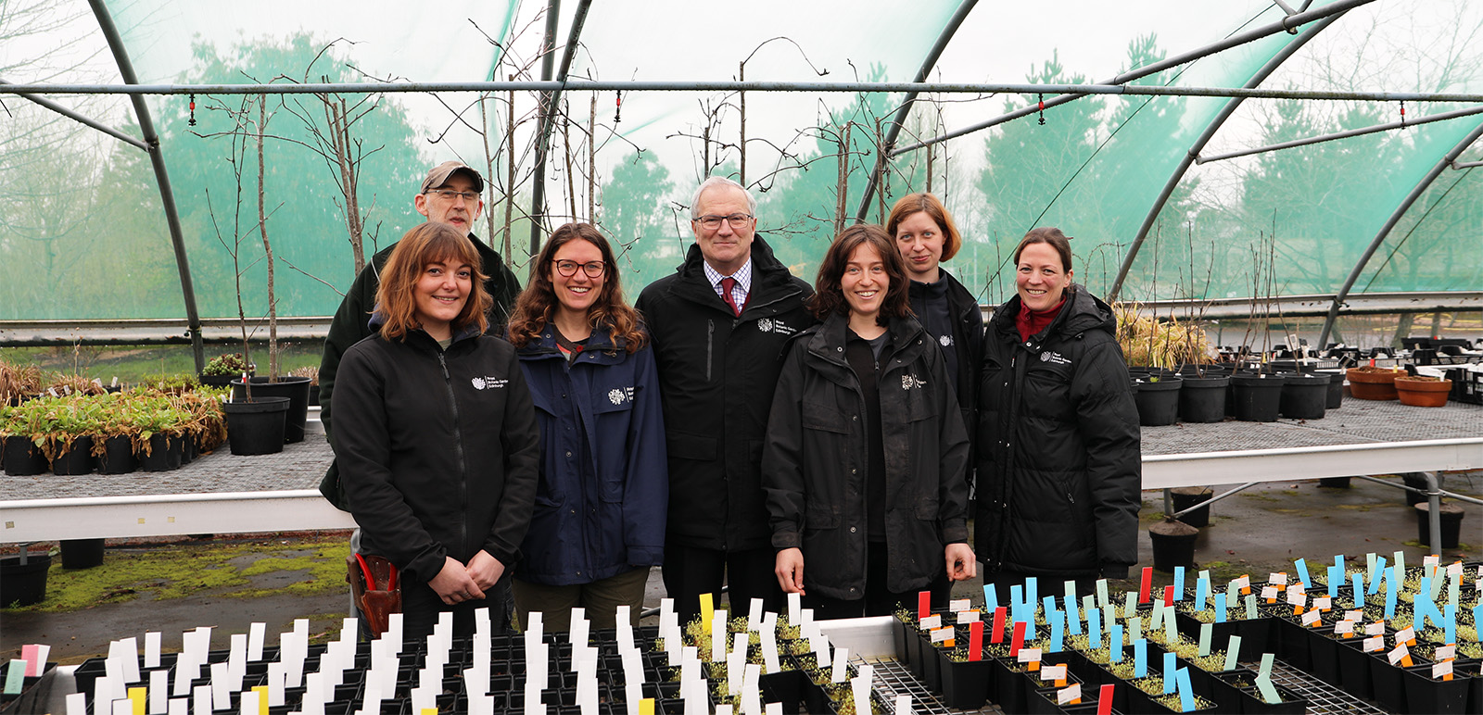
NRF 502209
Biodiversity Net Gain:
Biodiversity as a crucible for saving Scotland’s most threatened species.
Update April 2023
Prepared by Dr Aline Finger, afinger@rbge.org.uk
General:
Admin for and induction of new staff (Becca Drew, Emma Beckinsale, Rachel Robinson)
Partner meetings have been organised for BFT (June), Plantlife (May), Alladale (May)
Landowner permissions have been obtained for Saxifraga hirculus rootstock collections
MSB has agreed to send an initial 50 Saxifraga hirculus seed from Caithness to RBGE
NRF partner Thomas MacDonell (Glenfeshie) has visited RBGE to discuss project plans
A meeting was held with Ellie Mayhew (NRF Wild Strathfillan project) to agree on collaboration on Crab apple collections
First steering meeting has been organised and will be held on 25.05.23
A meeting was held with Ian Cornforth (NatureScot) to discuss collaborations with NatureScot on Arran Sorbus work
Collation of available information on horticulture has been started
Collation of information on species ecology and habitat requirements has been started
More partners / interested groups have joined the project, now 31
Weekly, minuted RBGE meetings (Tuesdays 9-12) are being held to ensure effective workflow and communication
NRF partner Thomas MacDonell (Glenfeshie) visiting RBGE
New staff have started and are welcomed by Regius Keeper Simon Milne
Left to right: Becca Drew, Pete Brownless, Emma Beckinsale, Simon Milne, Rachel Robinson, Martine Borge, Aline Finger
Left to right: Max Coleman, Thomas MacDonell, Martine Borge, Emma Beckinsale, Aline Finger

Slide 2
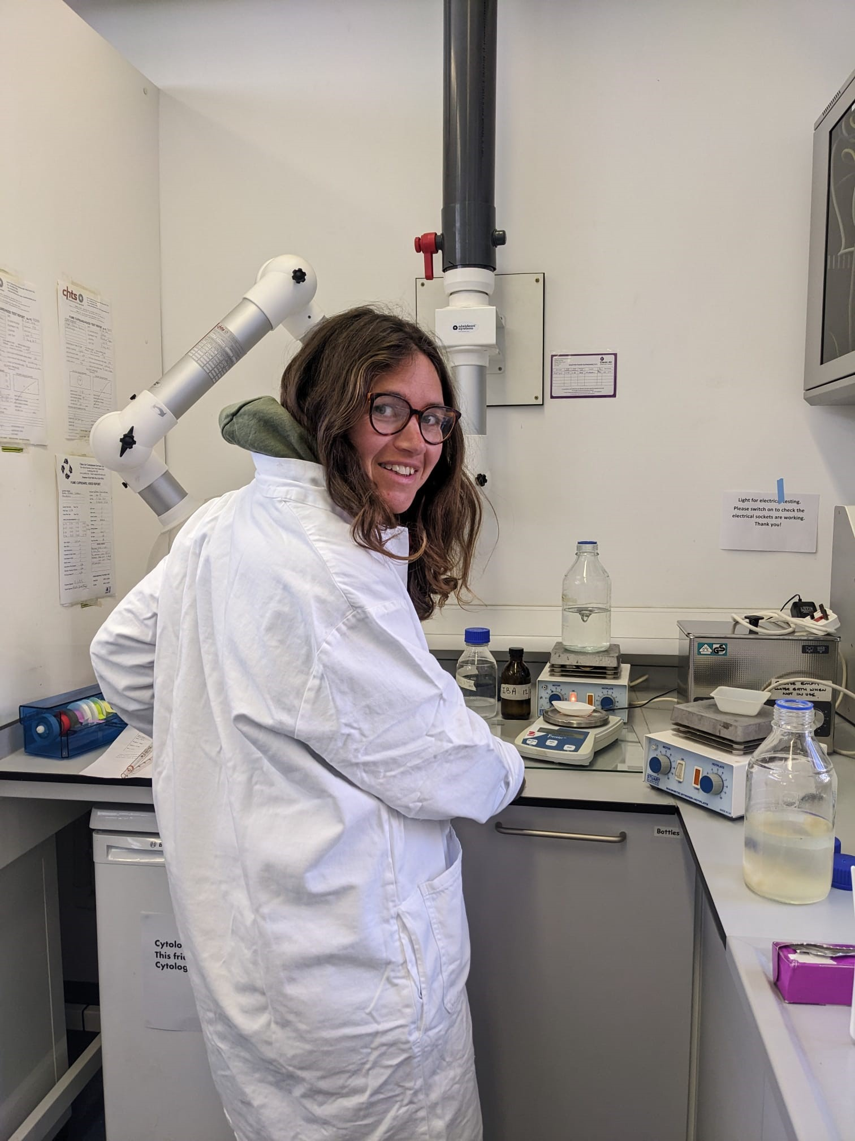
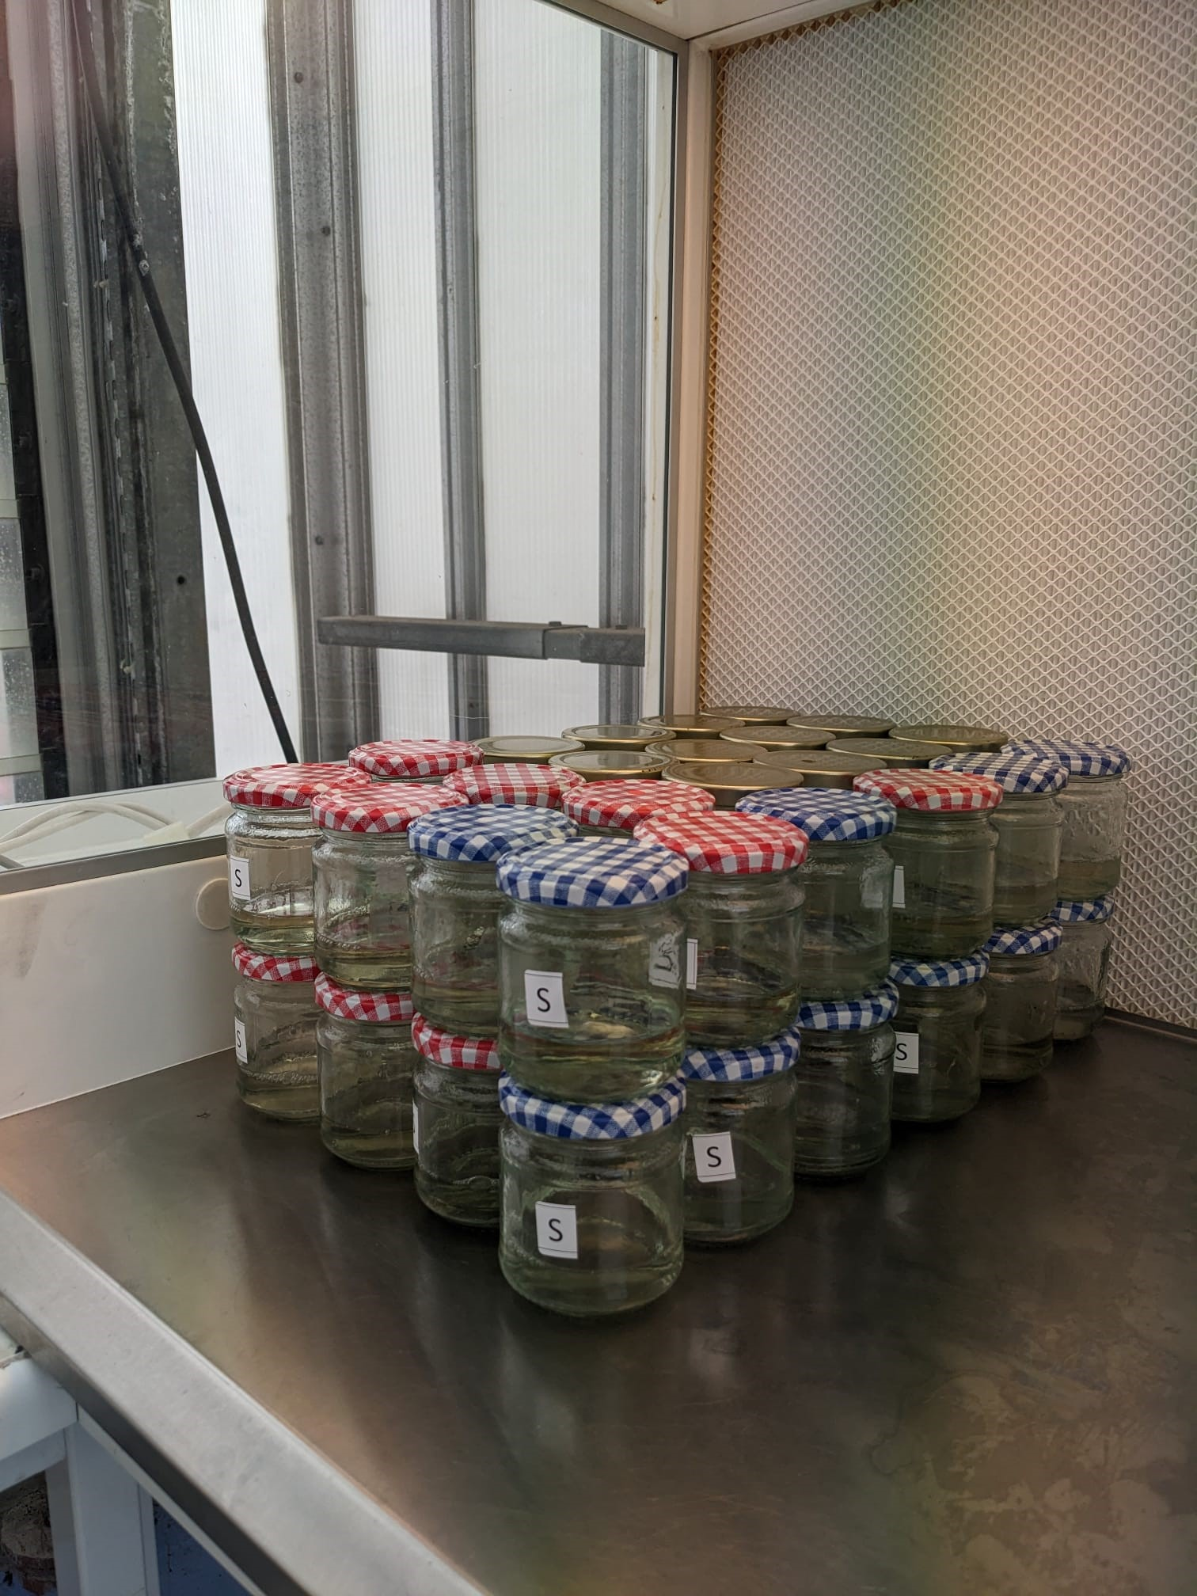
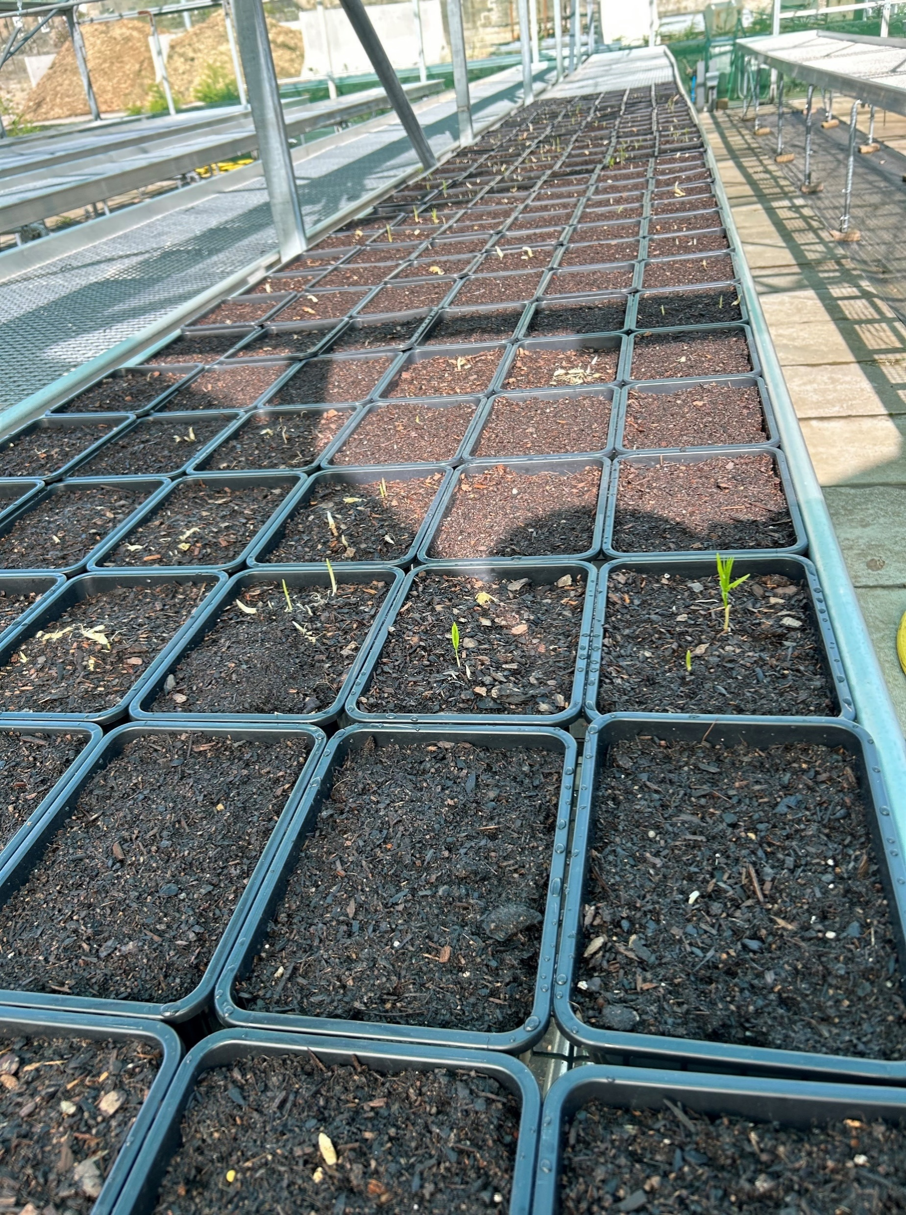
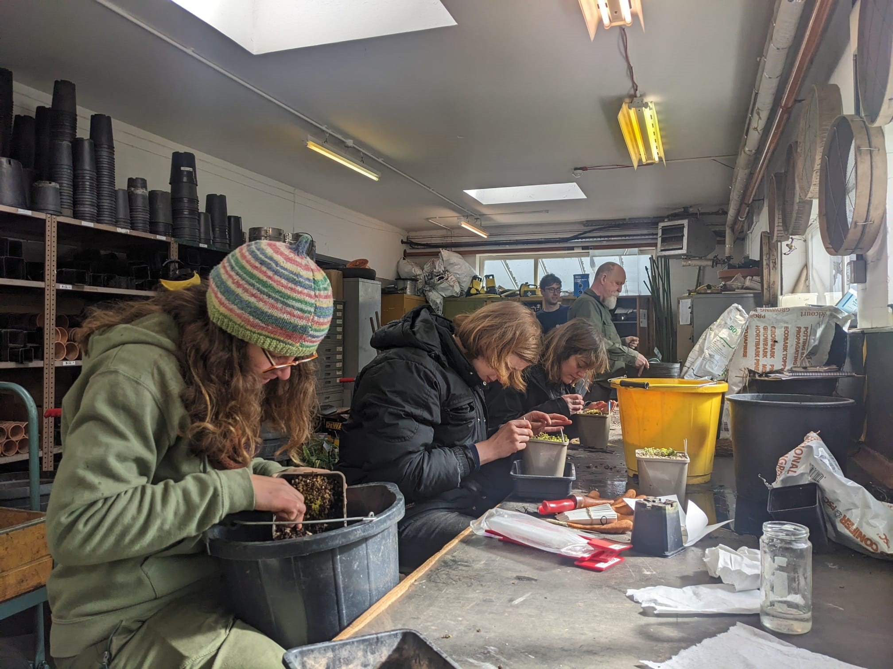
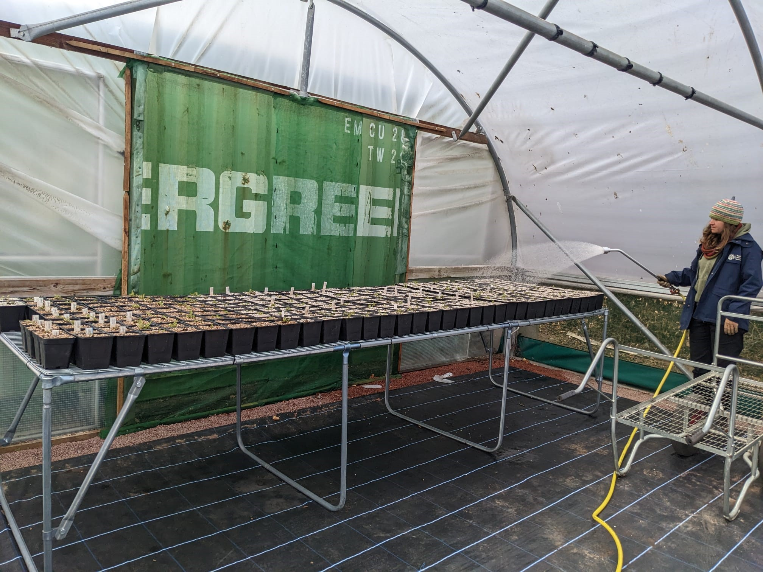
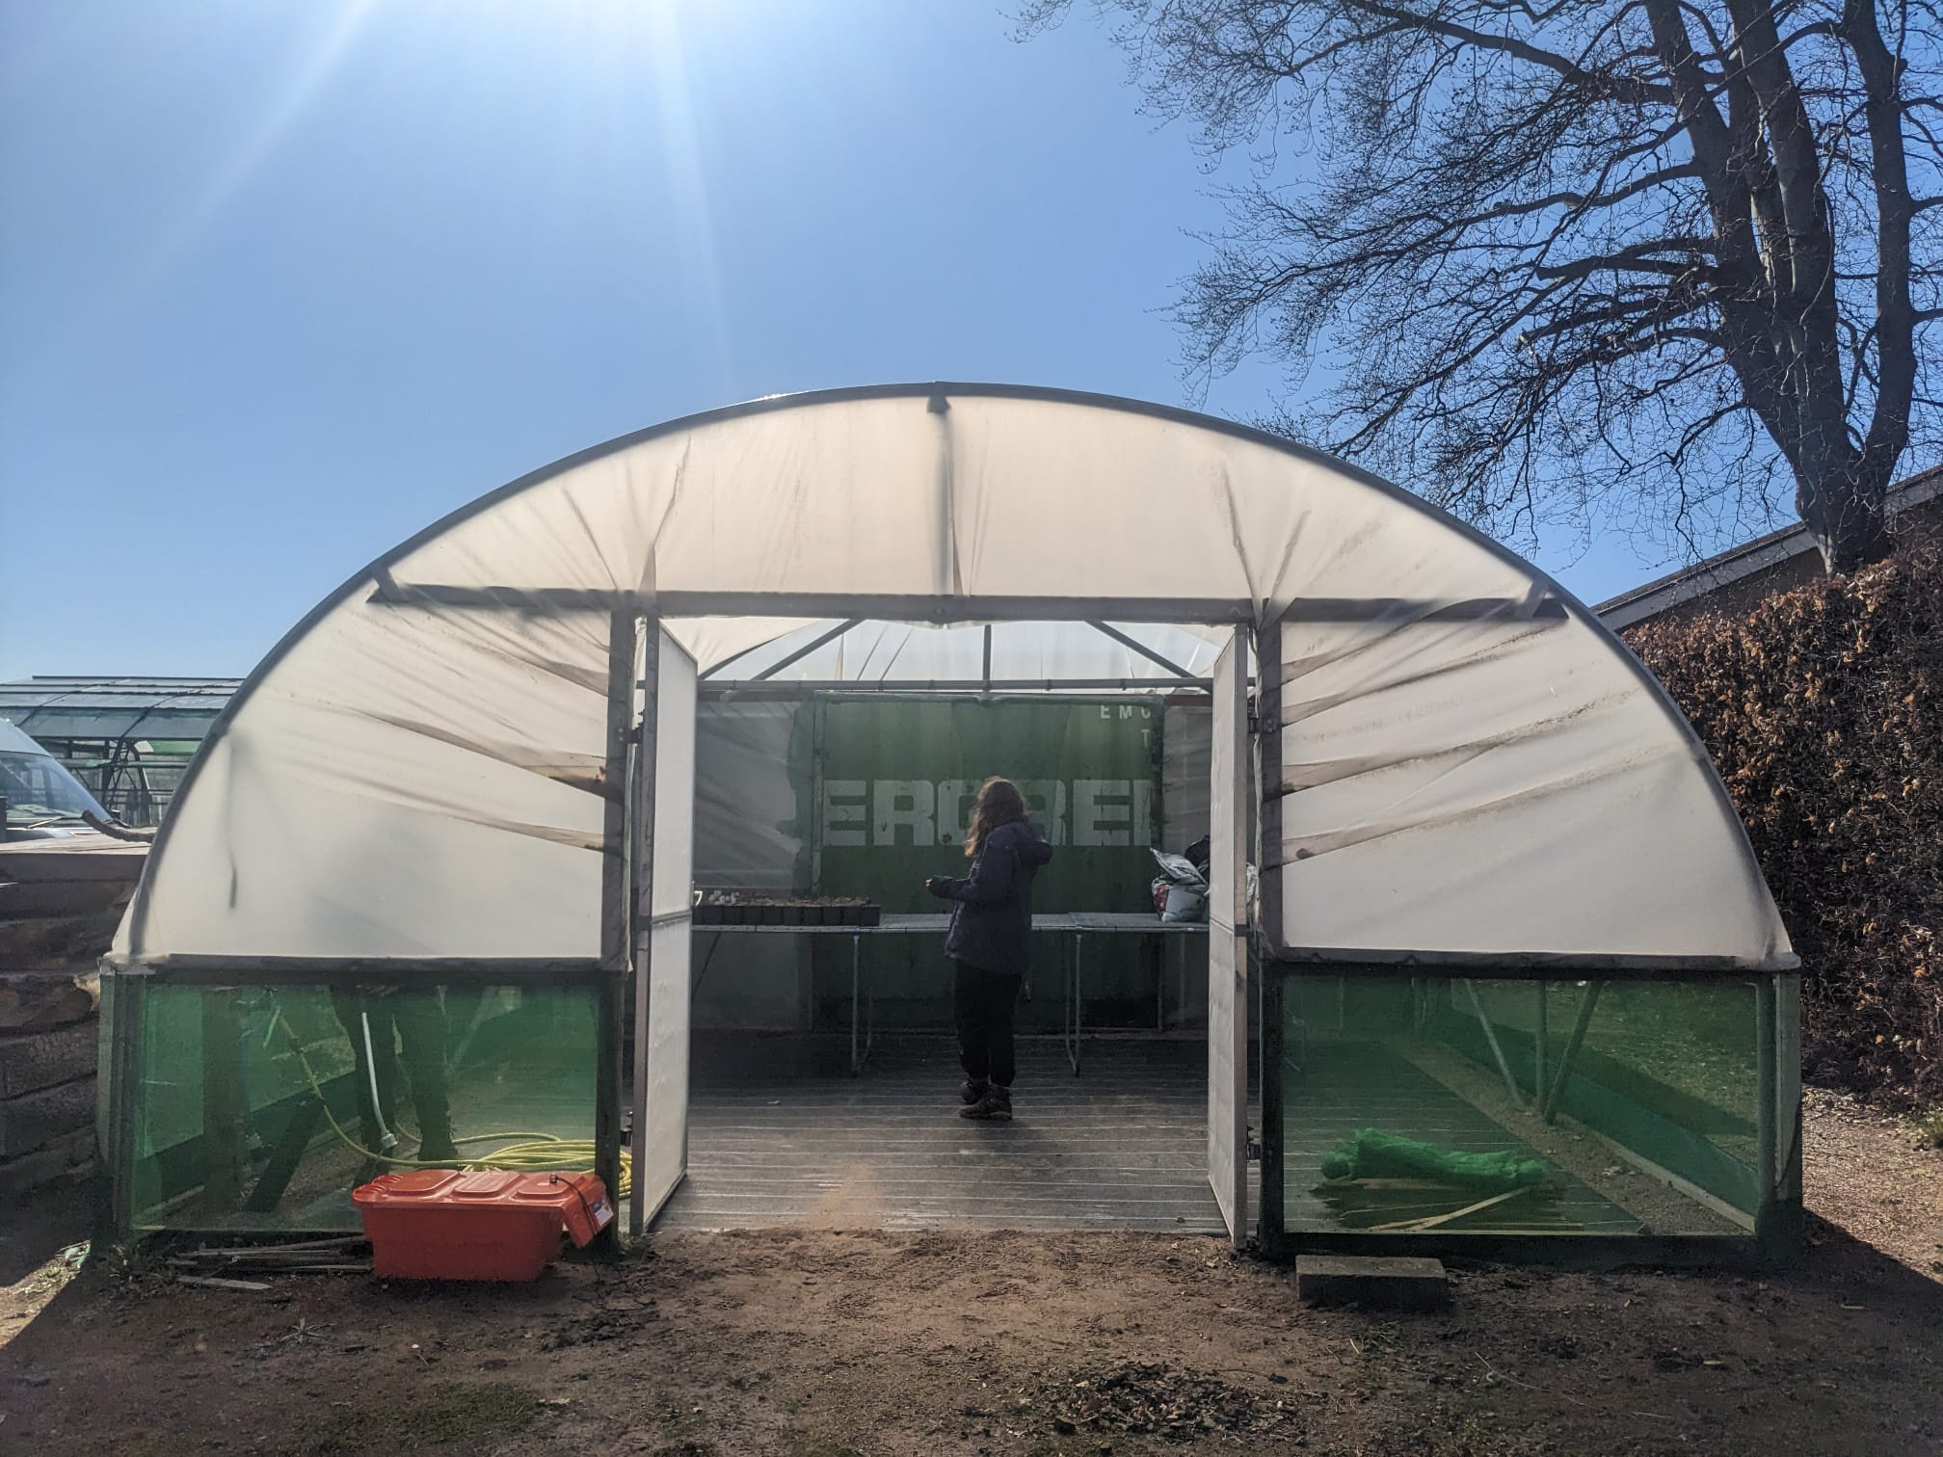
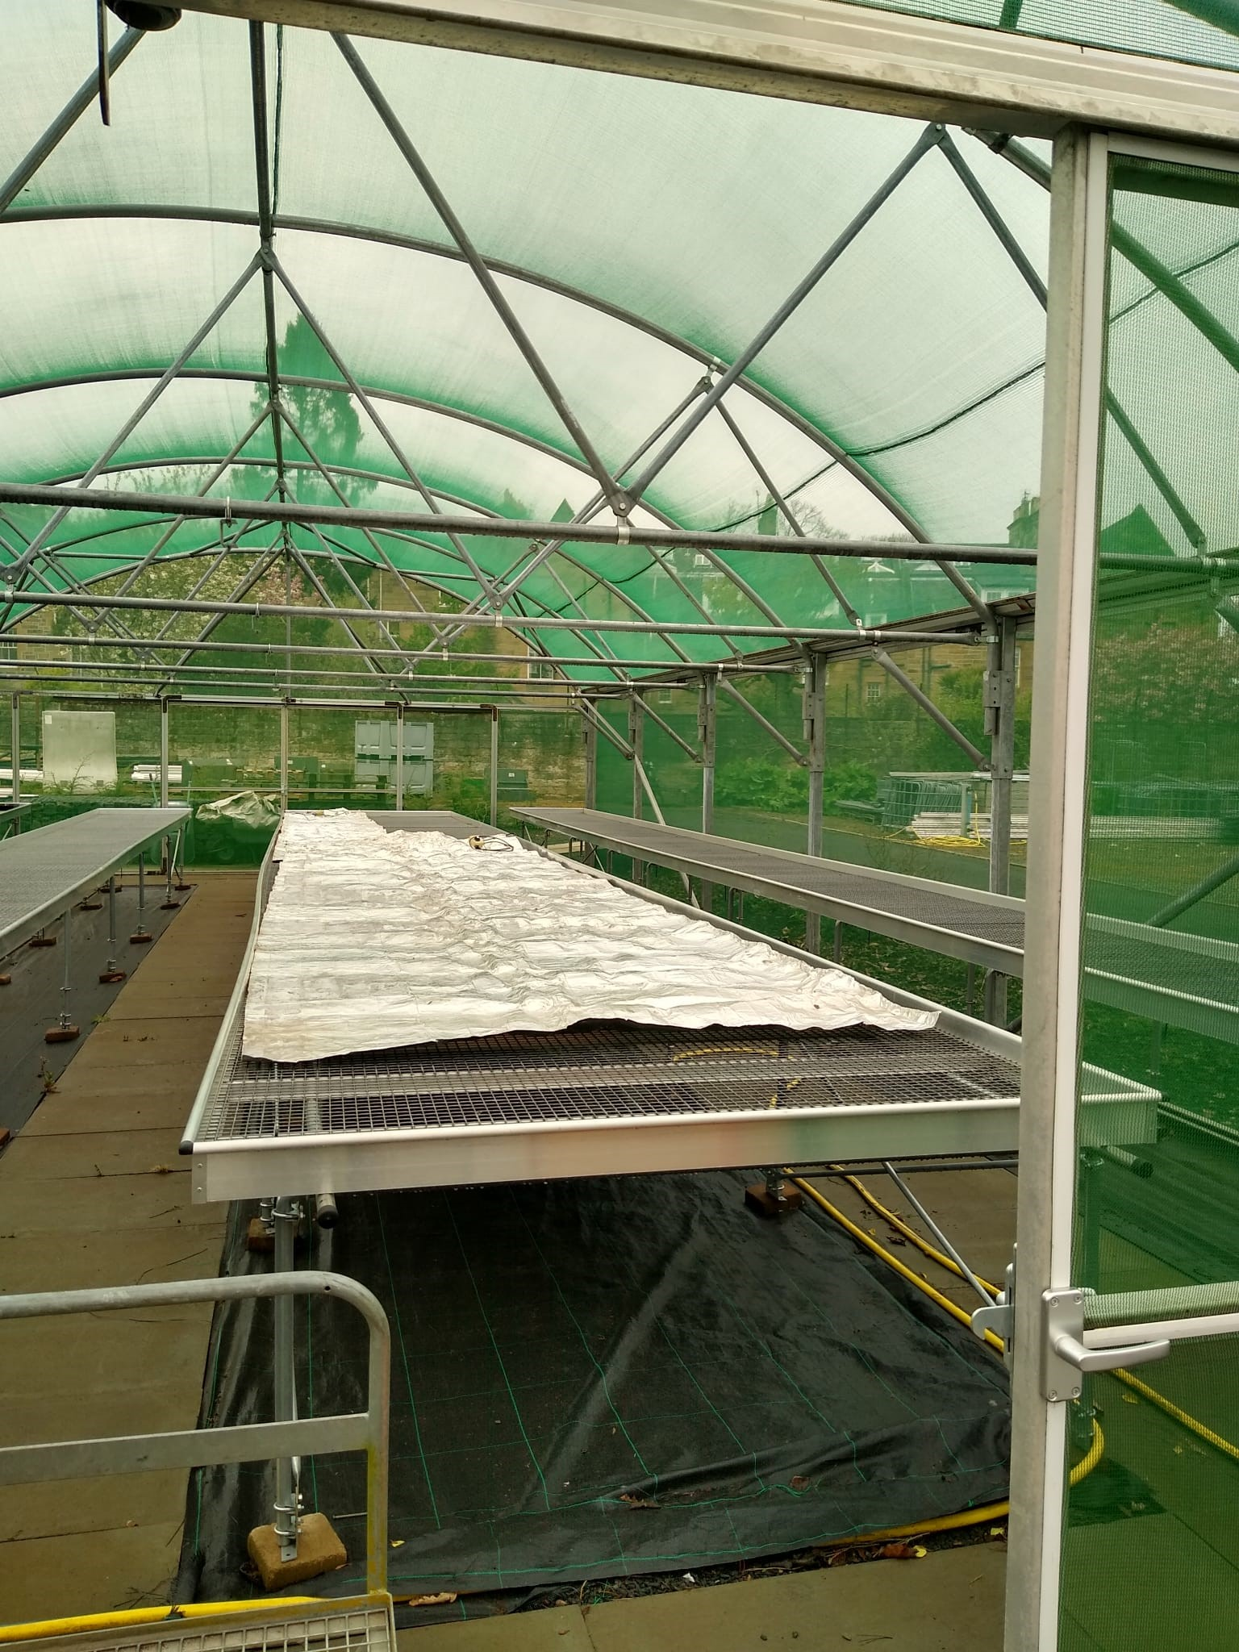
NRF 502209
Biodiversity Net Gain:
Biodiversity as a crucible for saving Scotland’s most threatened species.
Update April 2023
Prepared by Dr Aline Finger, afinger@rbge.org.uk
Nursery:
Rootstock of Polygonatum verticillatum has been divided – currently ~150 potted plants
Rootstock of Woodsia ilvensis has been weeded and divided – currently ~290 potted plants
Existing shade tunnel space has been organised
An interim shade tunnel has been prepared to be used until the new tunnel has been build
Sorbus micro-propagation and lab space organisation has started
Planning for converting growing space into isolation tunnels (for biosecurity) has started
More nursery consumables have been purchased to build an ex-situ setup for Saxifraga hirculus
Emma preparing the labs for micro-propagations
Polygonatum verticillatum divisions
Woodsia ilvensis weeding and divisions
Divided Woodsia ilvensis in shade tunnel
Interim shade tunnel until new tunnel is build
Heat mat for micro-prop

Slide 3
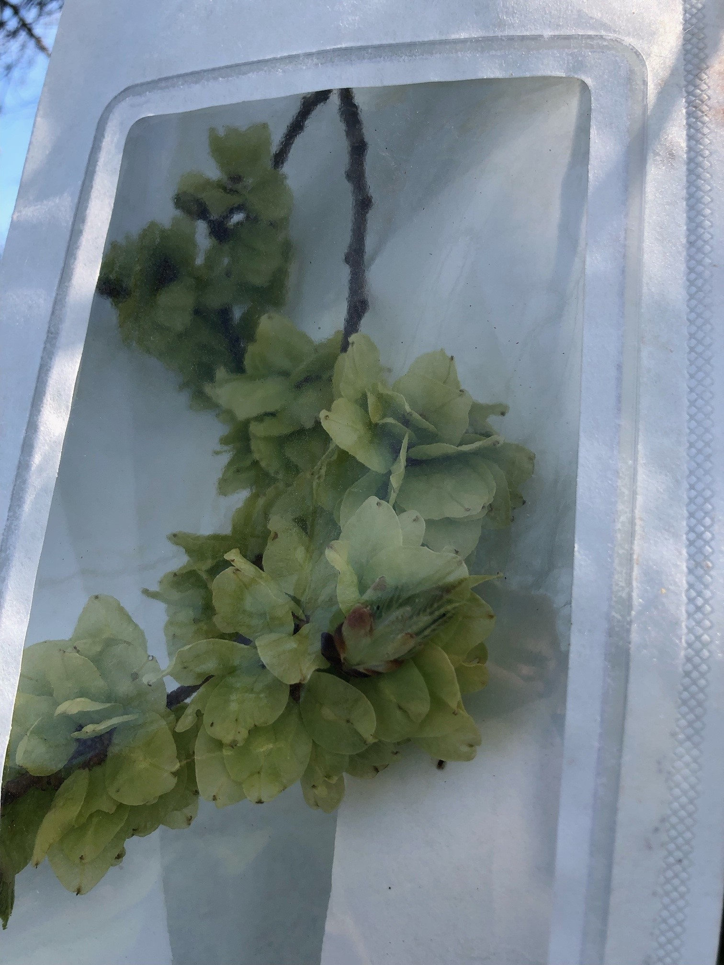
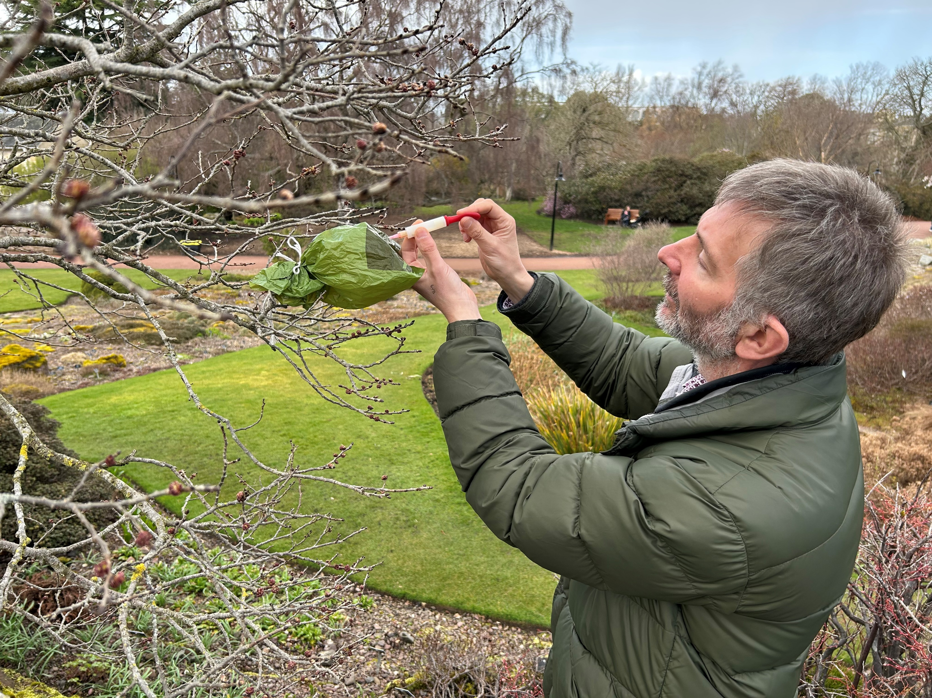
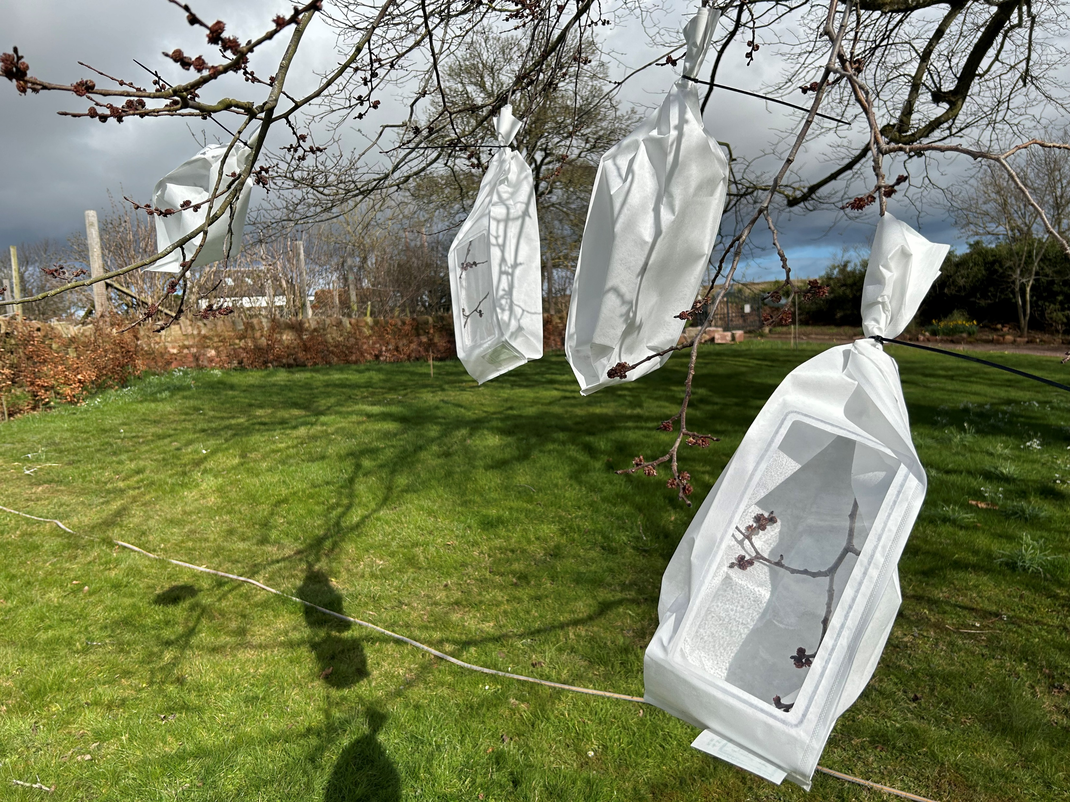
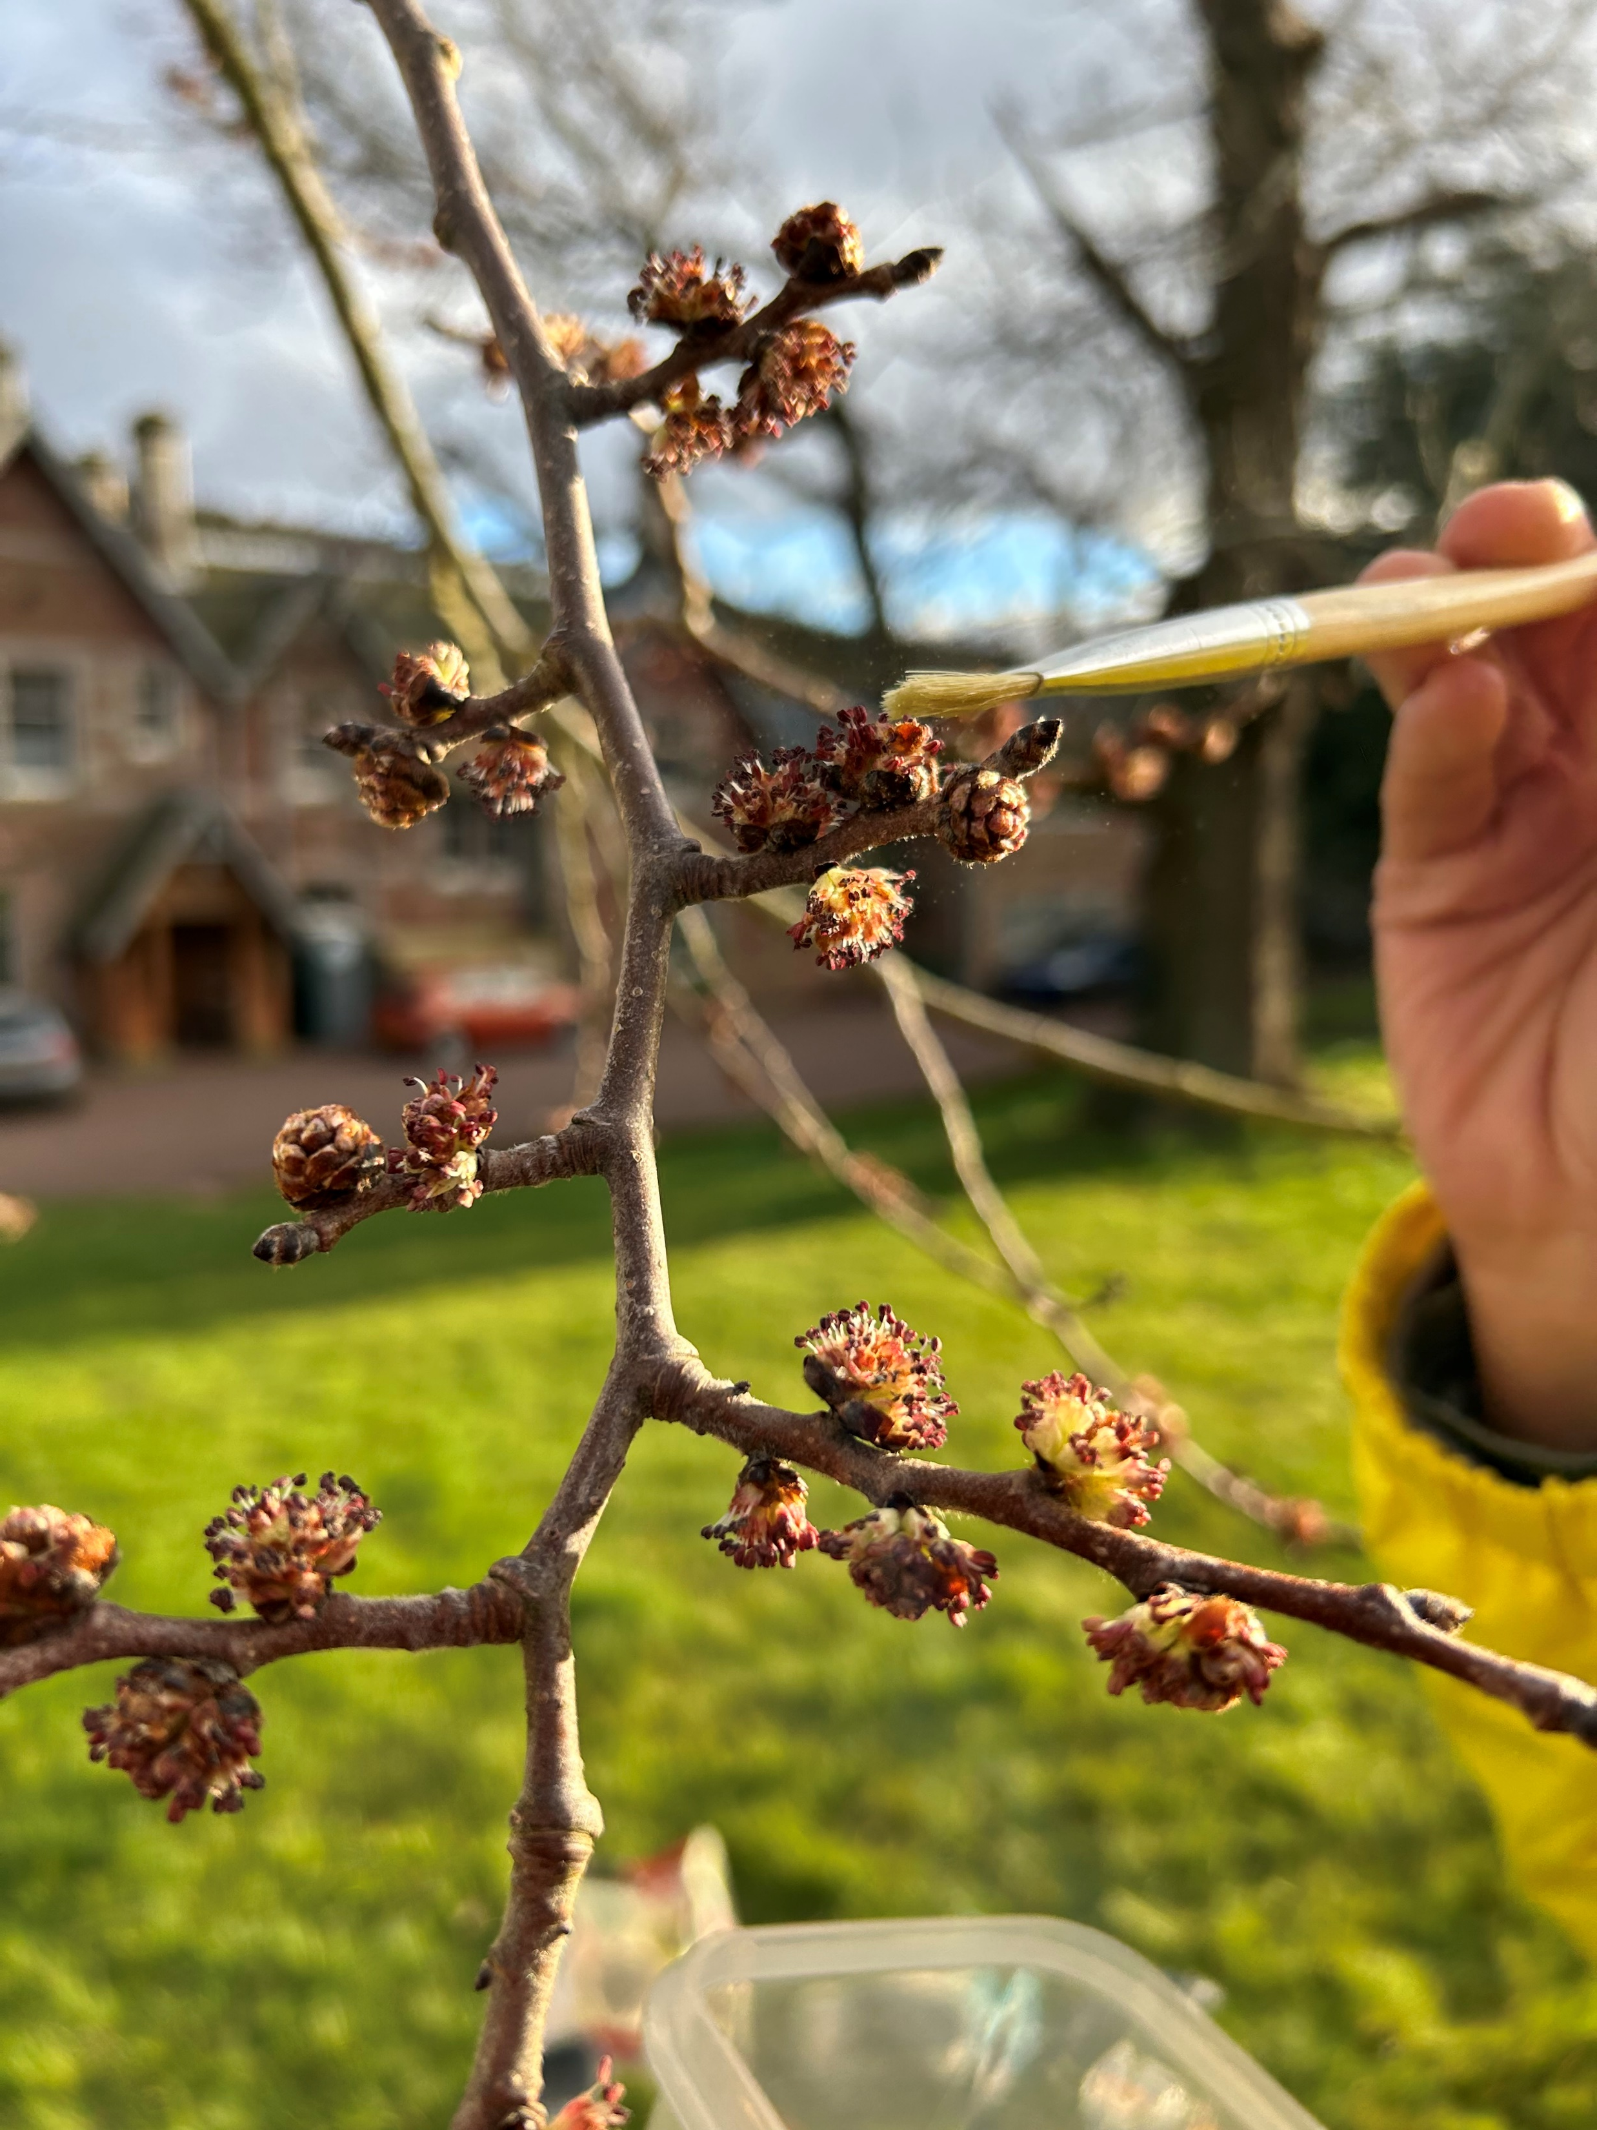
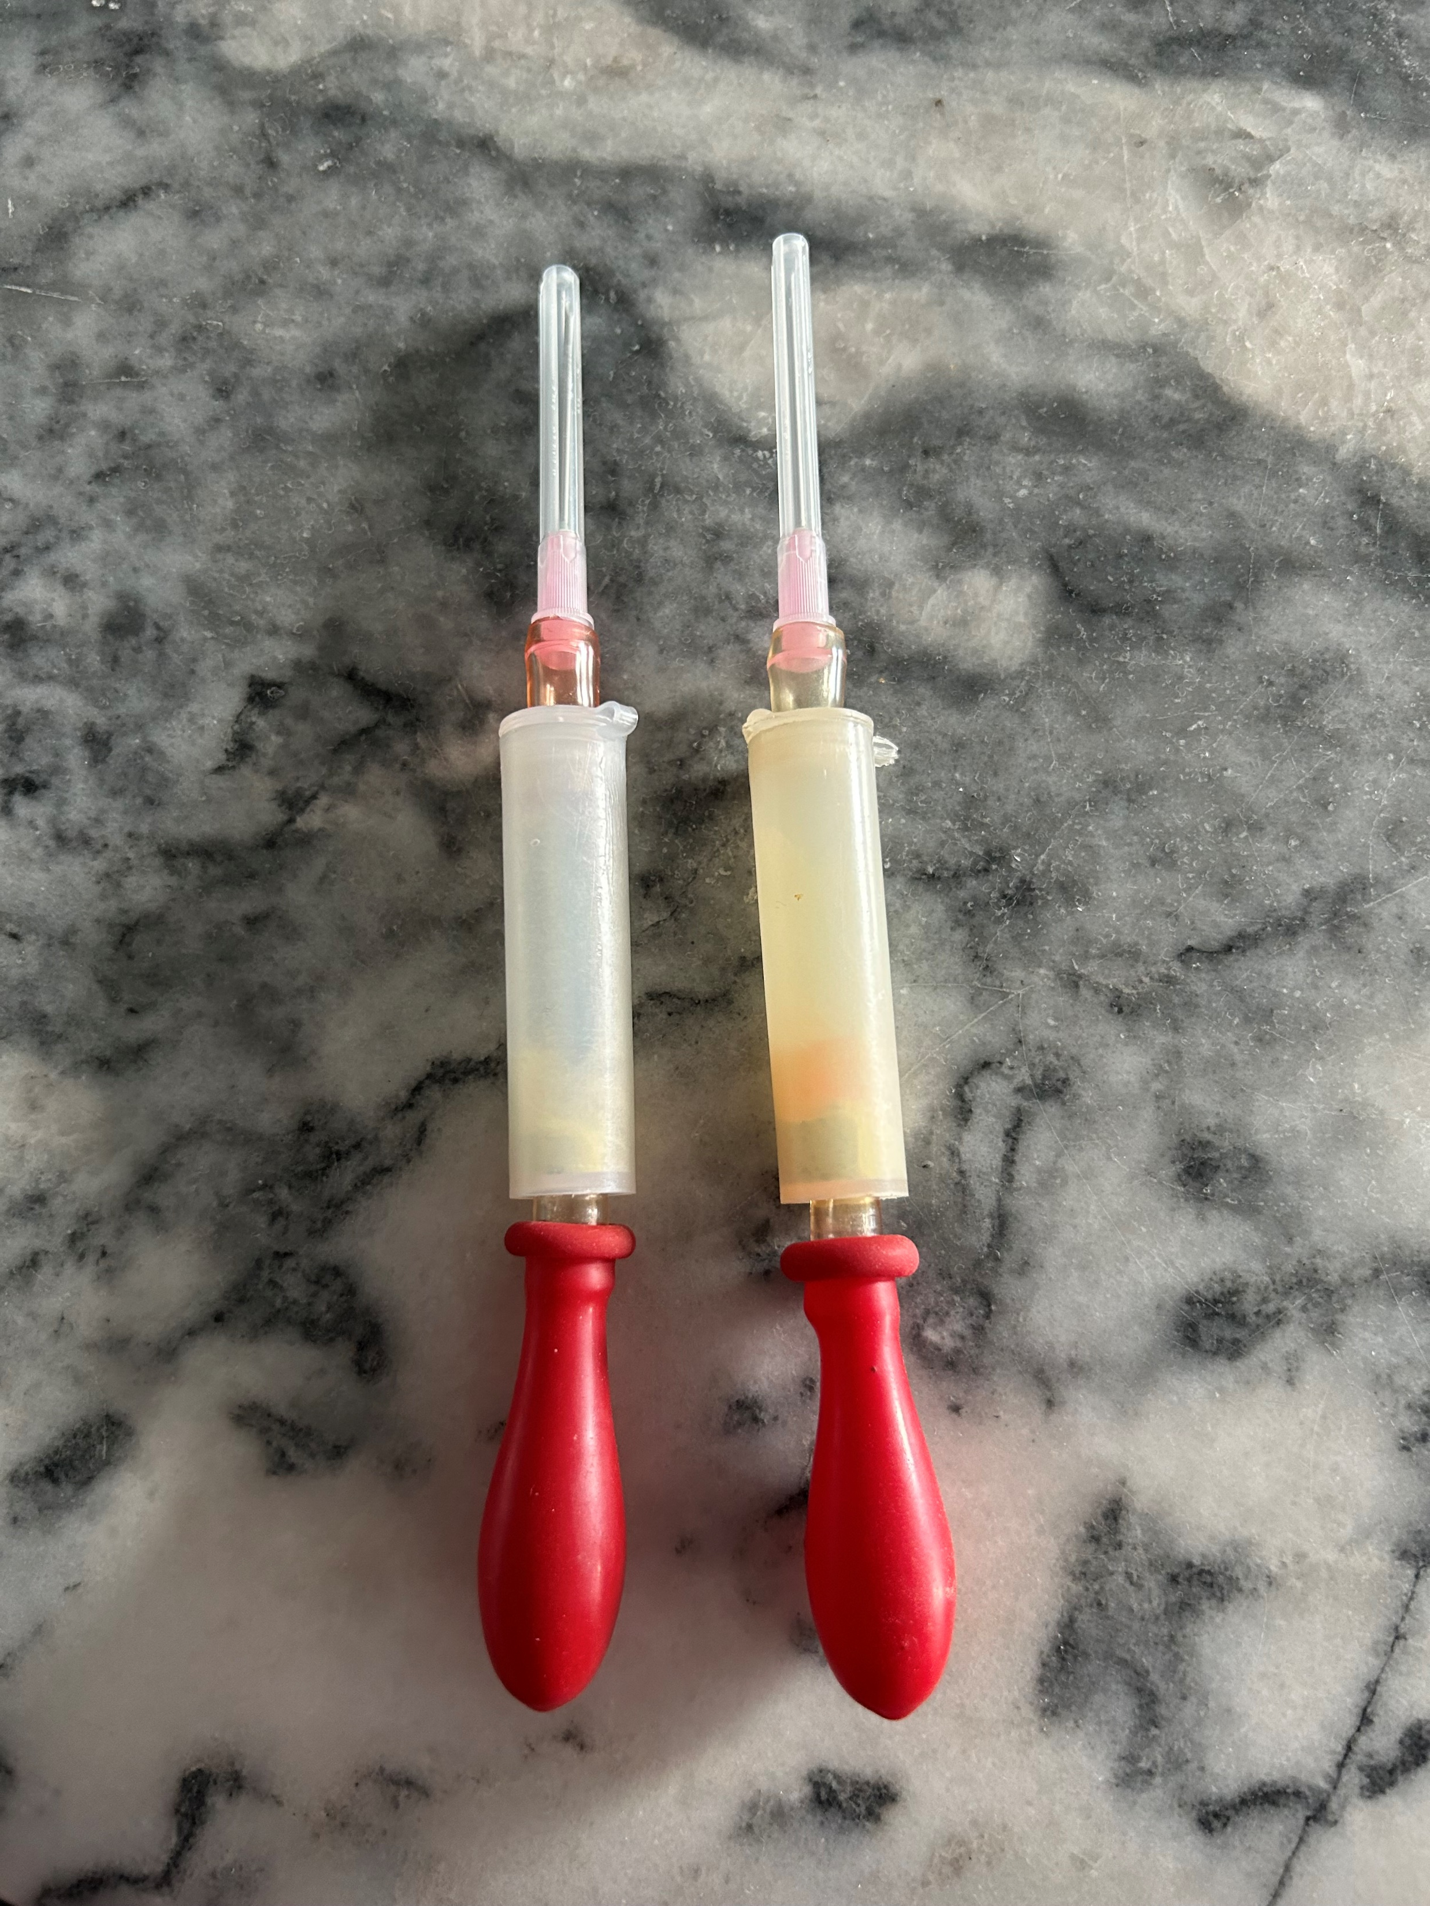
NRF 502209
Biodiversity Net Gain:
Biodiversity as a crucible for saving Scotland’s most threatened species.
Update April 2023
Prepared by Dr Aline Finger, afinger@rbge.org.uk
Ulmus glabra seeds maturing in pollination bags
Field work:
Site visit to Mar Lodge has been done to explore potential planting sites
Ulmus glabra cross-pollinated branches have been re-bagged for seed collection
Organised Saxifraga hirculus root stock collection field trip (May)
Organised field work trip to Arran to survey Sorbus and collect micro-propagation material (May)
Organised field trip to Alladale to explore potential planting sites (May)
Organised field trip to Borders Forest Trust owned land to explore planting sites (June)
Max using a “Pollination gun” at RBGE
Ulmus glabra hand pollinations using a brush
Ulmus glabra flowers in East Lothian bagged to prevent pollen contamination
“Pollination guns” borrowed from Forest Research

Slide 4
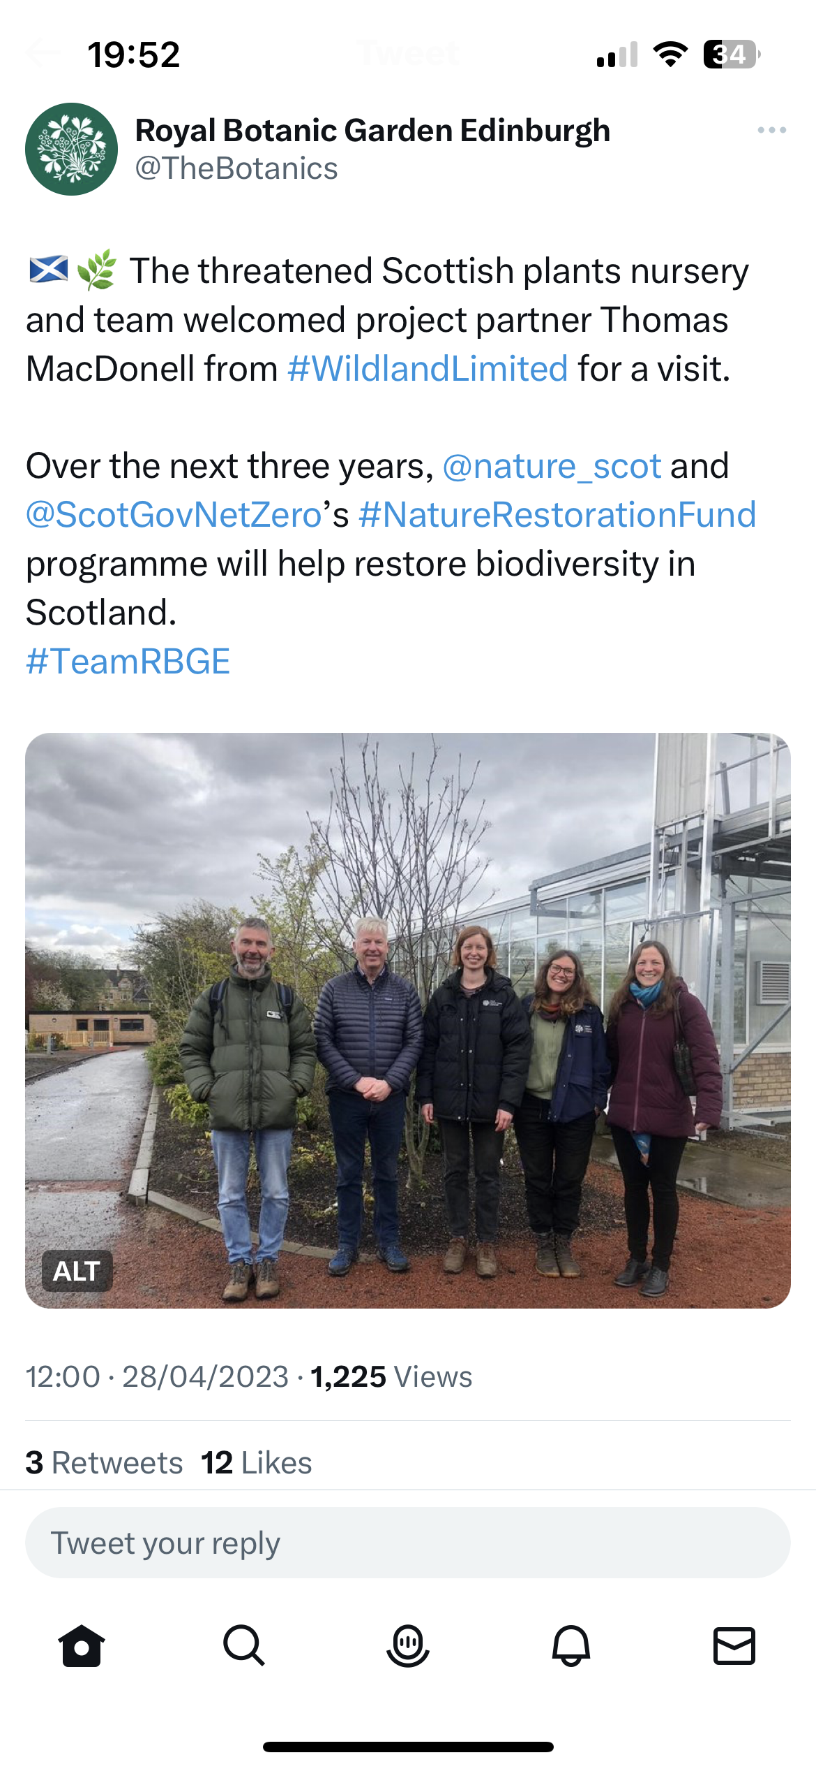
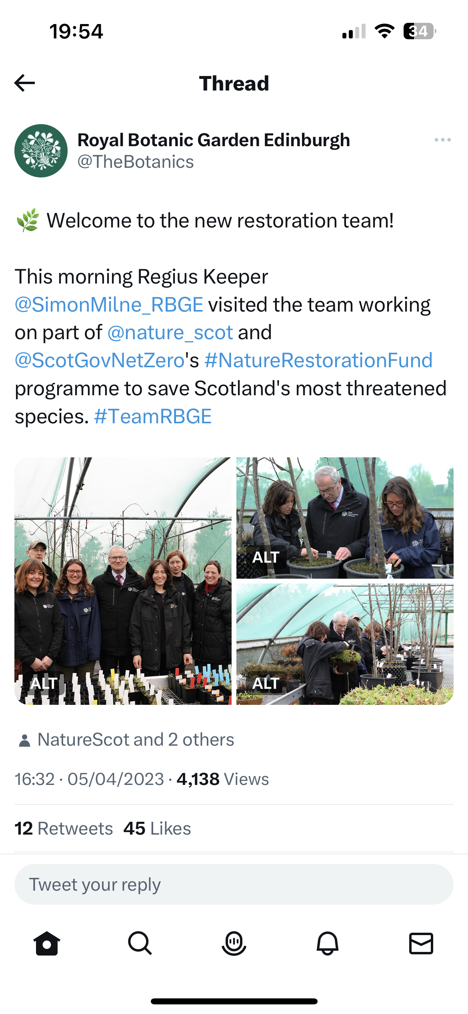
NRF 502209
Biodiversity Net Gain:
Biodiversity as a crucible for saving Scotland’s most threatened species.
Update April 2023
Prepared by Dr Aline Finger, afinger@rbge.org.uk
Press:
BBC out of doors with Max Coleman, minute 4.10: https://www.bbc.co.uk/sounds/play/m001l2y8
Social media: e.g. some Tweets
Plans for May 2023:
Field work to collect Saxifraga hirculus rootstock
Field work to collect Sorbus micro-propagation material from Arran
Field work / site visits at Alladale and visit partner at Brahan estate
Finish Saxifraga hirculus set-up and germinate MSB seeds
Continue Sorbus micro-propagation
Continue dividing Polygonatum verticillatum and Woodsia ilvensis
Continue collating information on species ecology and habitat requirements
Continue collating information on species ecology and habitat requirements
Start to write horticultural summaries on each species
Start organising Ulmus glabra collections (cuttings and DNA samples) for June
Collect cross-pollinated Ulmus glabra seeds (2 trees, East Lothian and near Peebles) and sow them

