Slide 1
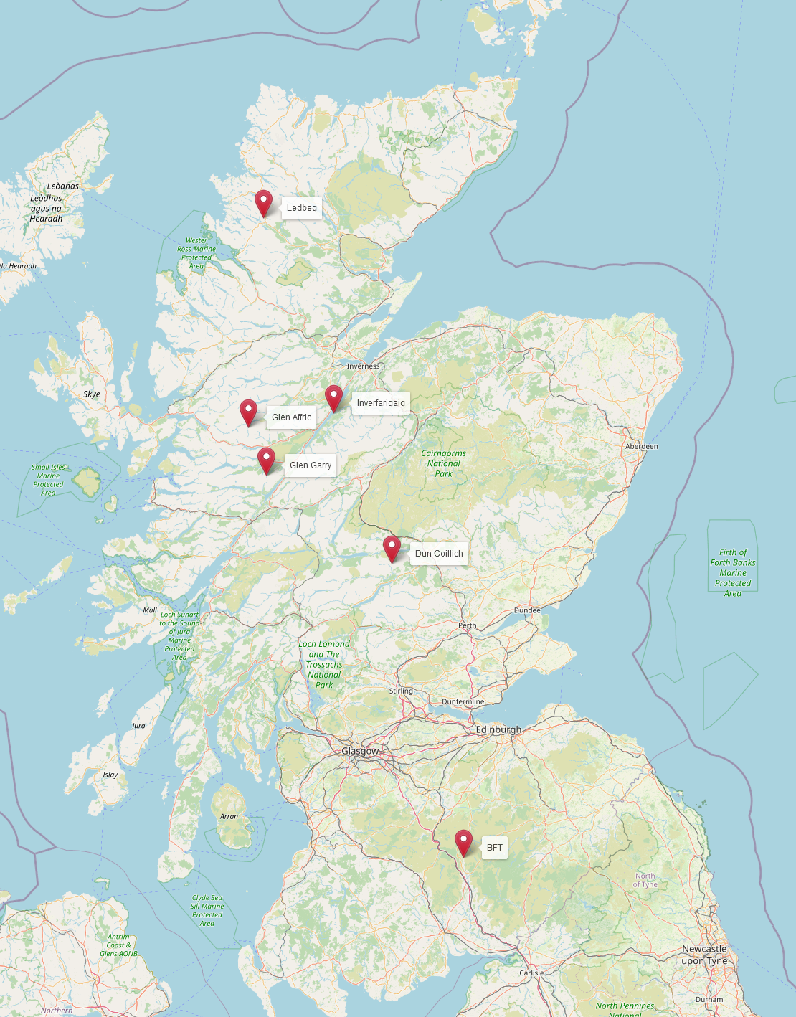
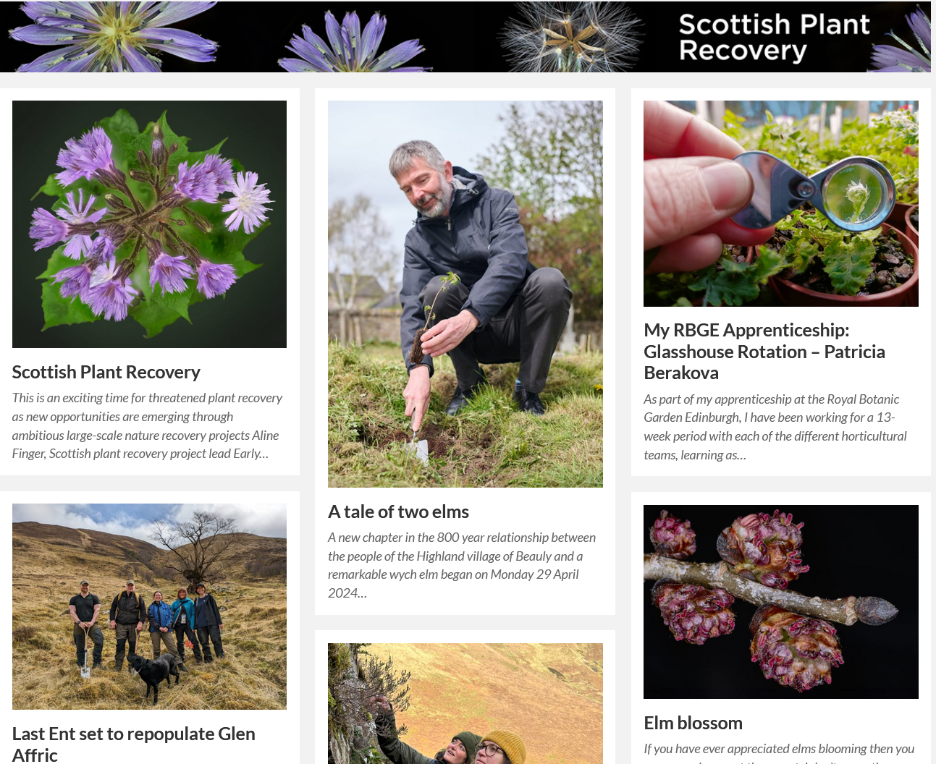
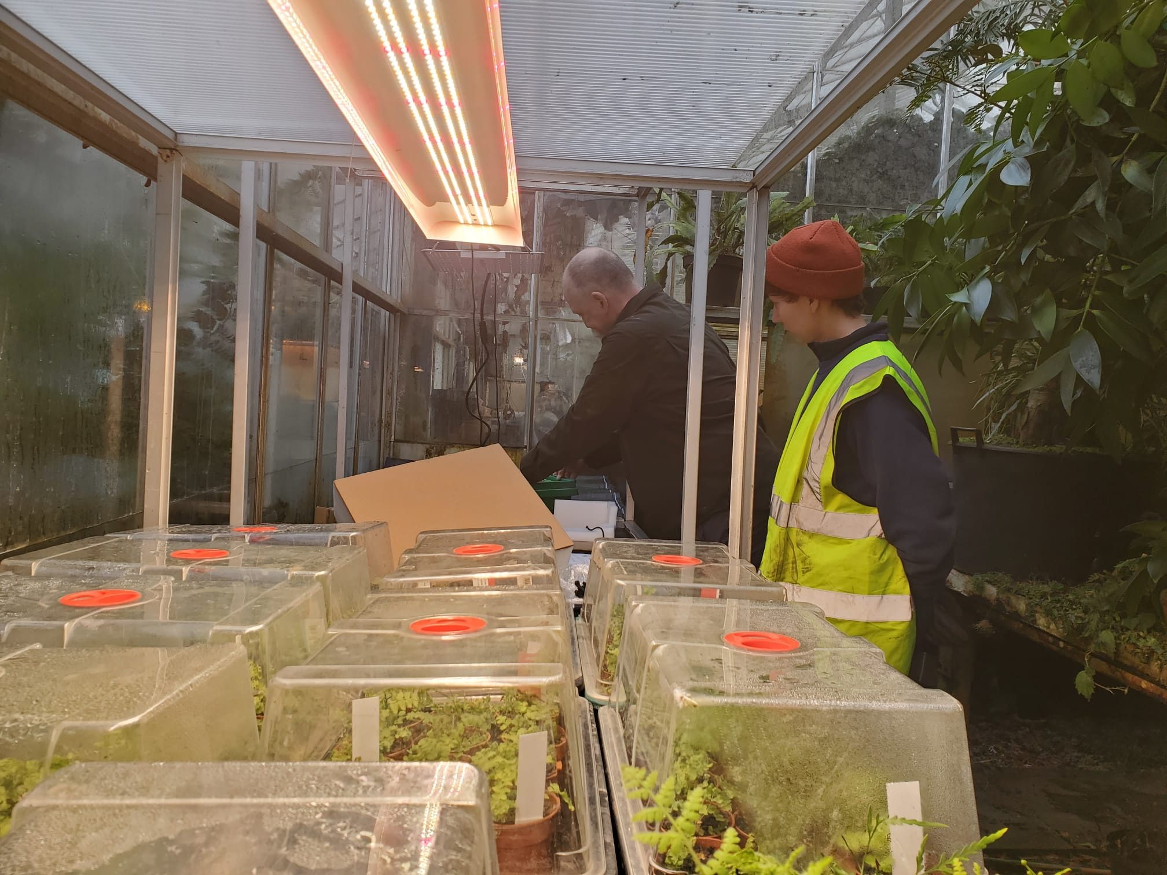
NRF 502209
Biodiversity Net Gain:
Biodiversity as a crucible for saving Scotland’s most threatened species.
Update April 2024
Prepared by Dr Aline Finger, afinger@rbge.org.uk
Highlights April 2024
First 6 NRF translocations, Ulmus glabra
2 new blog posts, 2 new Instagram lives, 2 radio interviews, 10 + press articles
Continuous successful propagation of genetically diverse plants by RBGE staff and volunteers

Slide 2
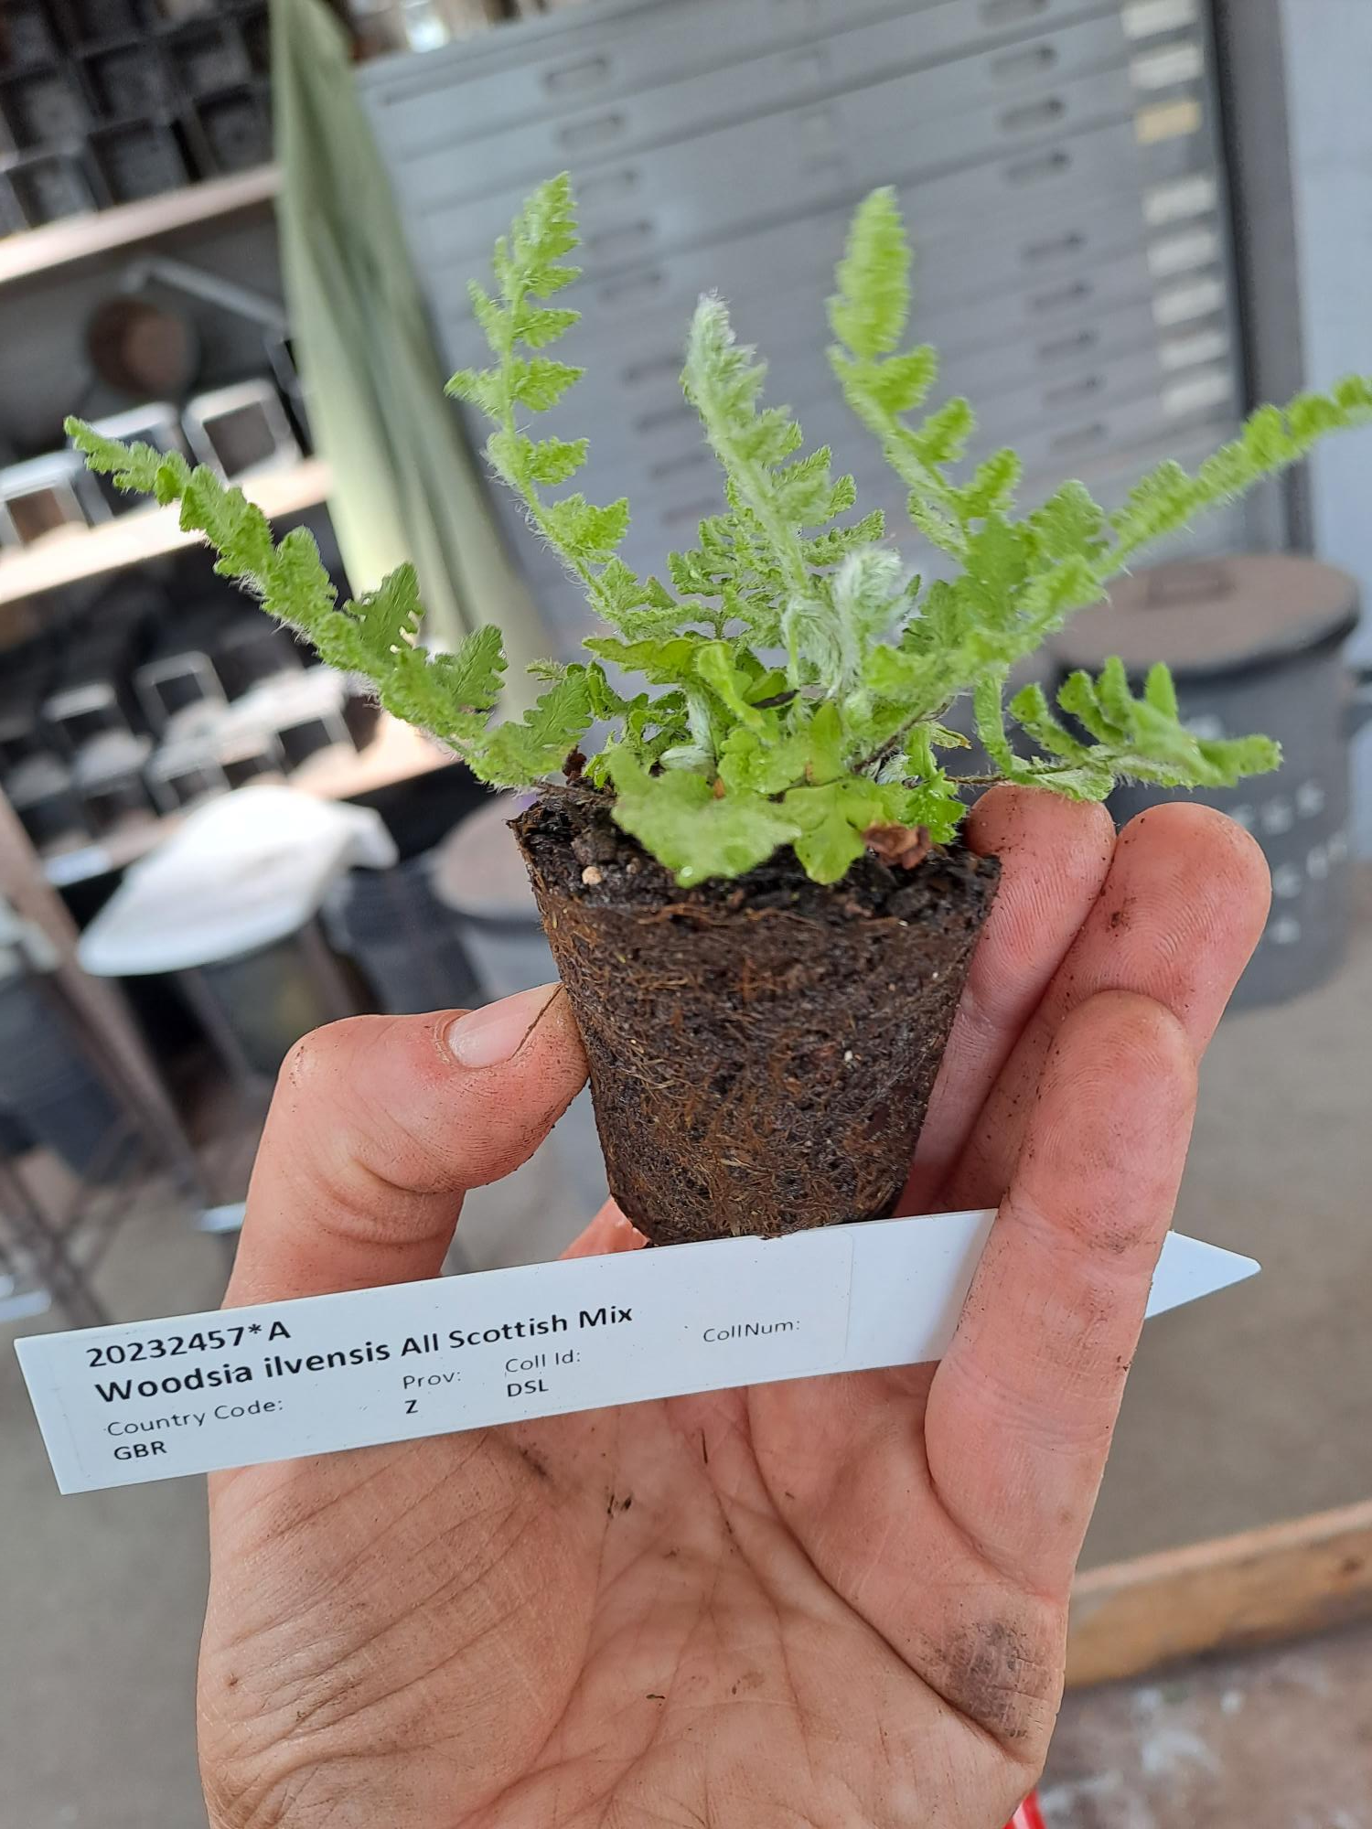
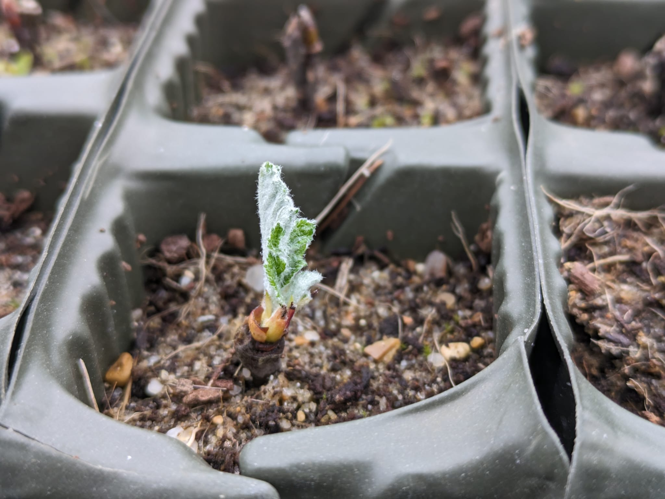
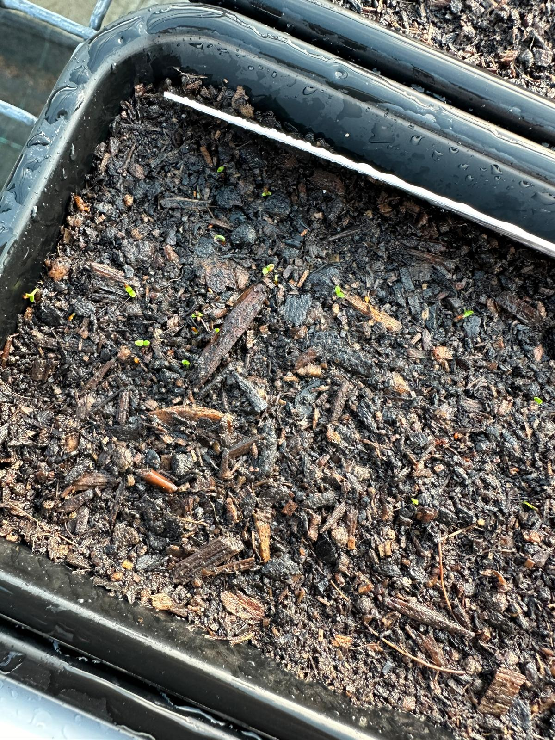
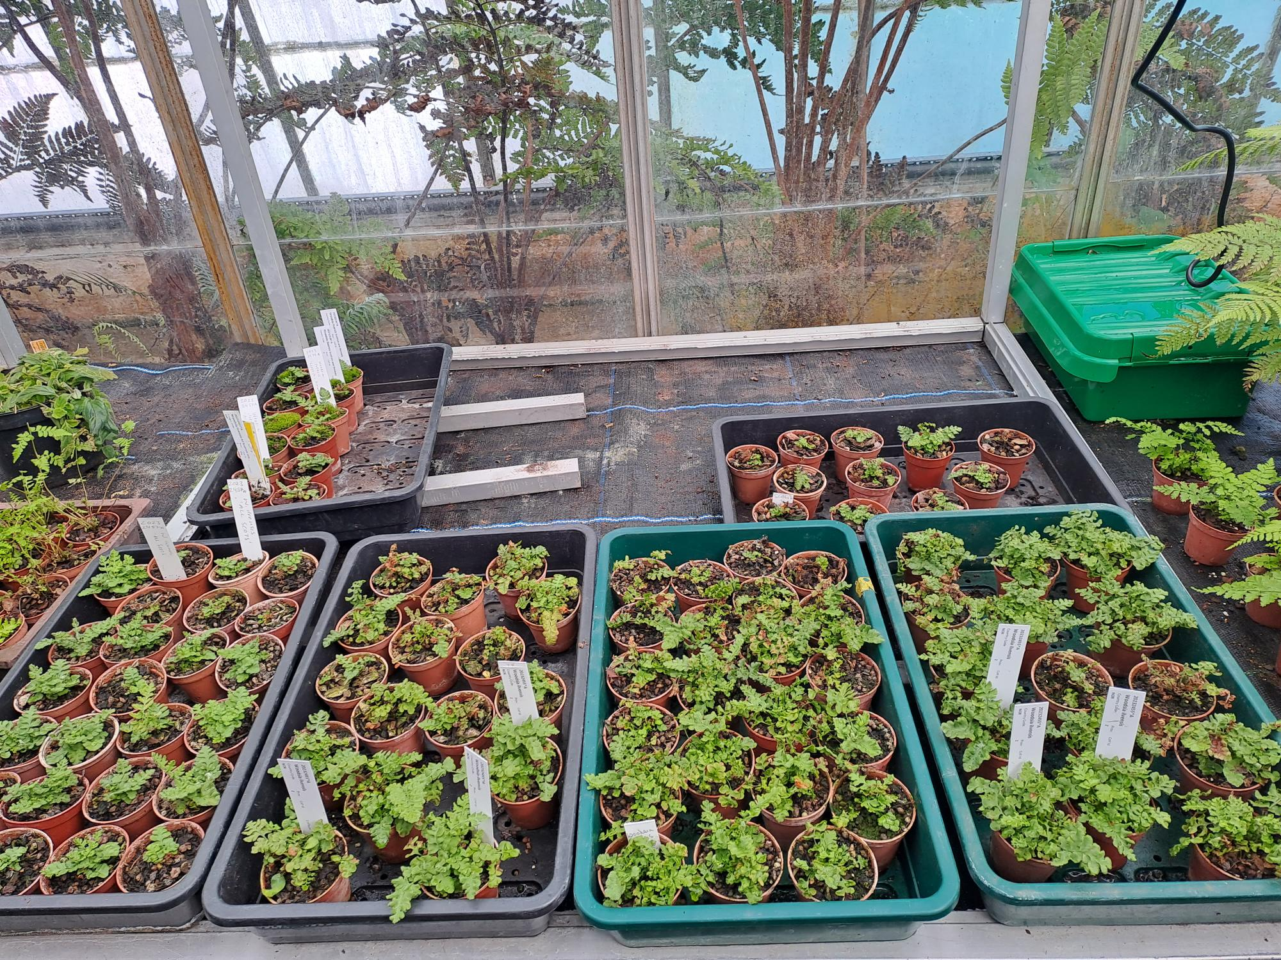
NRF 502209
Biodiversity Net Gain:
Biodiversity as a crucible for saving Scotland’s most threatened species.
Update April 2024
Prepared by Dr Aline Finger, afinger@rbge.org.uk
Nursery and lab:
Ulmus glabra and Melampyrum sylvaticum genetic analysis finished
Plant health checks showed that Woodsia ilvensis divisions best planted in 2025 (not 2024)
Continuous care of current collection
Current number of plants in ex-situ collection:
Ulmus glabra: 10 seedlings + few softwood cuttings + hardwood cuttings
Hedlundia / Sorbus complex: 91 seedlings (H. pseudofennica: 19, H. arranensis: 16, H. pseudominichii: 56)
+ 2612 seed placed into stratification + some softwood cuttings
Malus sylvestris: Seed from 16 trees, 4,407 stratified + 25,000 dried and stored
Cicerbita alpina: 549 plants + 9725 seed sown (Scottish, Swiss + Norwegian)
Woodsia ilvensis: 447 plants (from divisions) + ~250 young plants
Polygonatum verticillatum: 820 plants + 8886 seed sown (Scottish, Swiss + Norwegian)
Saxifraga hirculus: 51 plugs + 28 foreign seedlings + Scottish seed
Melampyrum sylvaticum: 3,500 plants + 460 Scottish and 900 Swiss seed
Andy Ensoll and horticulture apprentice Patricia Berakova building more LED lights for Woodsia ilvensis
Woodsia ilvensis plant from mixed spore sowing (all Scottish populations mixed)
Hedlundia cuttings starting to grow
Saxifraga hirculus germinating
Woodsia ilvensis plant from mixed spore sowing (all Scottish populations mixed)

Slide 3
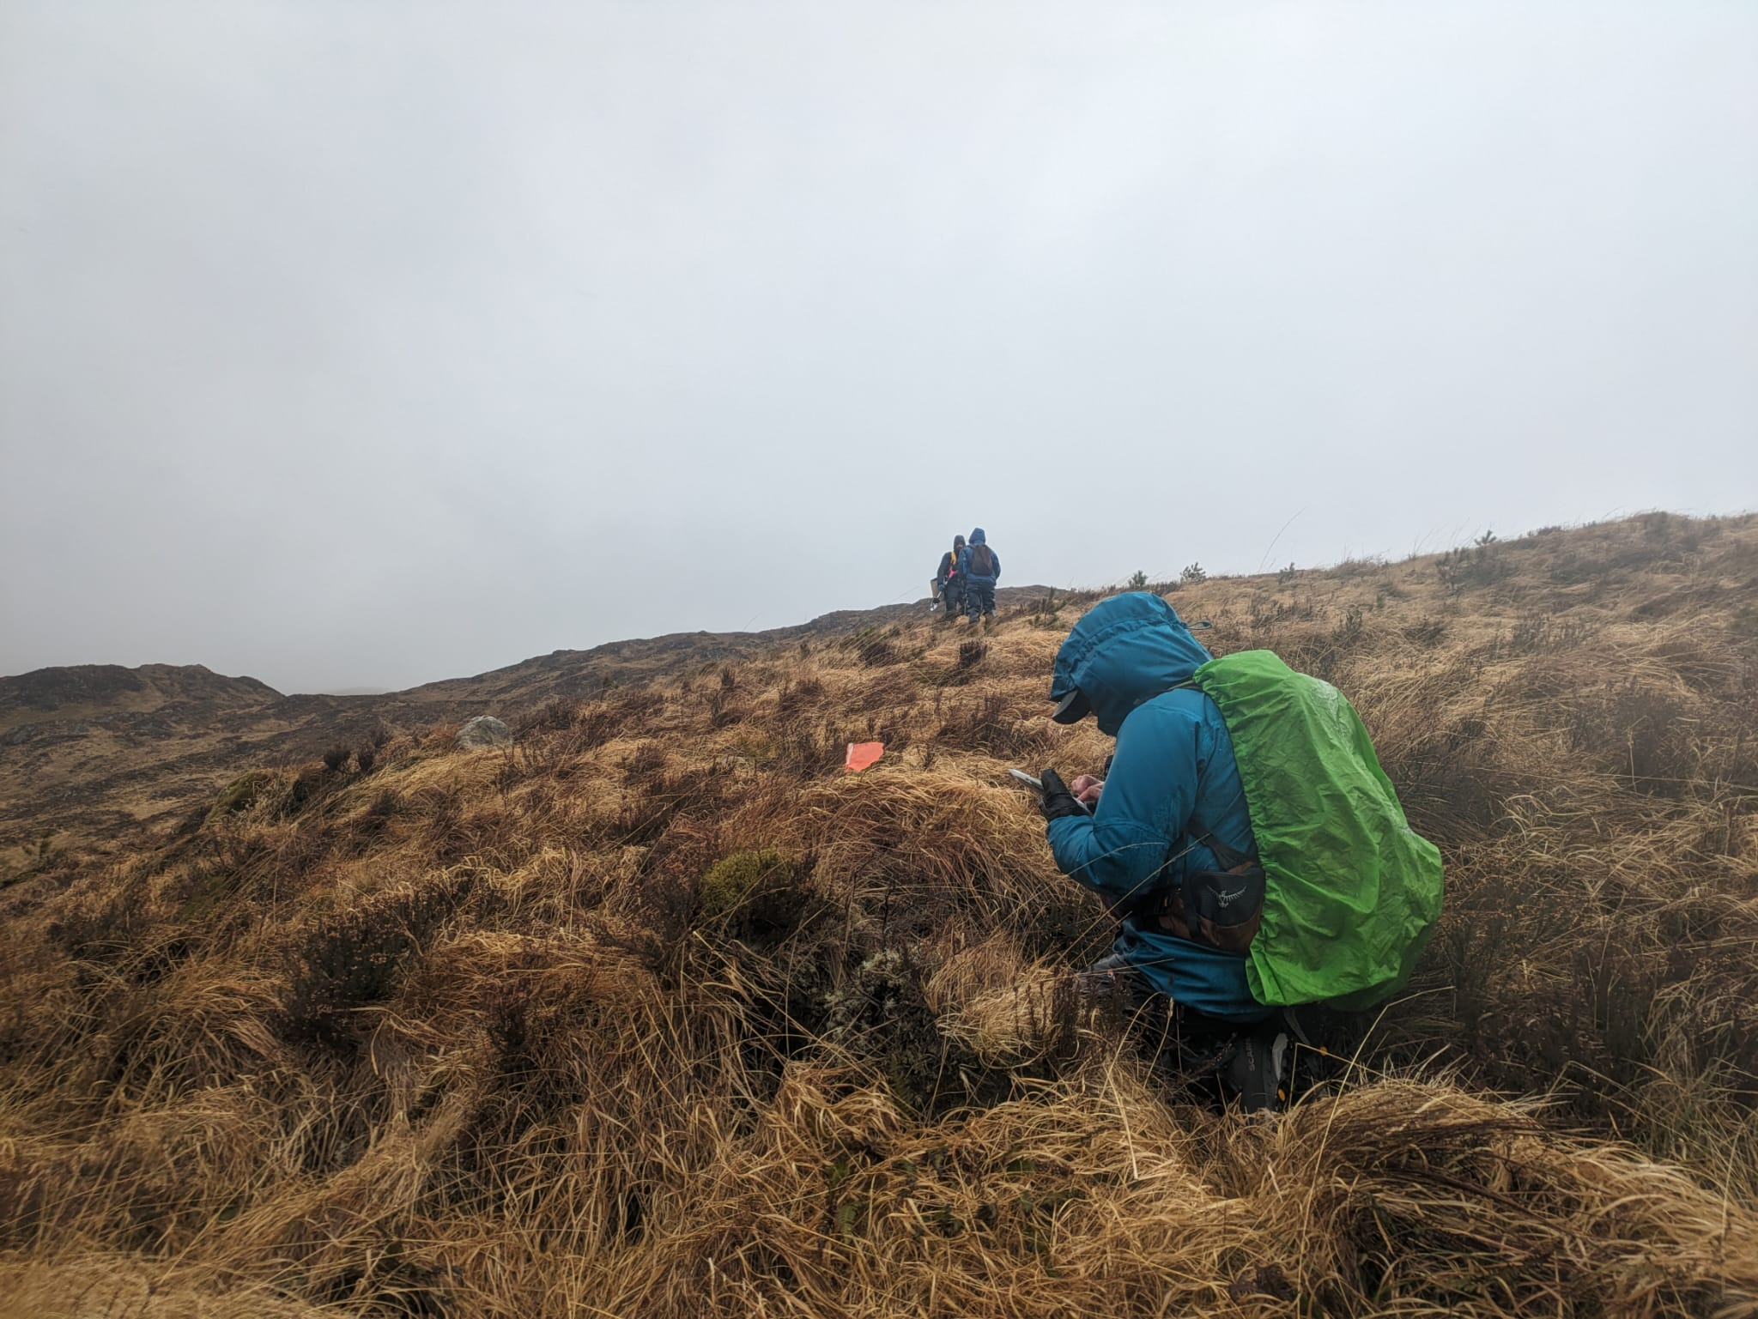
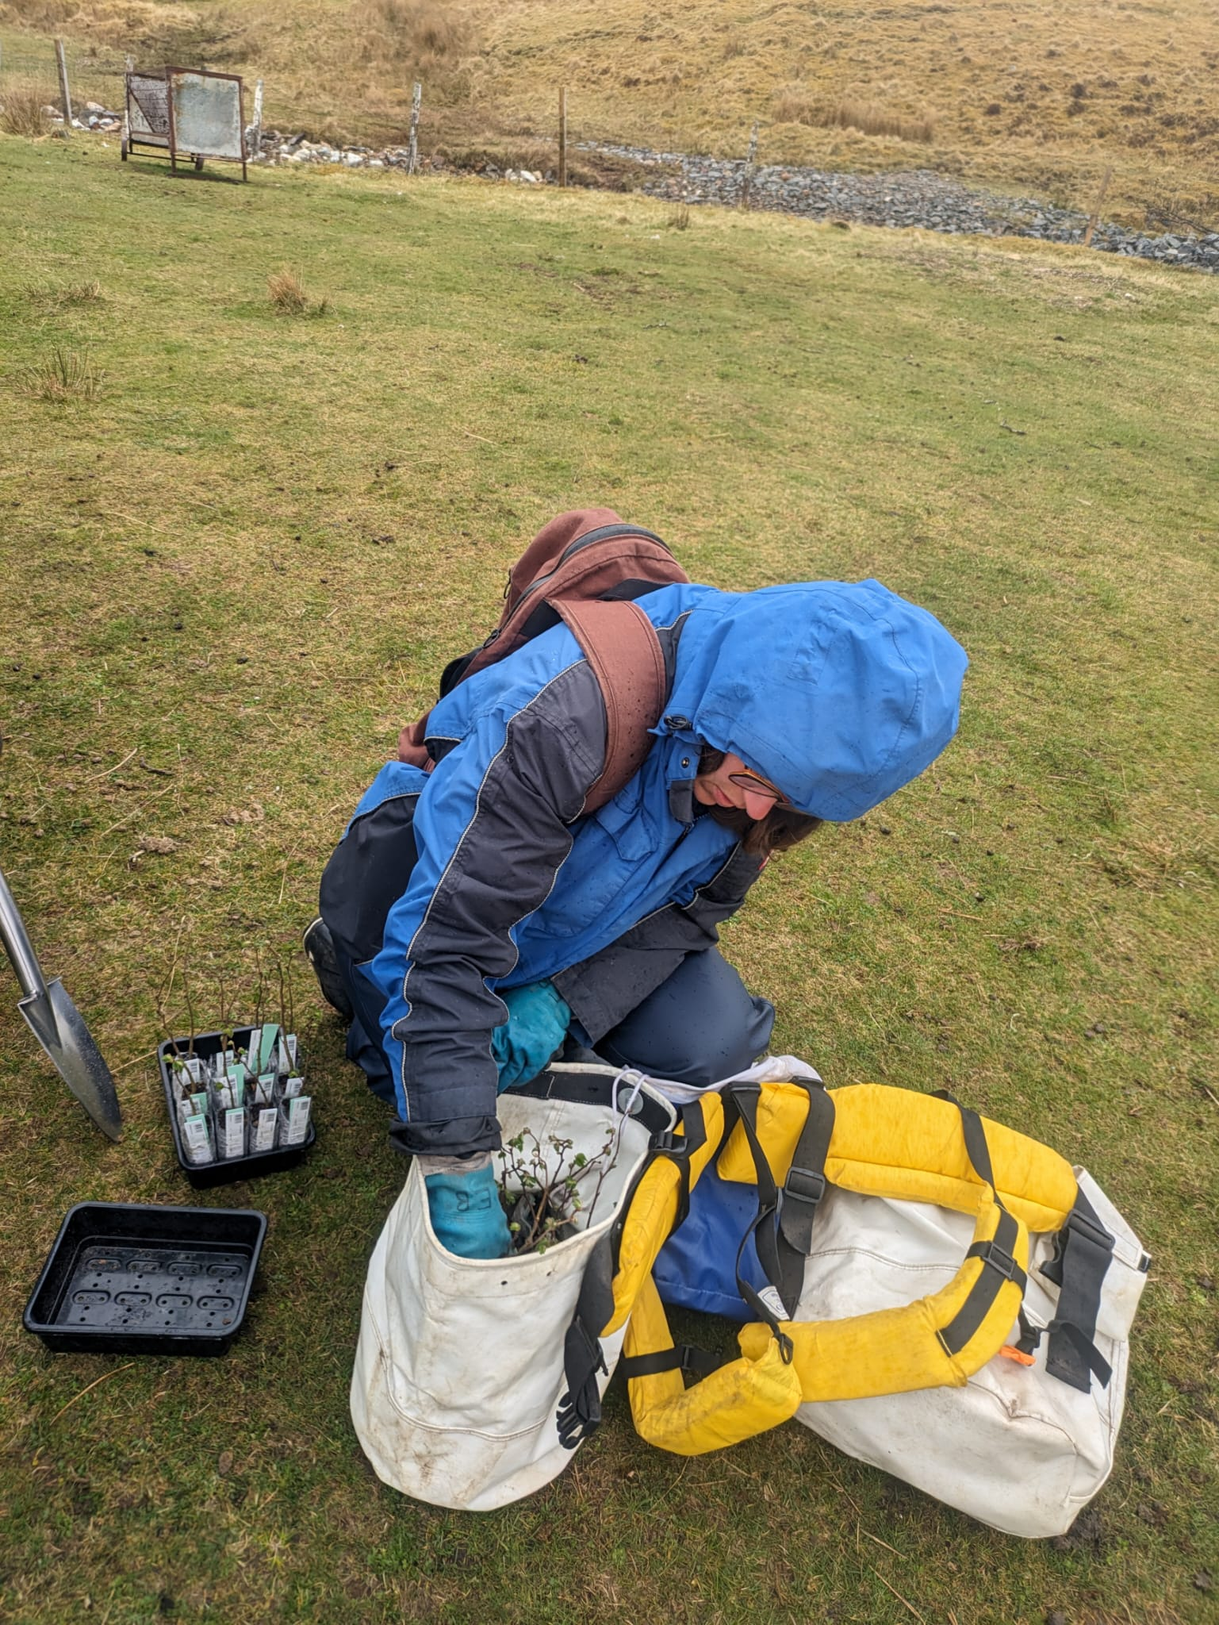
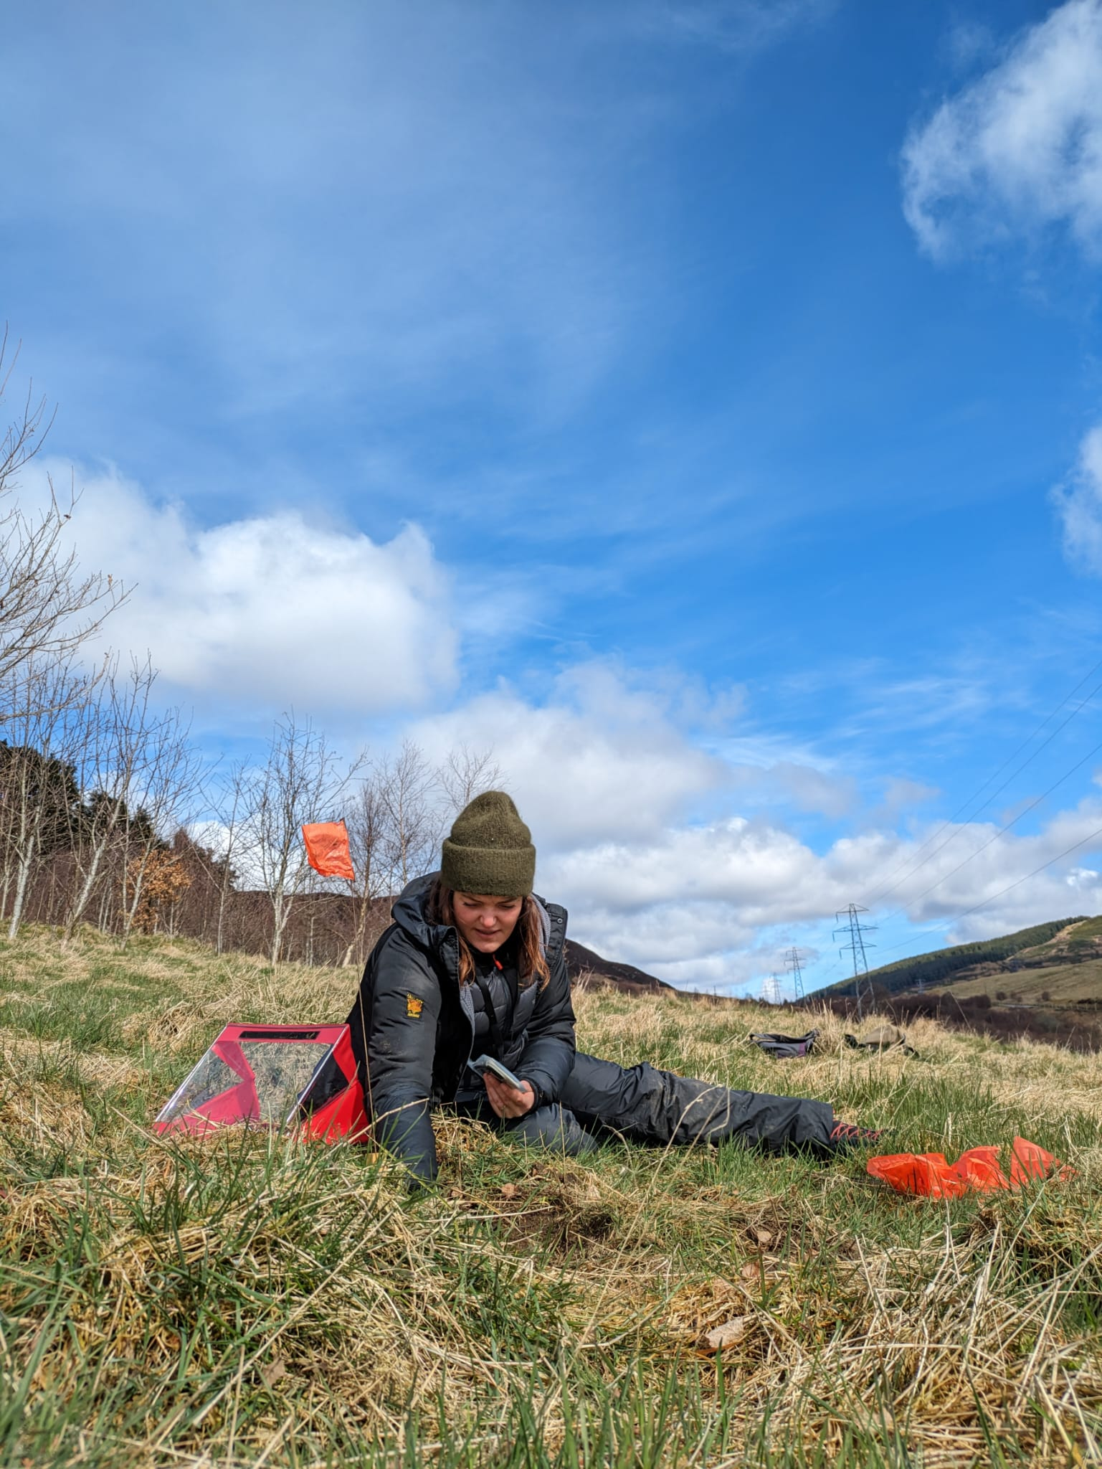
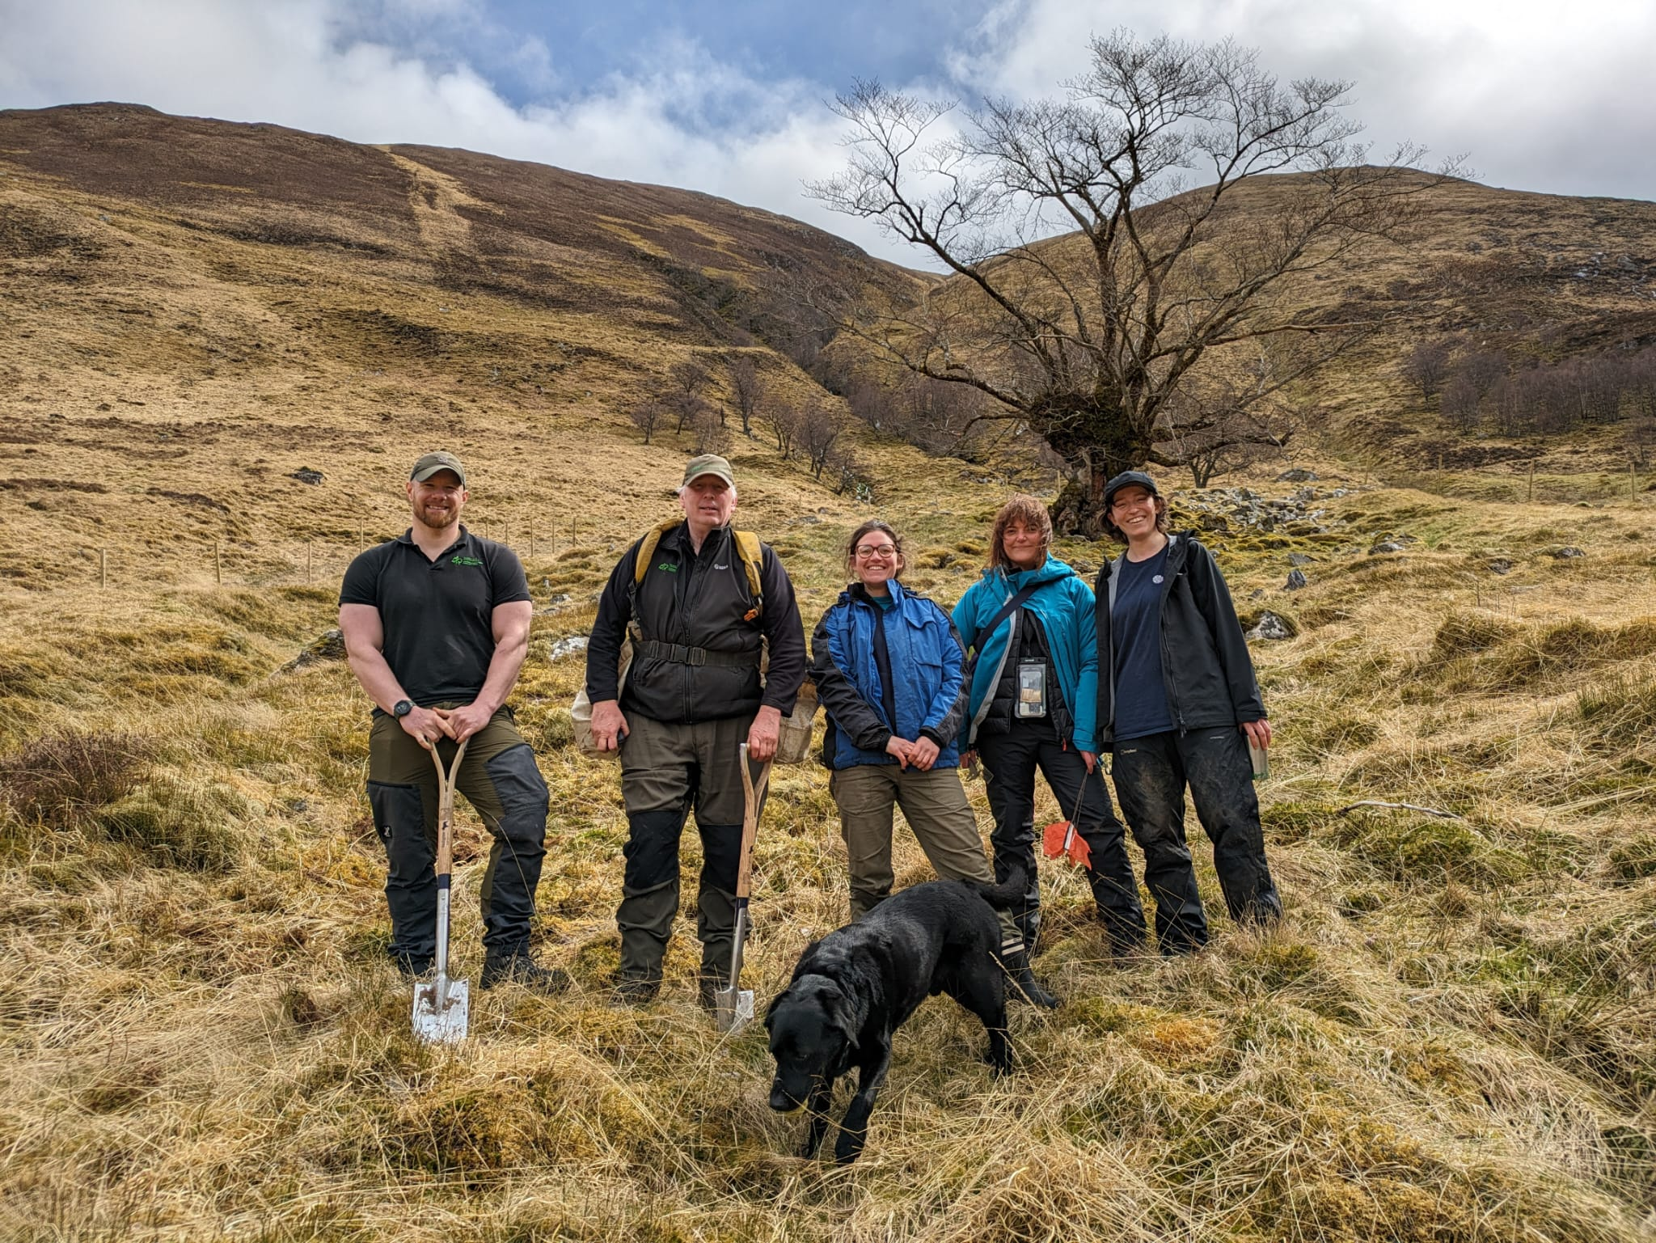
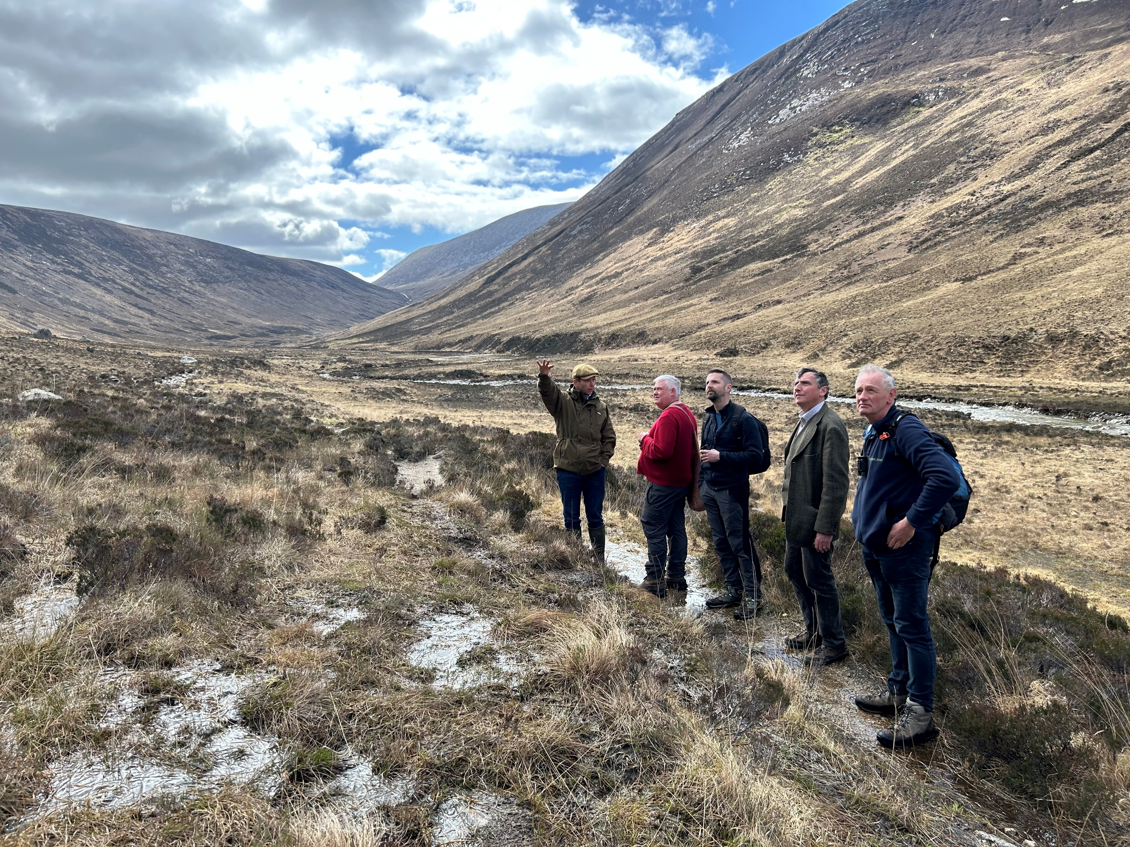
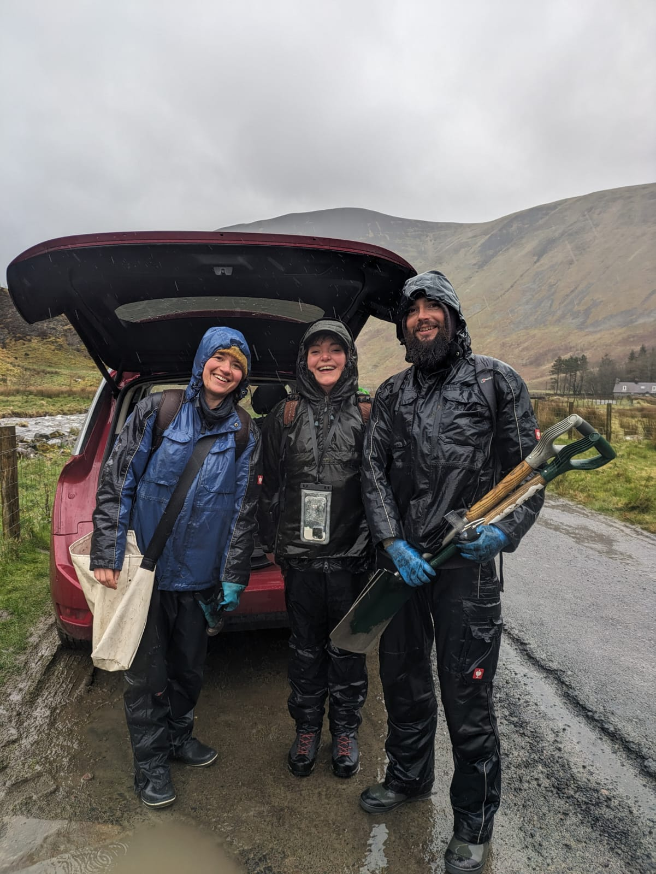
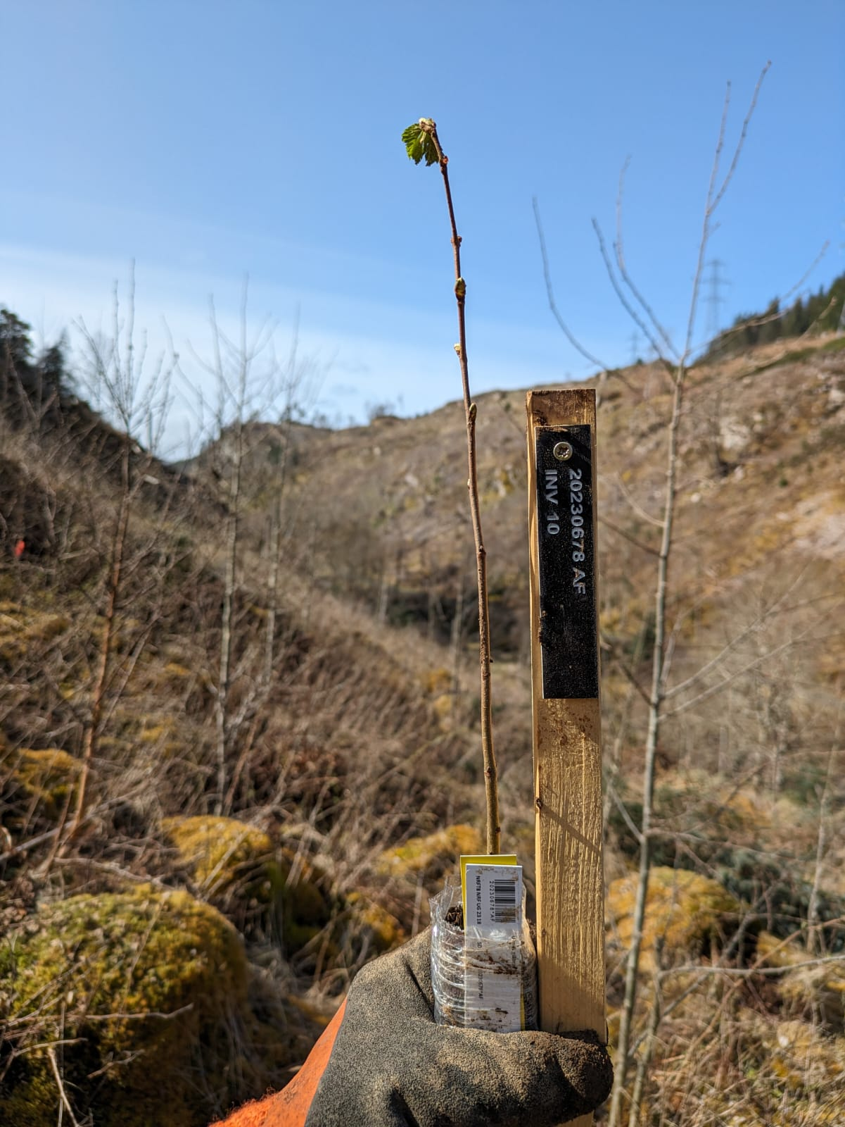
NRF 502209
Biodiversity Net Gain:
Biodiversity as a crucible for saving Scotland’s most threatened species.
Update April 2024
Prepared by Dr Aline Finger, afinger@rbge.org.uk
Field work:
First NRF plantings: 210 Ulmus glabra seedlings have been planted into 6 new sites (35 each): Ledbeg (The Assynt Foundation), Inverfarigaig (FLS), Glen Affric (FLS), Glen Garry (FLS), Dun Coillich (Highland Perthshire Communities Land Trust), Border Forest Trust (BFT)
Glencoe trip 22.04. with Dan Watson (NTS) for Woodsia ilvensis planting site
Arran site visit on 19.04. including NatureScot (Ross Lilley, Andy Macgregor, Iain Macdonald) and RBGE (Raoul Curtis-Machin, Aline Finger) to meet landowner Jamie Gibbs of Dougarie estate and discuss collaborations and planting strategy for Hedlundia
Glen Garry
Ledbeg
Ulmus glabra planting sites
Dun Coillich
Glen Affric
Field trip to Arran, Glen Catacol, to meet landowner Jamie Gibbs
BFT
Inverfarigaig

Slide 4
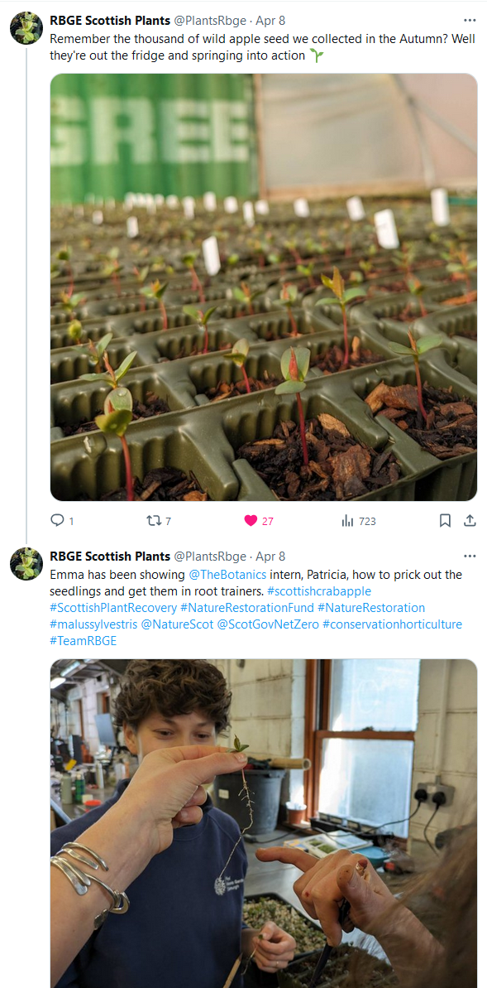
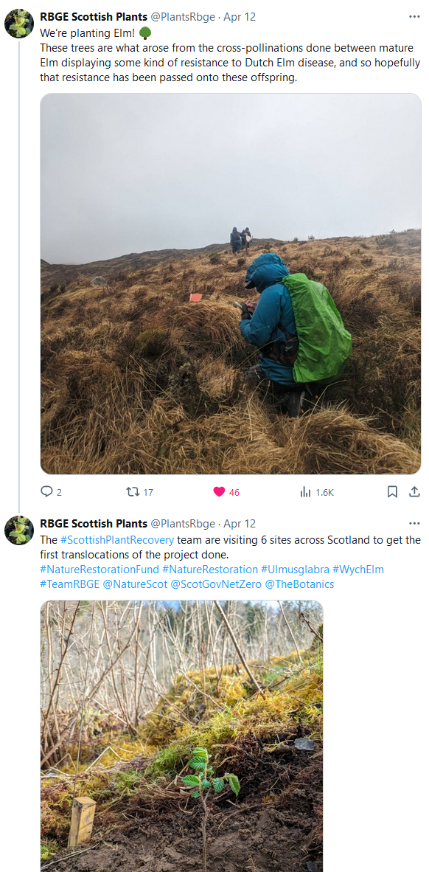
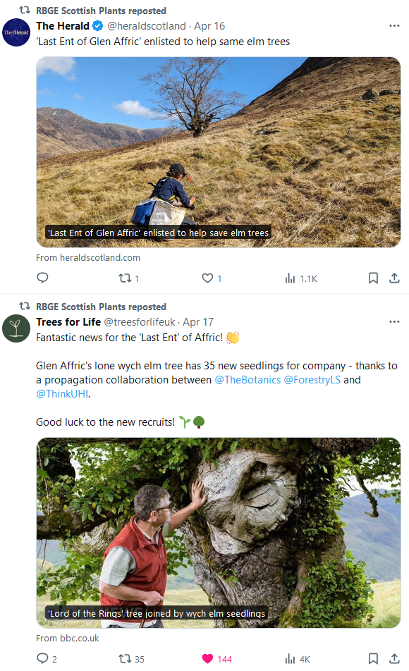
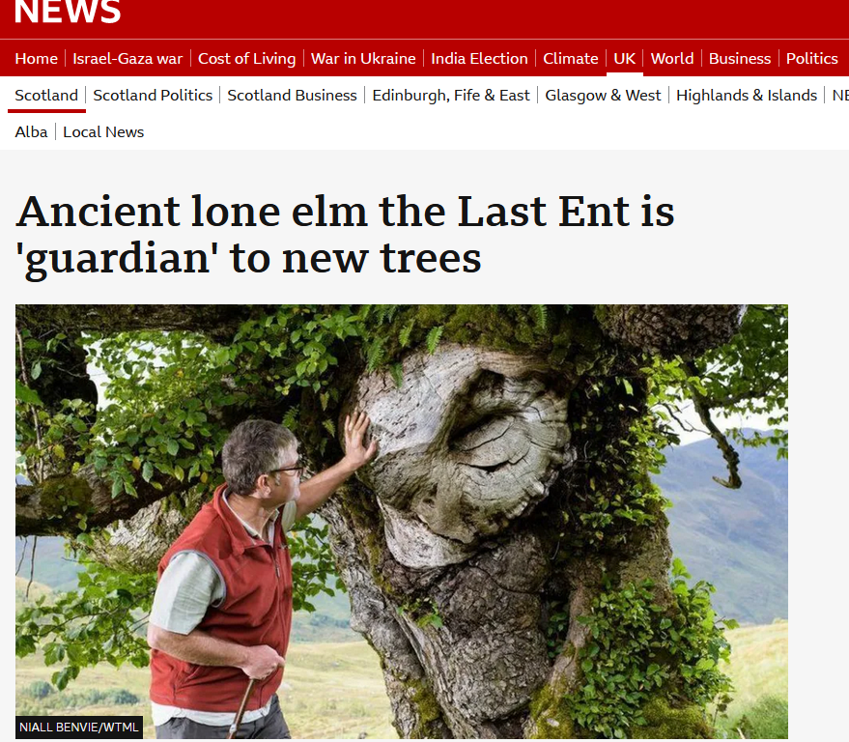
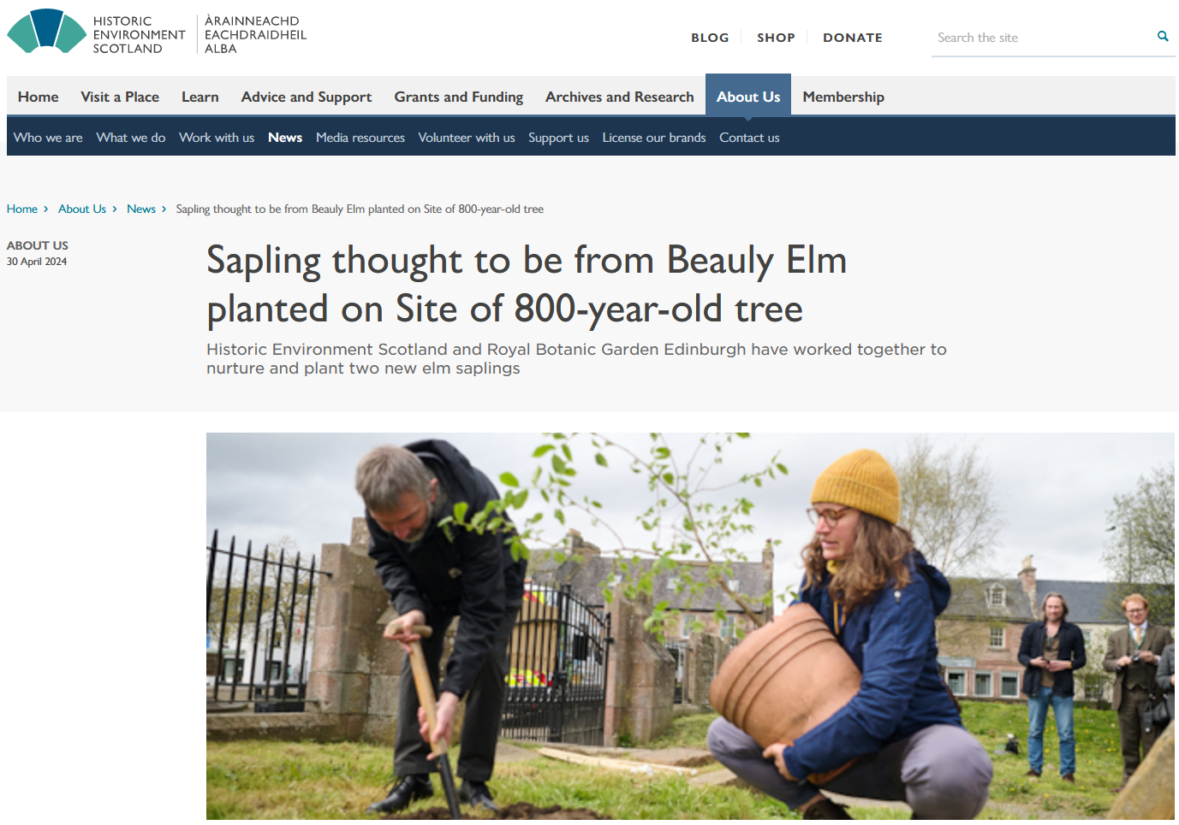
NRF 502209
Biodiversity Net Gain:
Biodiversity as a crucible for saving Scotland’s most threatened species.
Update April 2024
Prepared by Dr Aline Finger, afinger@rbge.org.uk
Communication, press and publications:
We continued to create regular social media posts.
New Botanic Stories:
Wych elm plantings: https://stories.rbge.org.uk/archives/38765
Patricia Berakova apprenticeship and work on Woodsia ilvensis: https://stories.rbge.org.uk/archives/38782
Interview with BBC Radio Scotland on 16.04.24 on Last Ent (Ulmus glabra) plantings https://www.bbc.co.uk/news/articles/c51n2gvy3lpo. This was also featured in a news item on the 5.30 BBC Highlands and Islands News.
The Last Ent planting has attracted significant coverage on BBC news, The Times, BBC Radio Scotland, The Press & Journal, The Herald, The Inverness Courier, The National, Yahoo News, Ross-shire Journal, Head Topics, Forestry Journal, Oban Times and Angry Bear. The story is also highlighted on the FLS website.
Two RBGE Instagram Lives by Max (24.04. at 6pm and 25.04. at 9am) have been about this NRF project
BBC Radio Scotland interview with Max on Beauly Priory elm planting on 30th April for broadcast on 01.05.
Article on Beauly Priory Elm planting of two saplings to replace Europe’s oldest wych elm, with one elm specially bred at RBGE highlighted on BBC website and HES website, picked up in Scottish Field and the Inverness Courier. Interview/quotes with Max Coleman.
Plans for May 2024:
Continue maintenance of nursery plants
Balmoral partner meeting
Saxifraga hirculus plug collections
Next steering group meeting
Start Polygonatum verticillatum genetic work
Some of our latest social media posts

