Slide 1
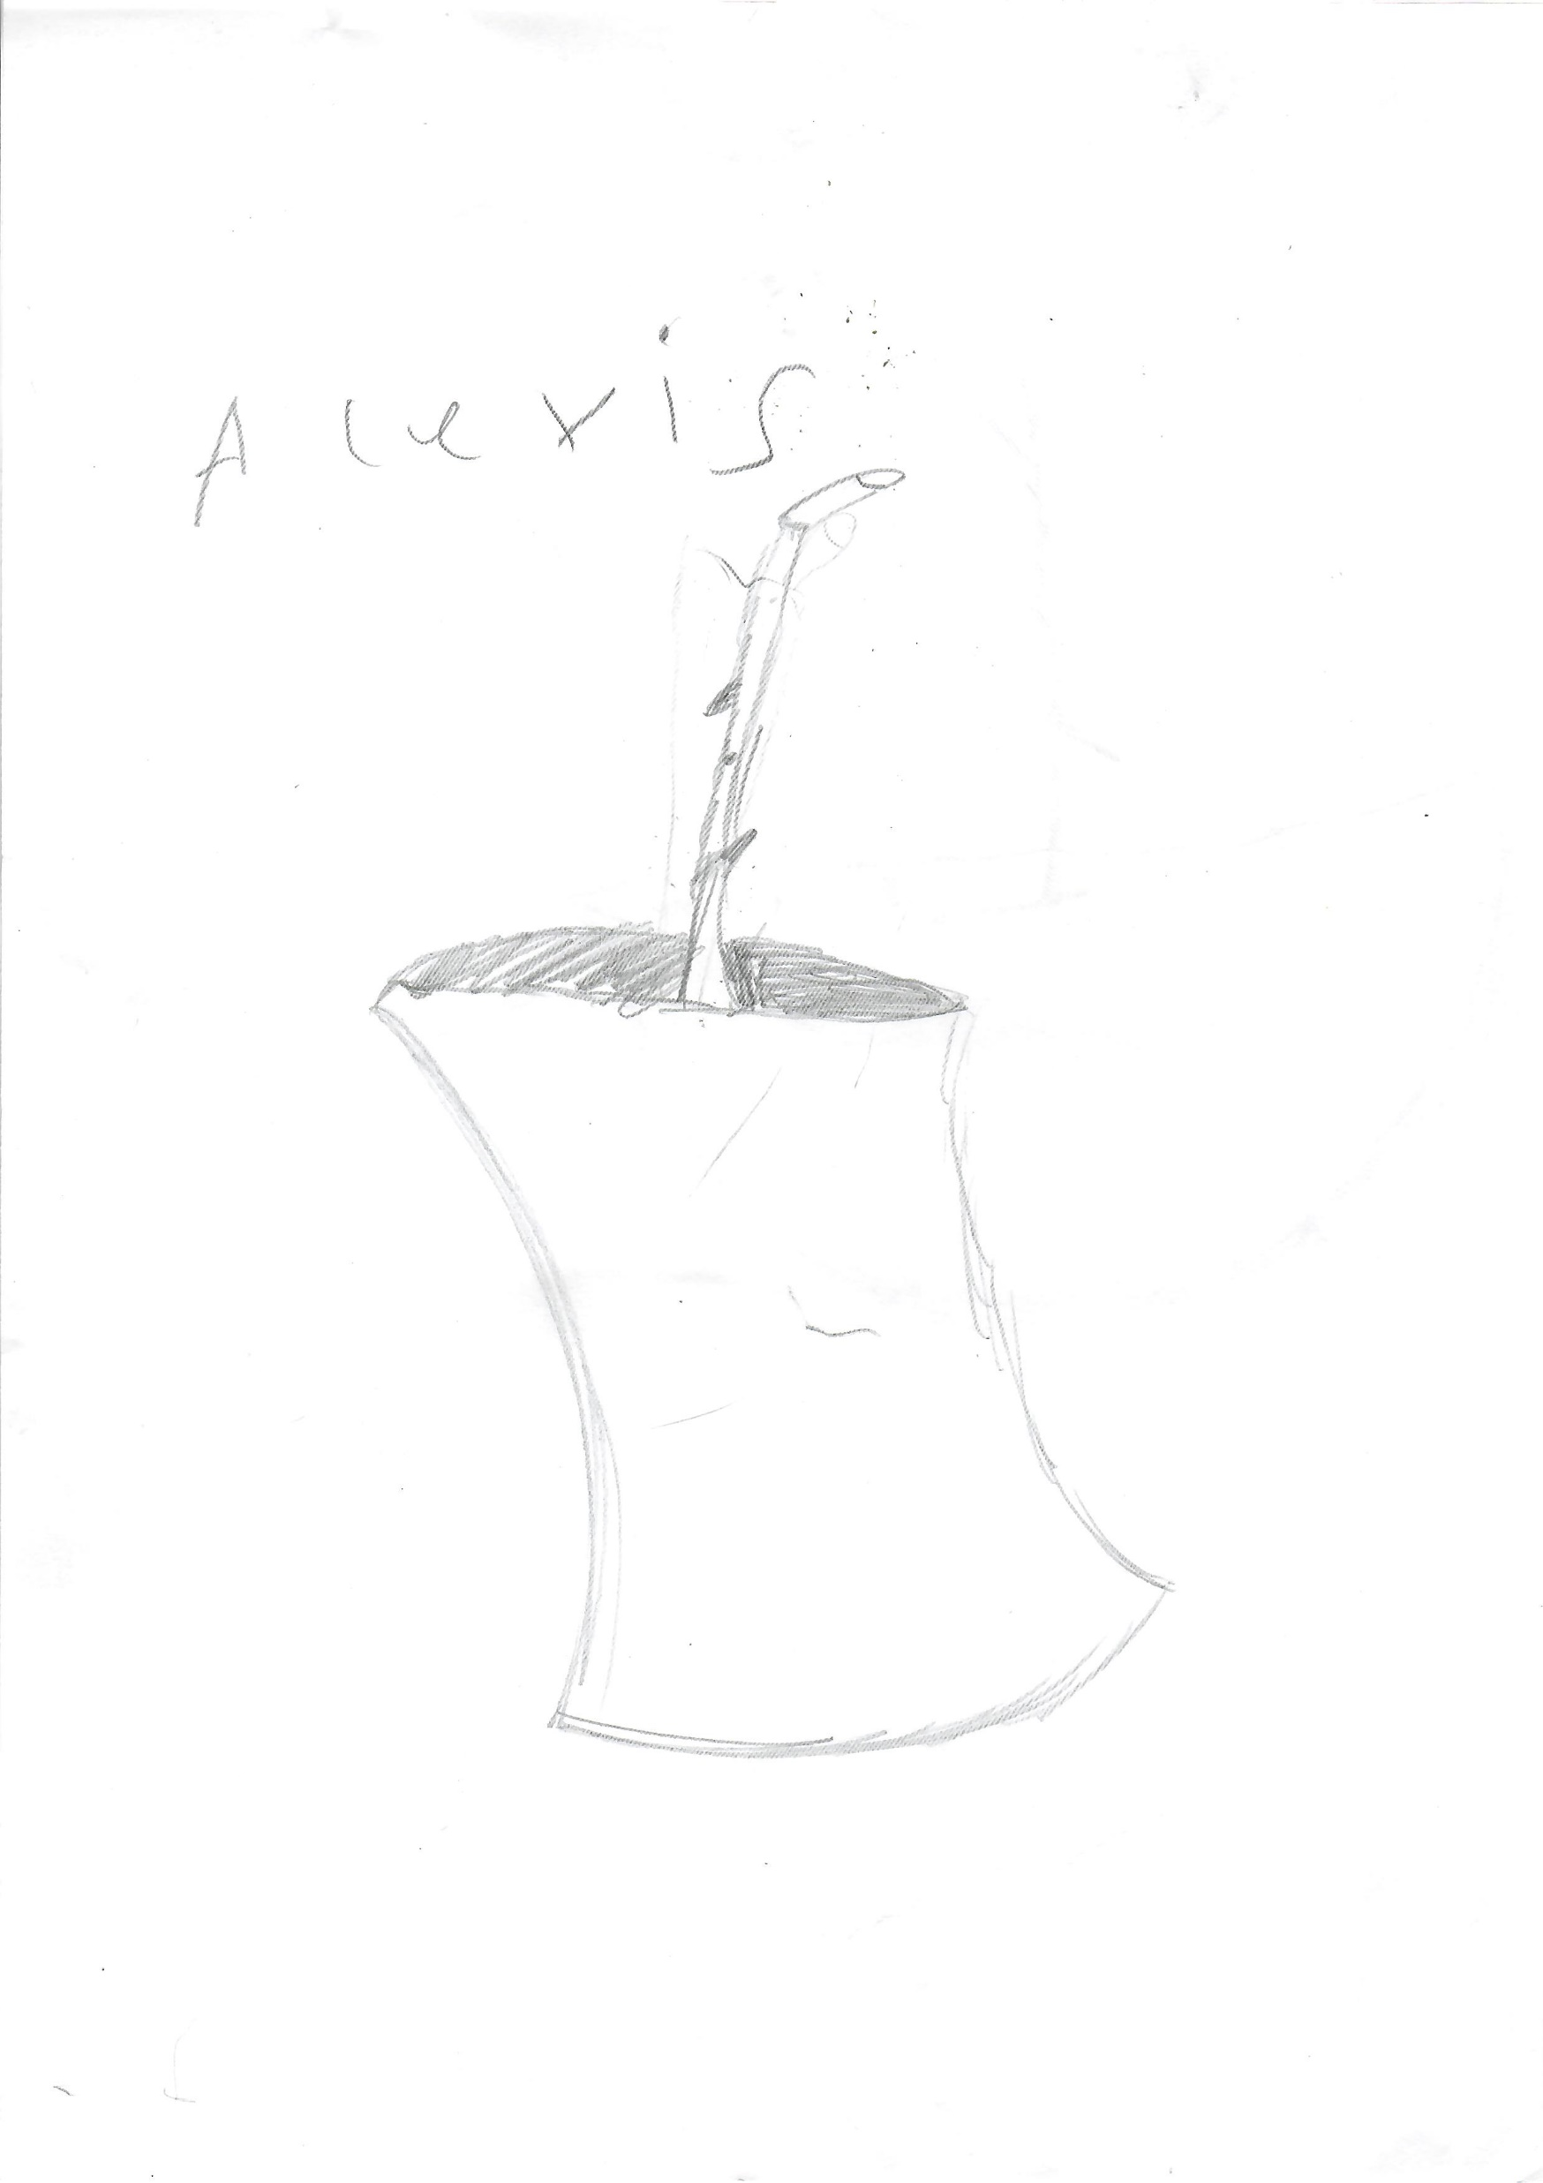
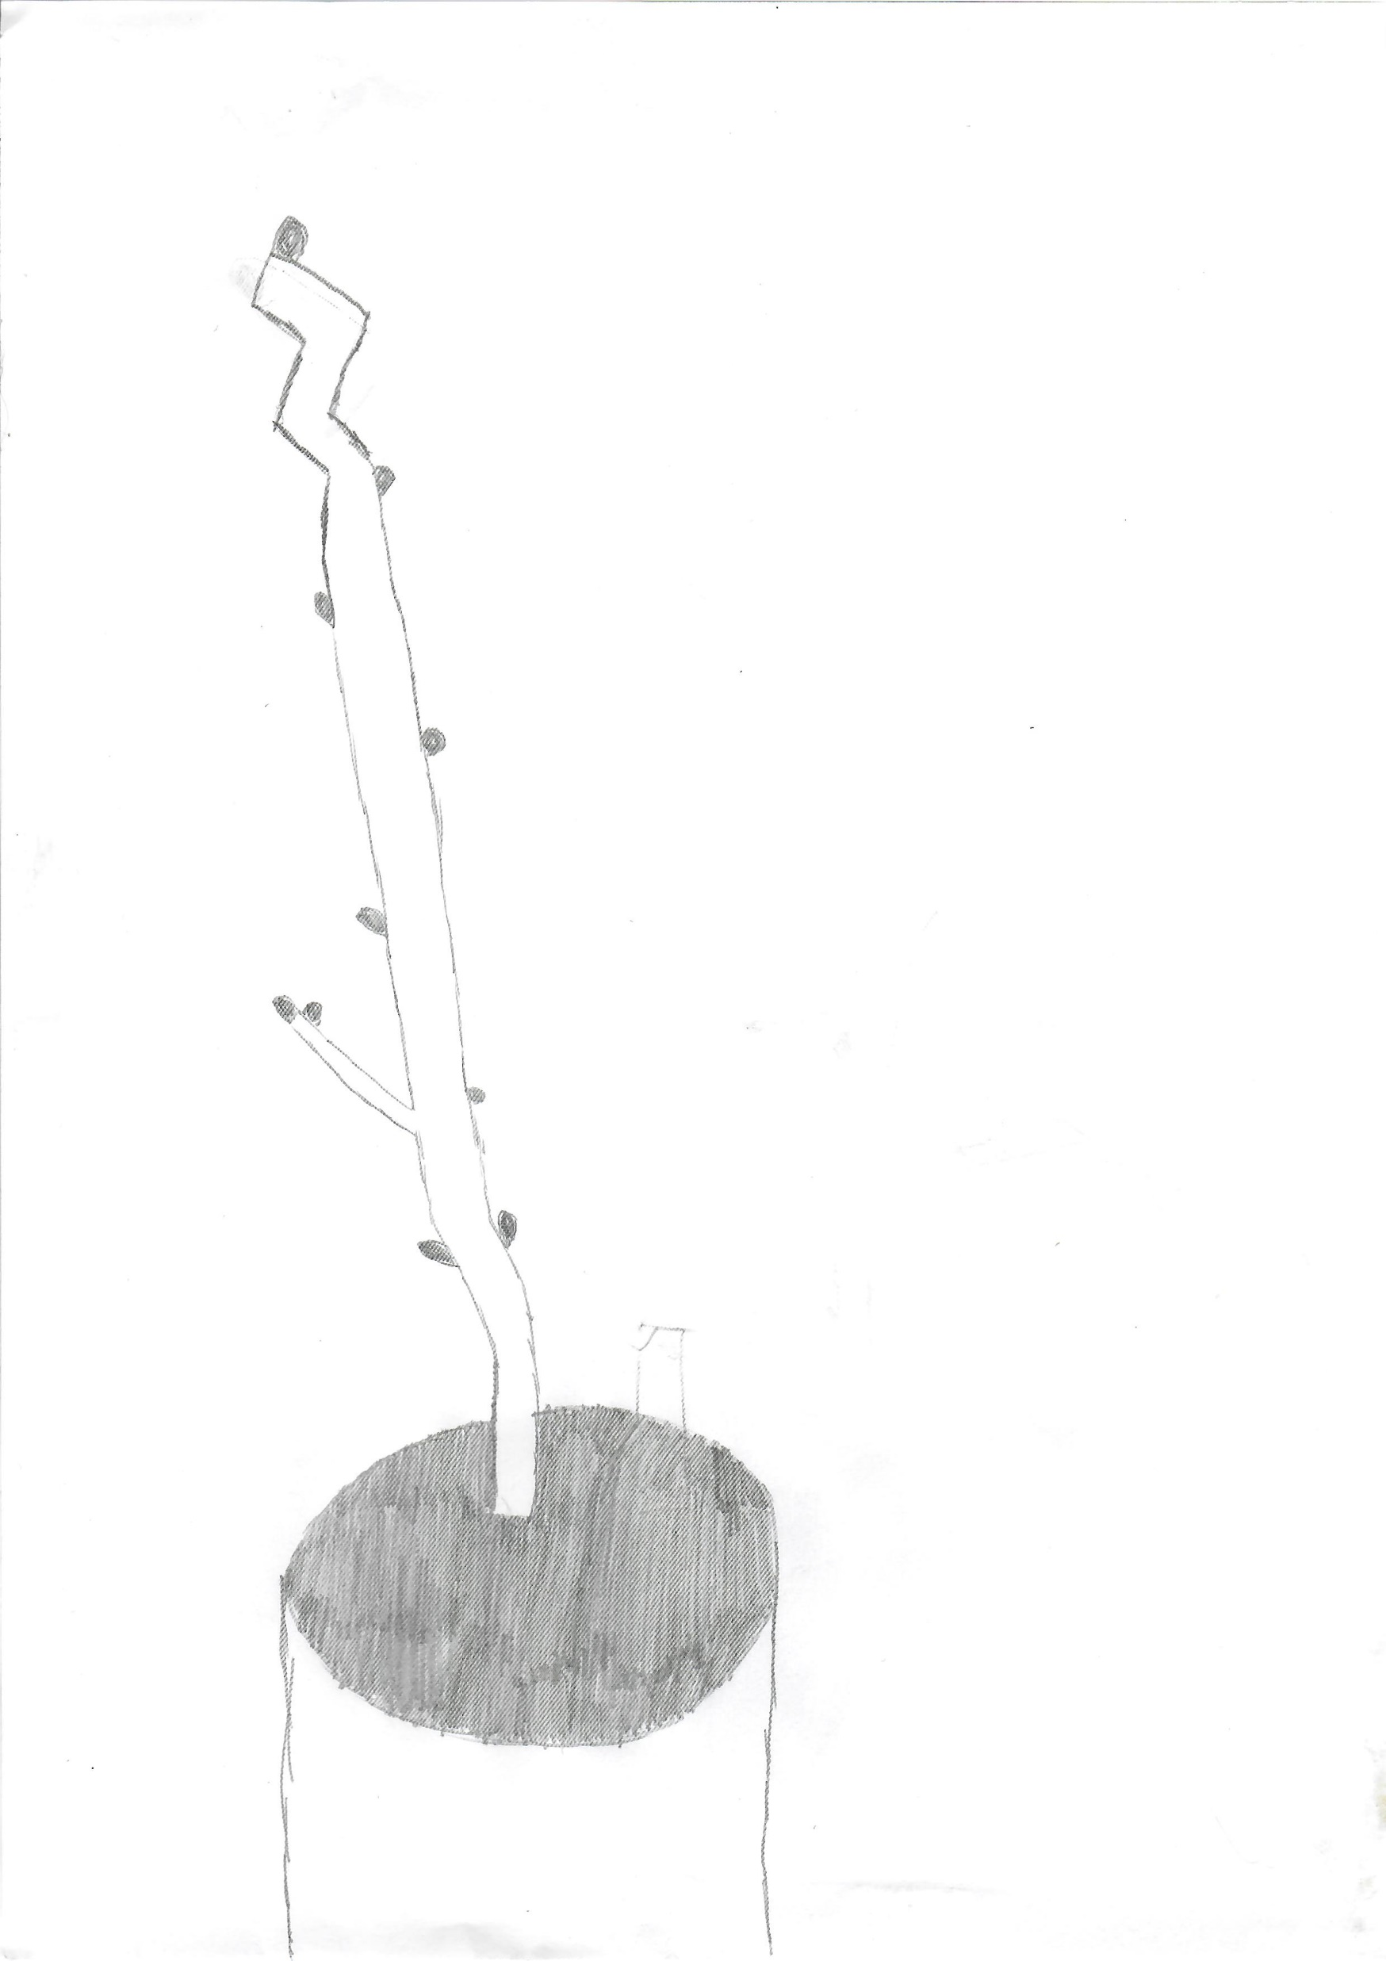
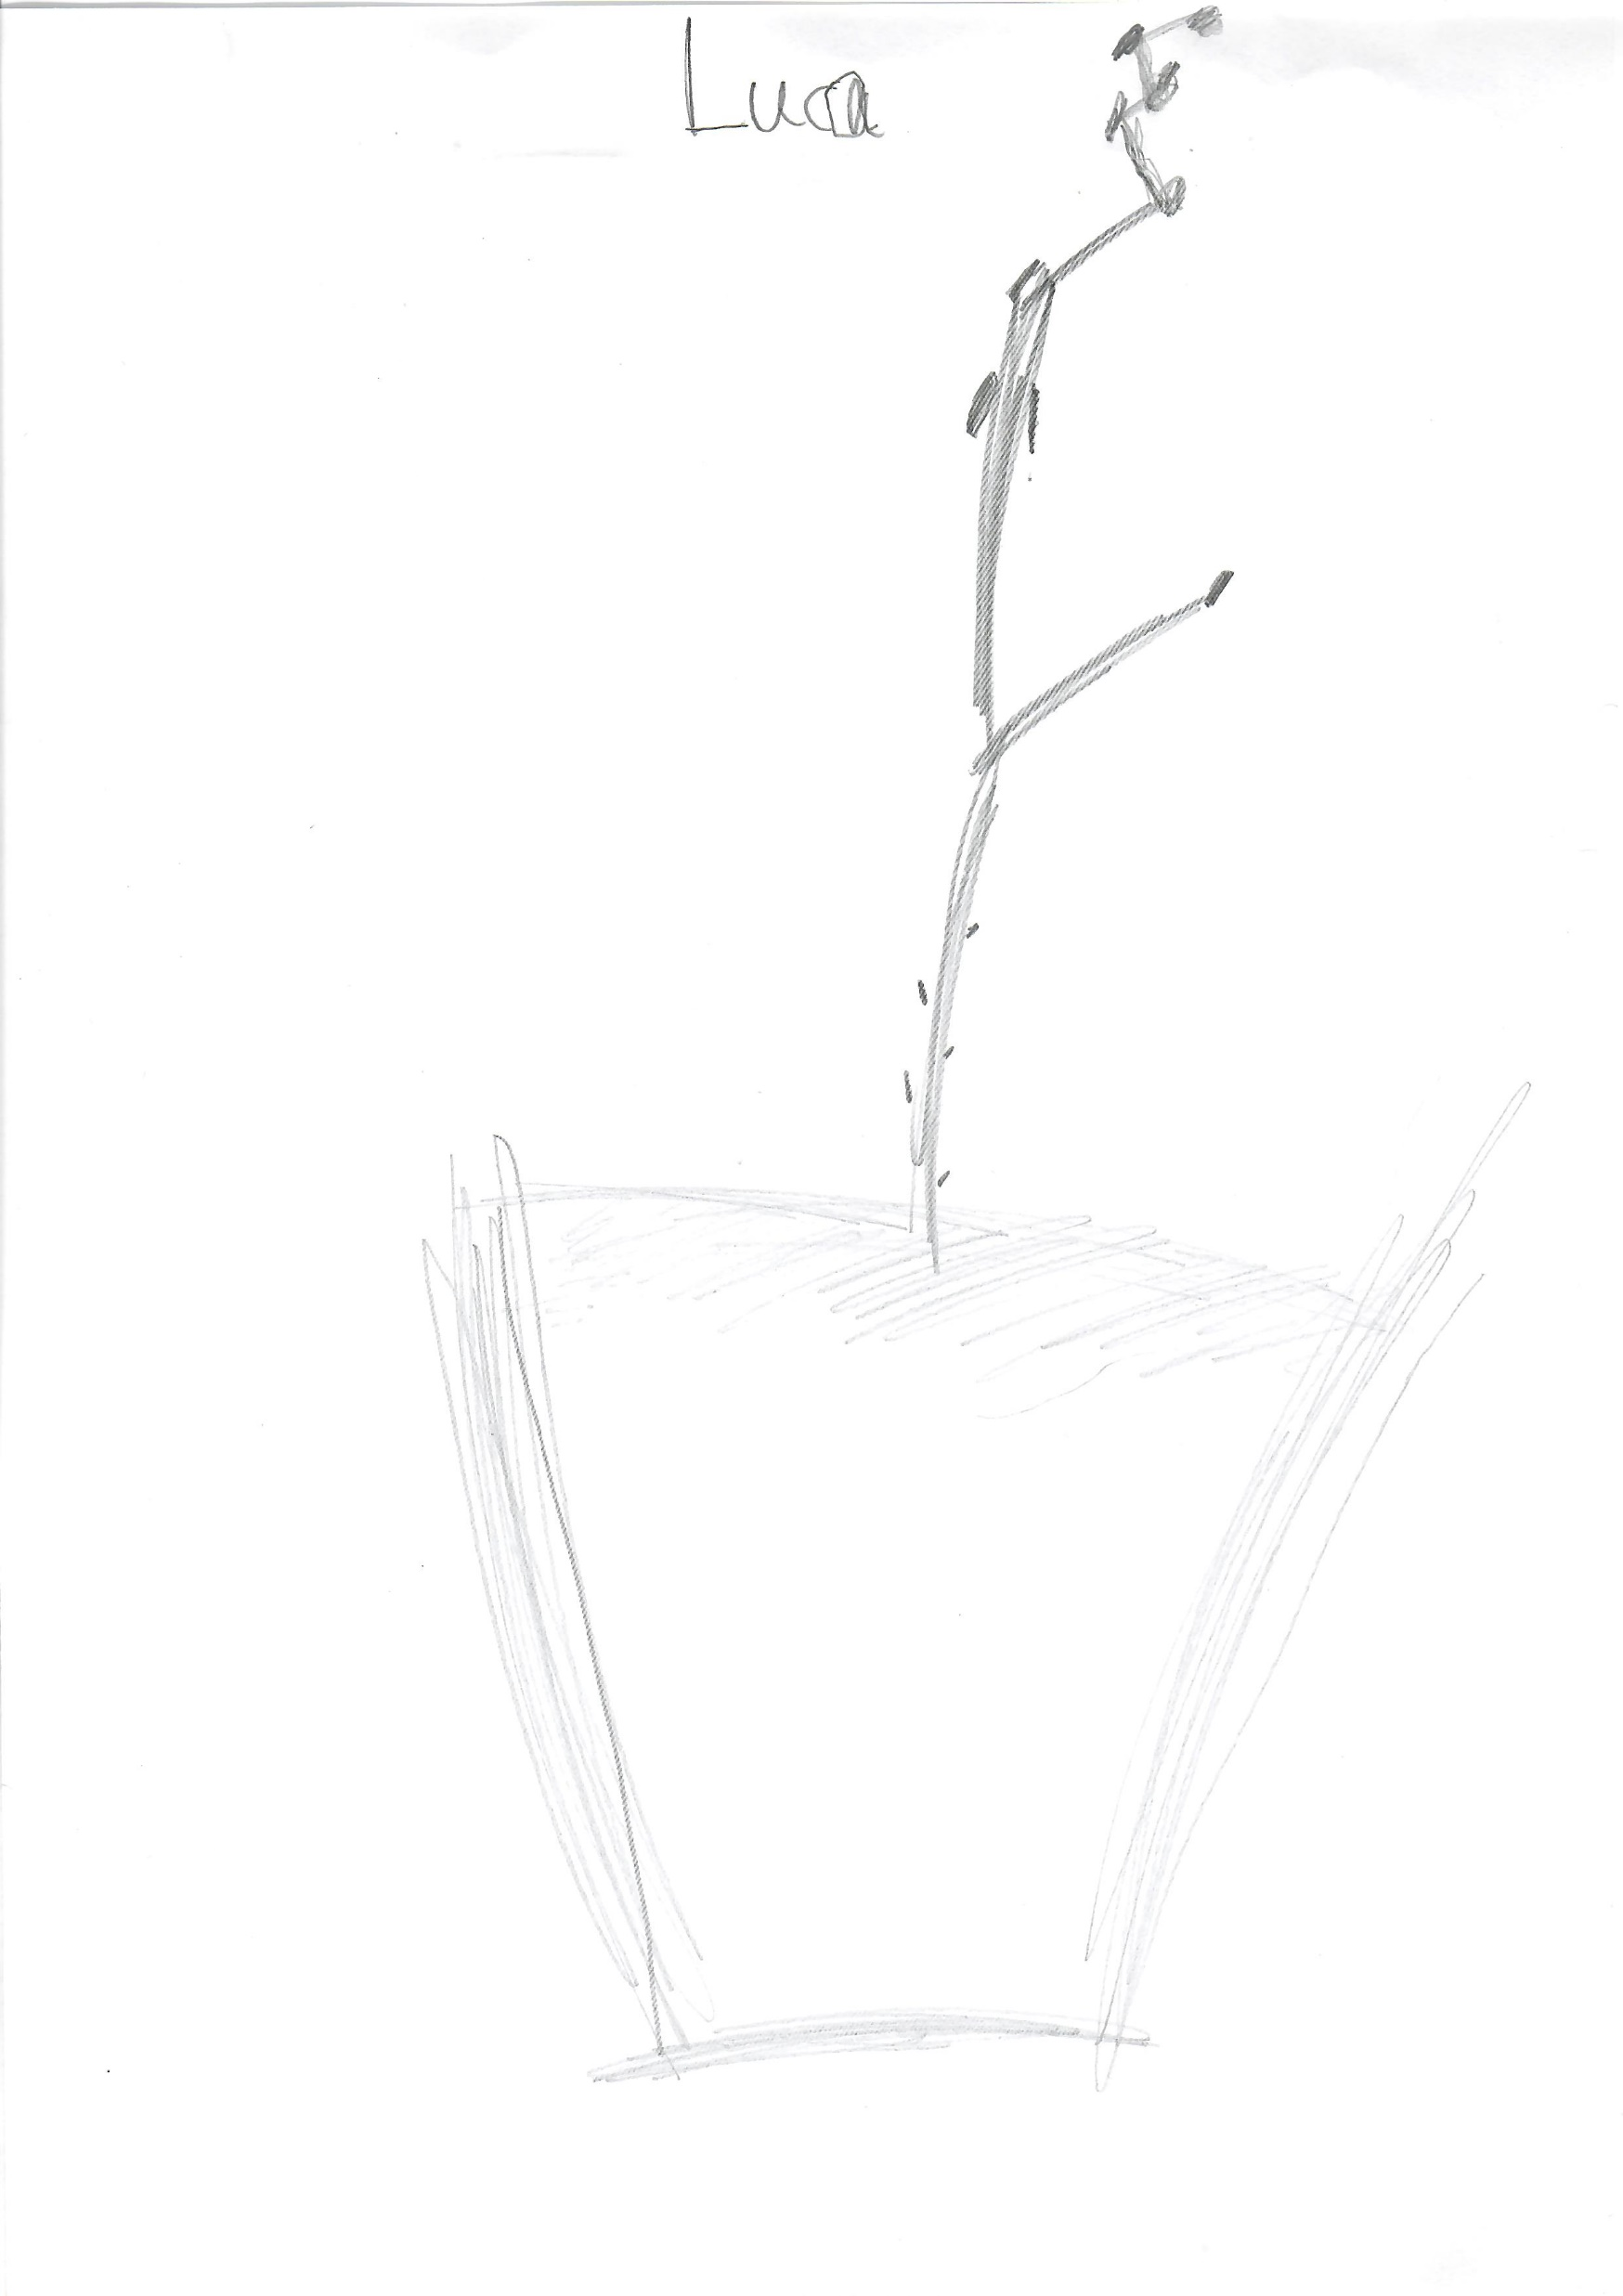
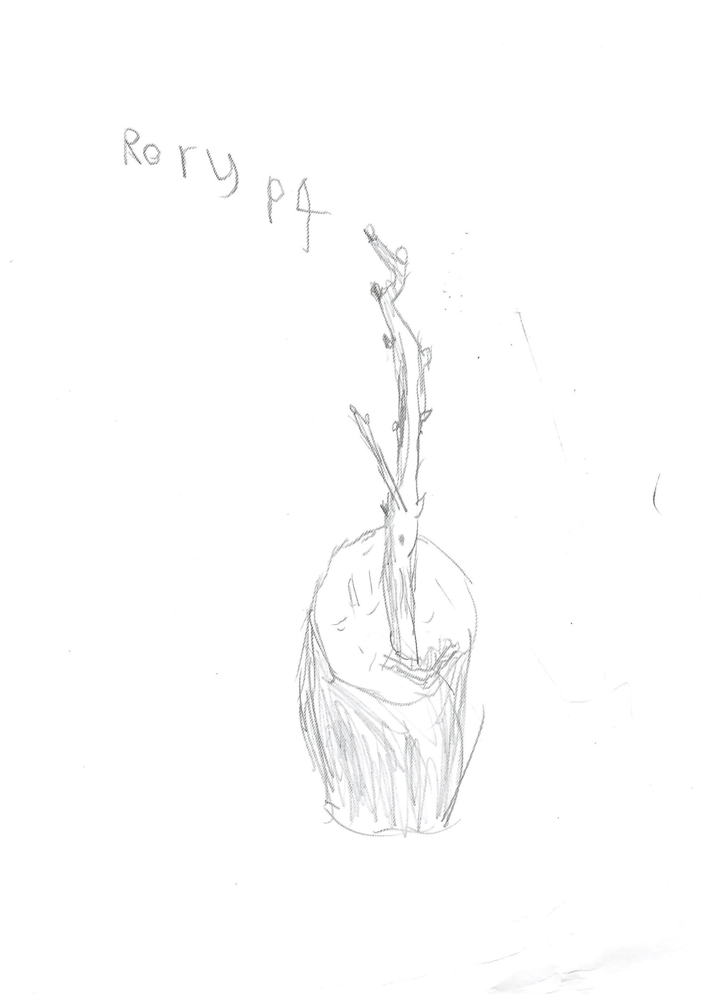
NRF 502209
Biodiversity Net Gain:
Biodiversity as a crucible for saving Scotland’s most threatened species.
Update January 2024
Prepared by Dr Aline Finger, afinger@rbge.org.uk
General:
Regular, minuted RBGE meetings (generally Mondays 9.45-11.45) take place to ensure effective workflow and communication
Polygonatum verticilatum, Cicerbita alpina and Woodsia ilvensis strategy meetings were held to discuss best propagation methods, planting sites and plan first translocations
Scottish Water visited the nursery to test the Saxifraga hirculus cascade water to ensure best quality for plant growth
Project representation by Emma and Becca to all RBGE horticulture staff as part of the “Dark Mornings” sessions
Max Coleman met with various local organisations at Little Assynt, i.e. Culag Community Woodland Trust, Assynt Field Club, Assynt Foundation, Scottish Woodland Trust, John Muir Trust, other interested local people, schoolteachers, ranger for Highland High Life, local artist and conservation officer for John Muir Trust, Little Assynt Community Tree Nursery managers
Drawings of the ‘special’ NRF wych elm by pupils of the Lochinver Primary School

Slide 2
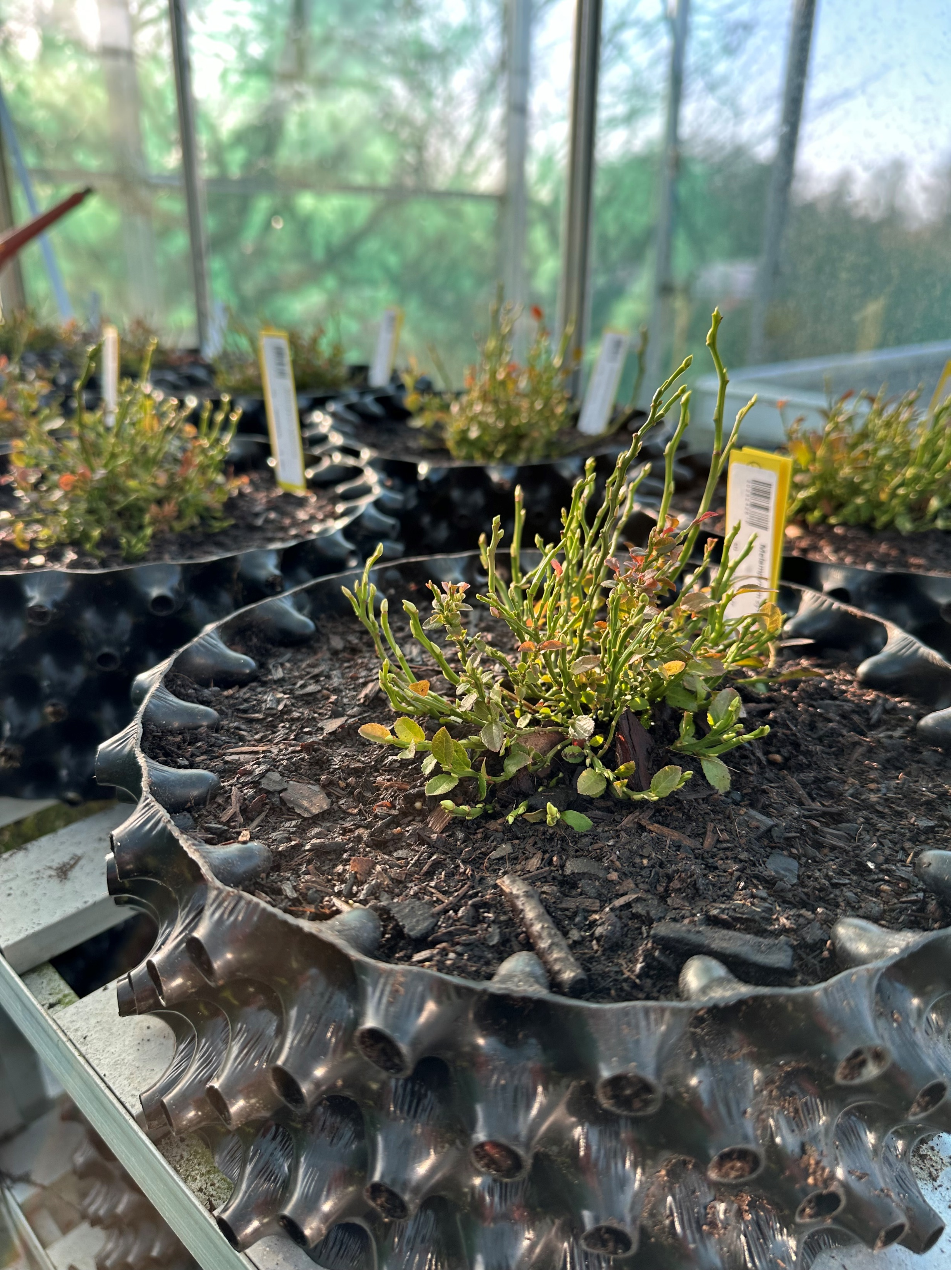
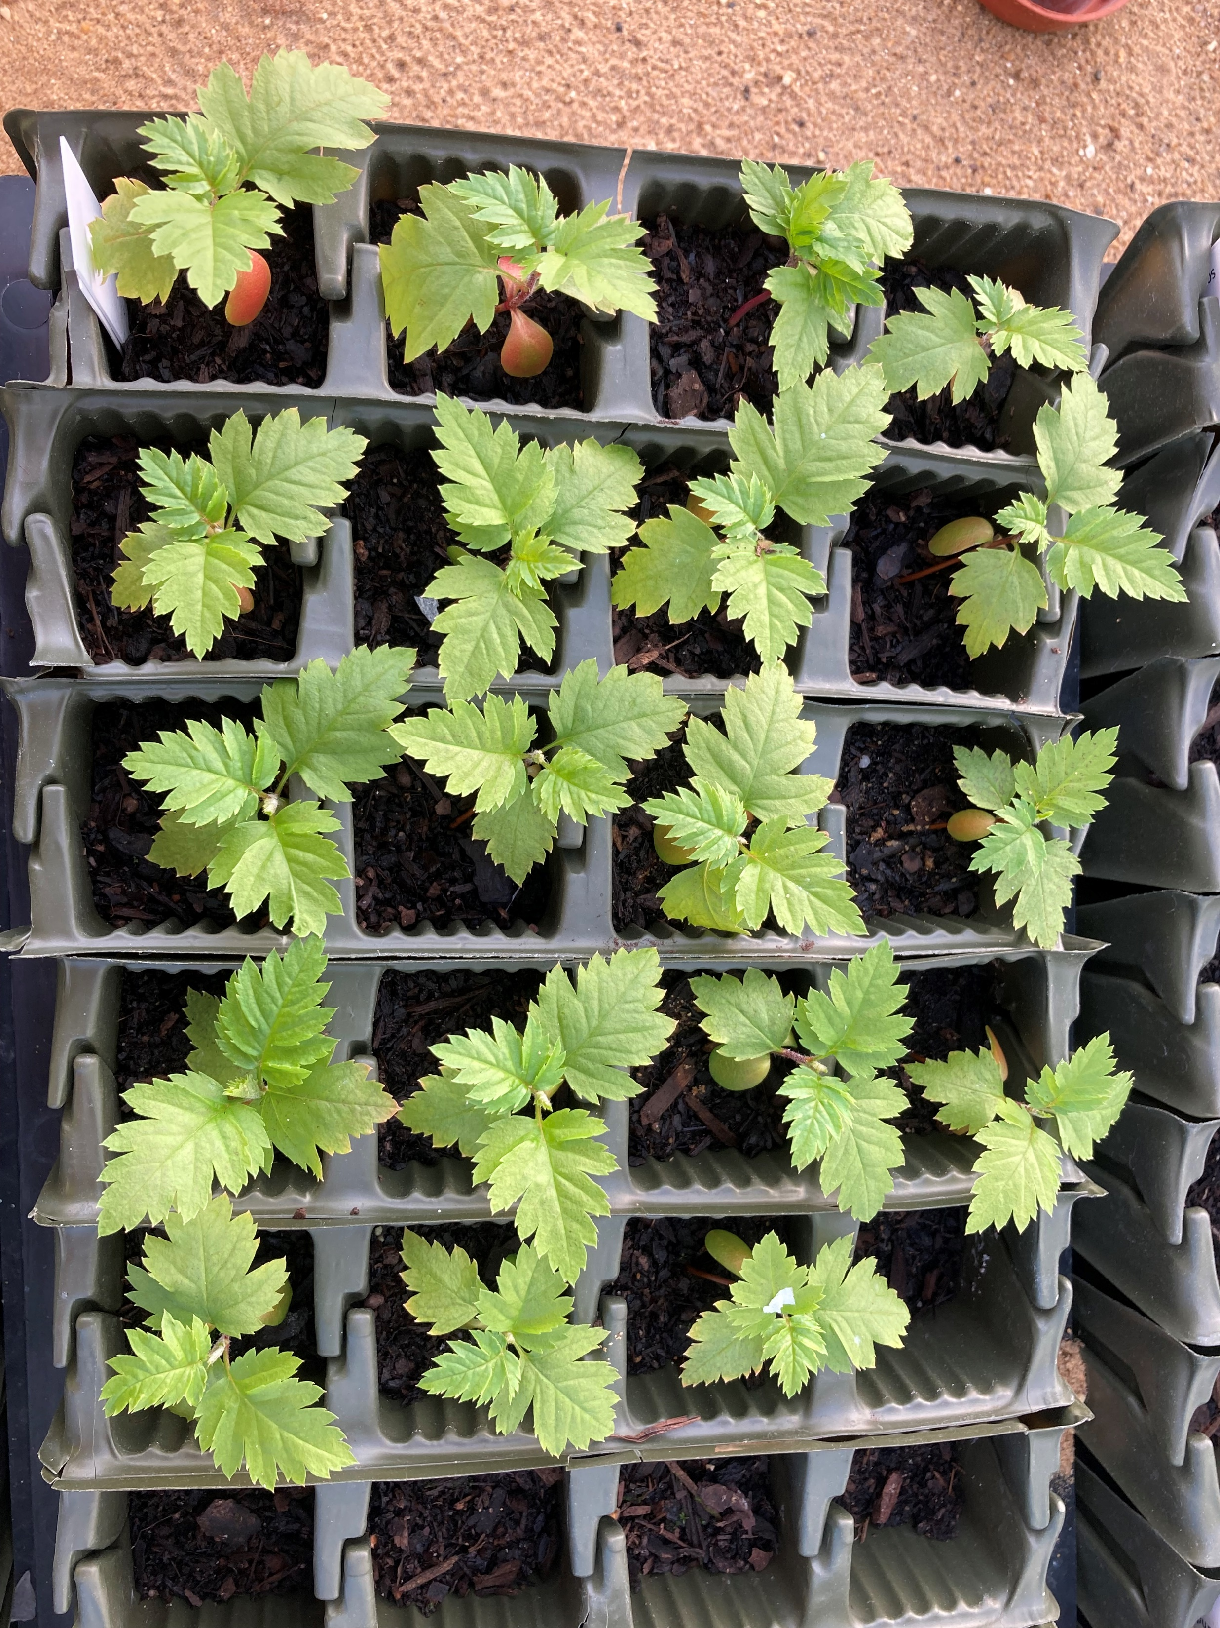
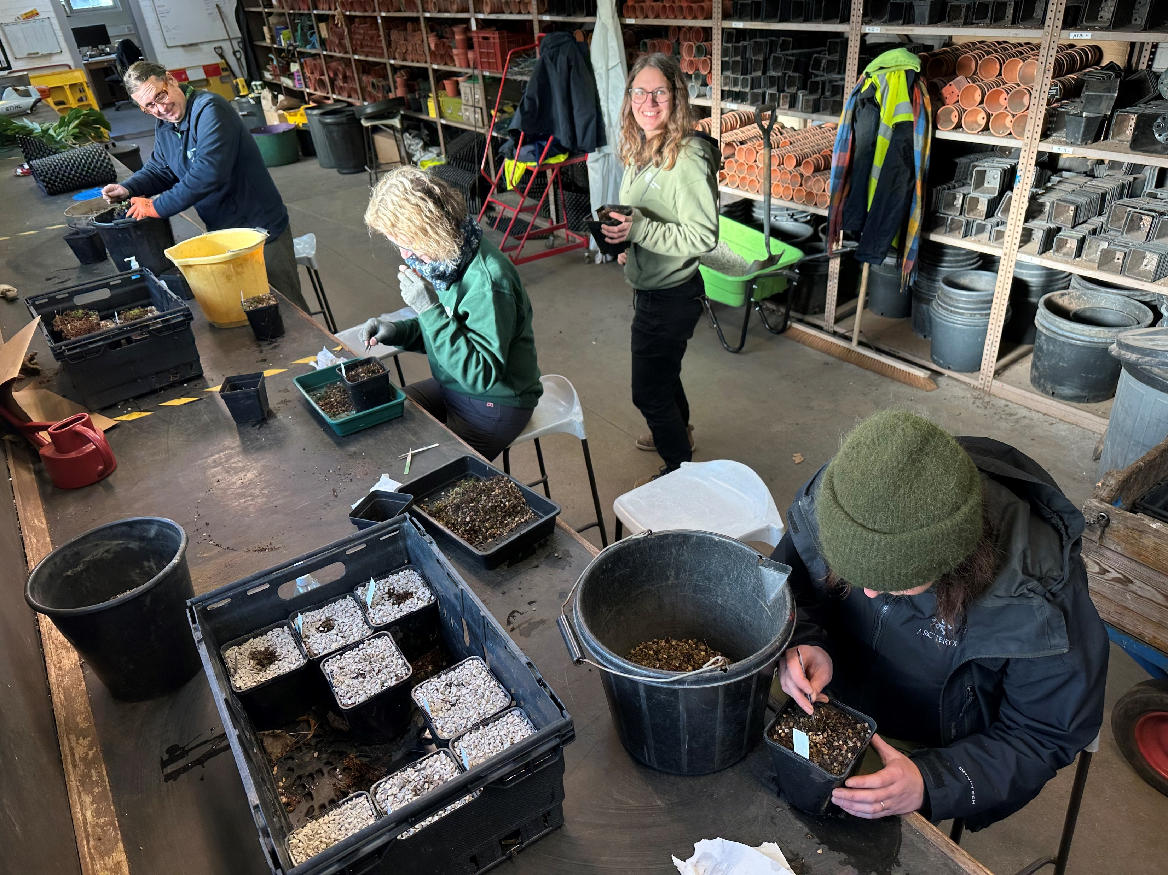
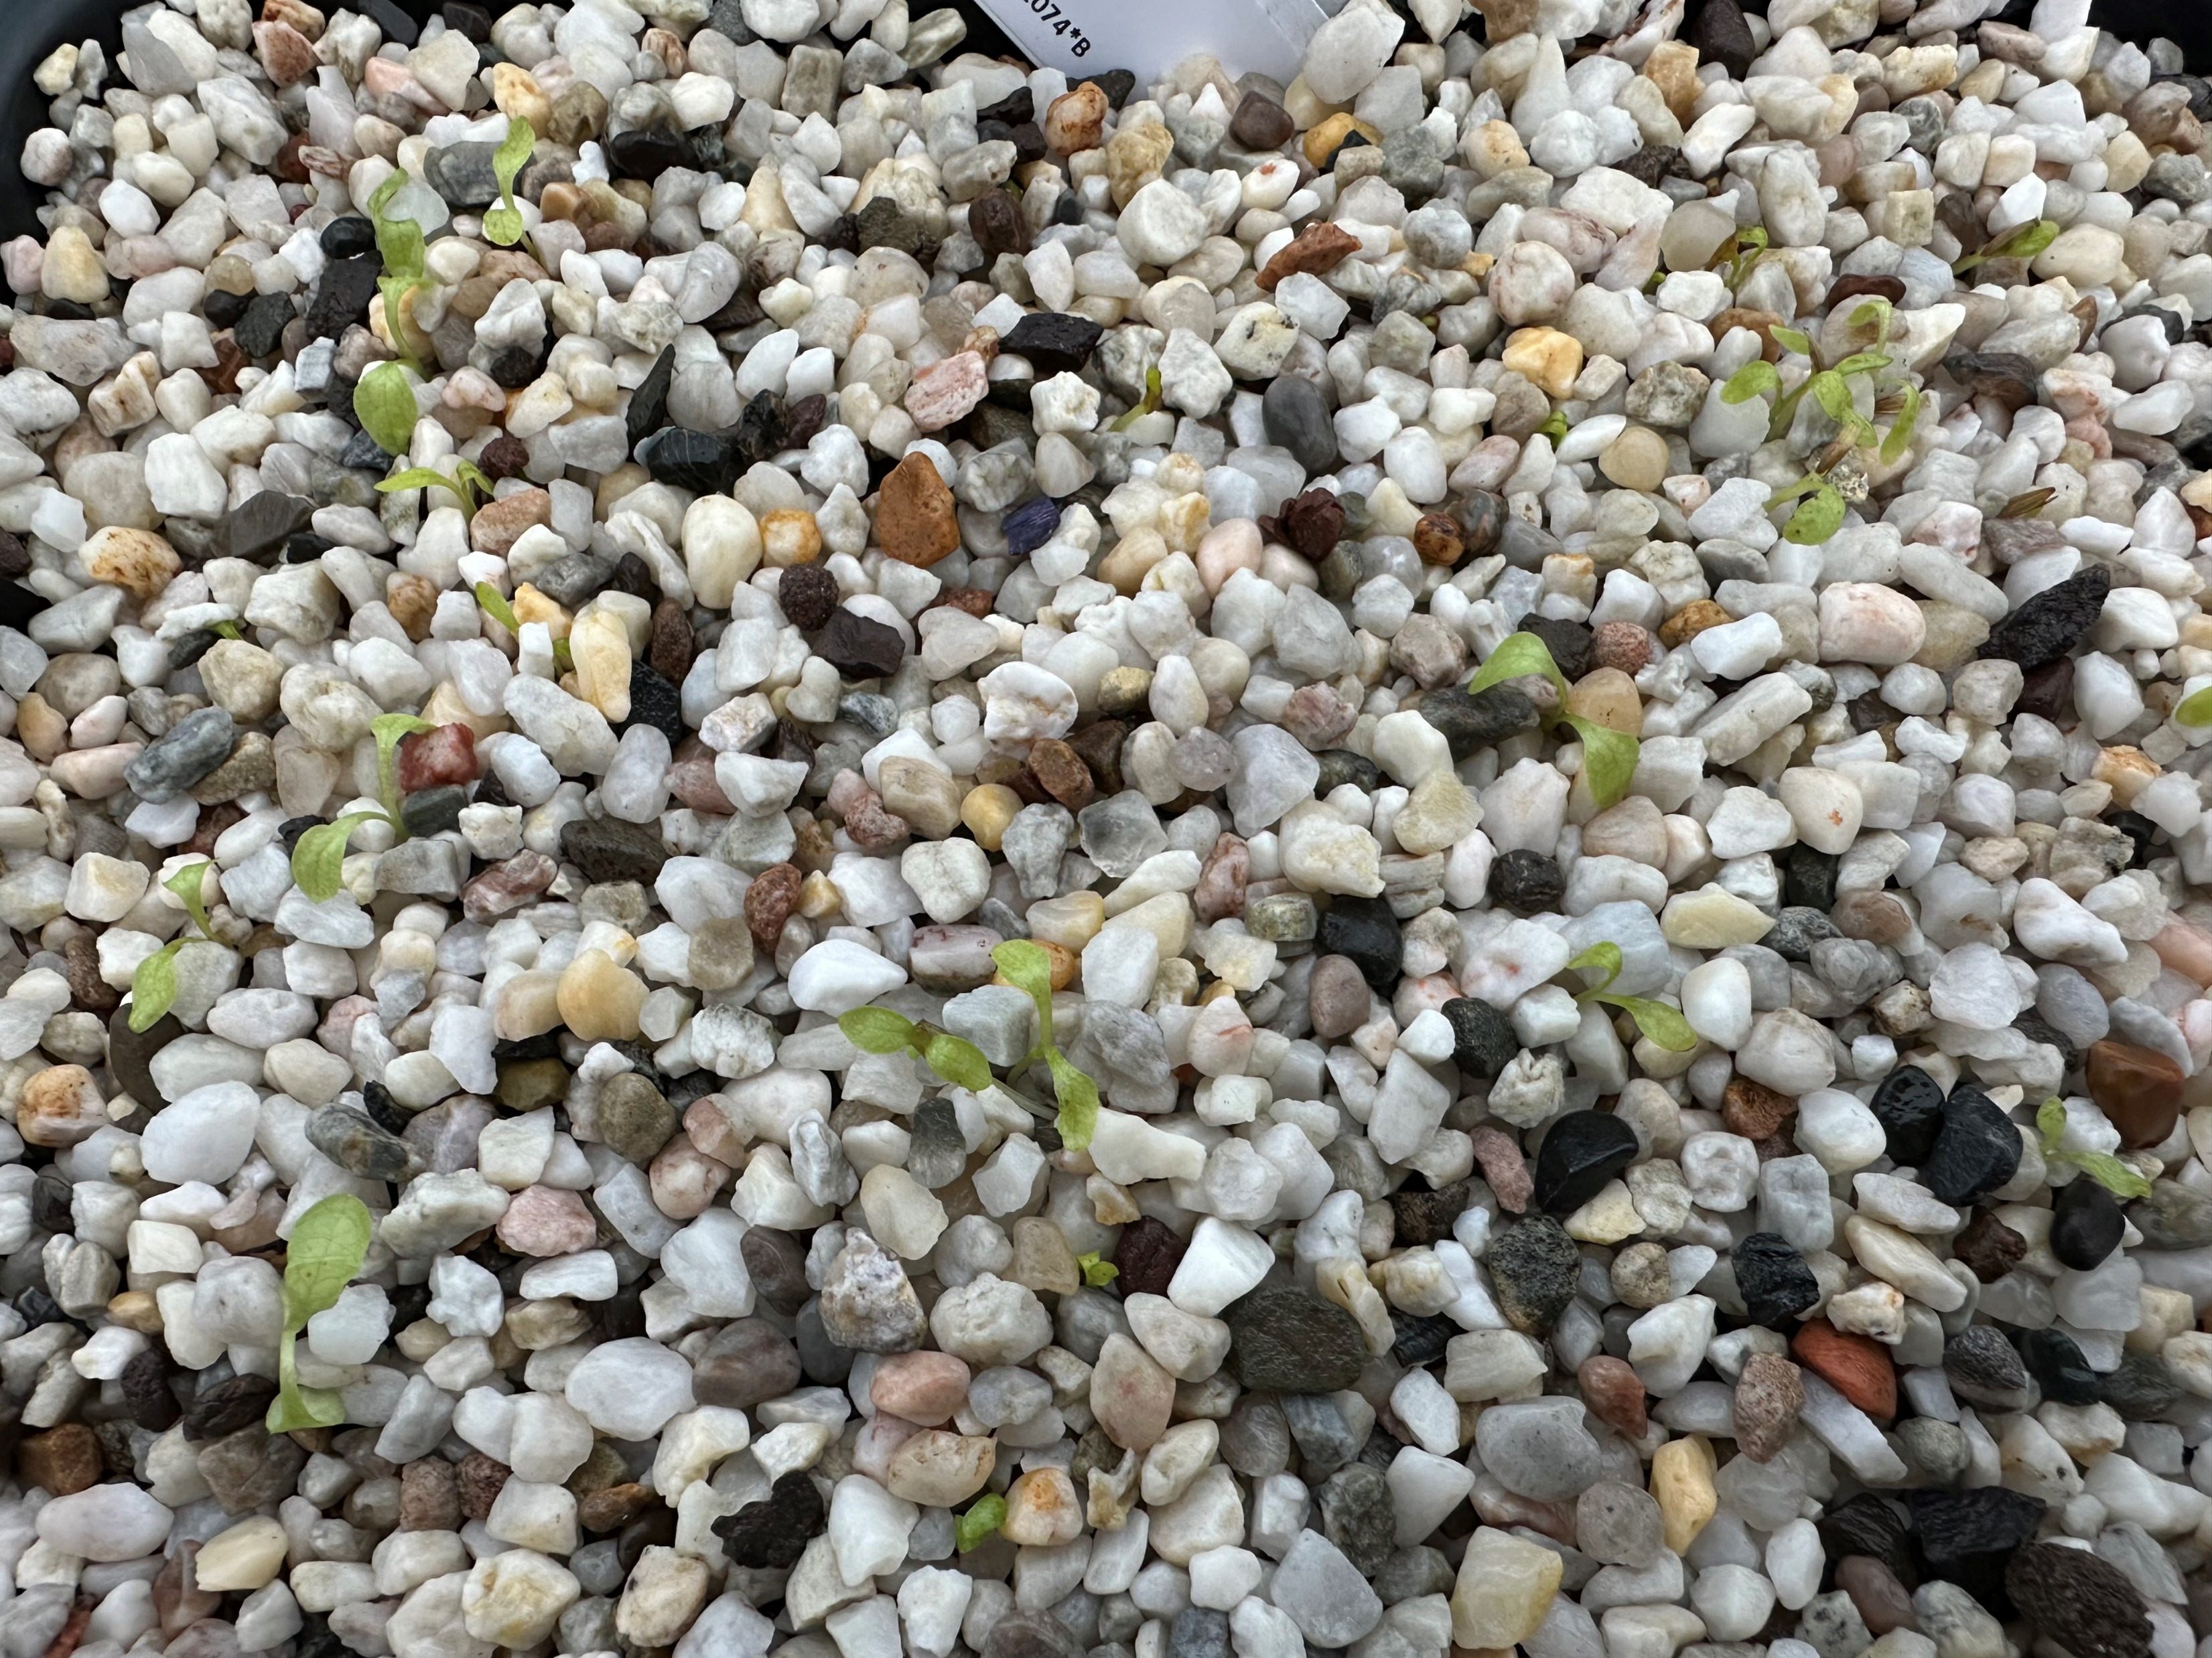
NRF 502209
Biodiversity Net Gain:
Biodiversity as a crucible for saving Scotland’s most threatened species.
Update January 2024
Prepared by Dr Aline Finger, afinger@rbge.org.uk
Nursery and lab:
Ulmus glabra genotyping continued and Melampyrum sylvaticum DNA extractions completed
Continuous care of current collection
Current number of plants in ex-situ collection:
Ulmus glabra: 273 seedlings + some softwood cuttings
Hedlundia / Sorbus complex: 91 seedlings (H. preudofennica: 19, H. arranensis: 16, H. pseudominicci: 56)
+ 2612 seed cleaned and placed into stratification
Malus sylvestris: Seed from 16 trees, 4,407 stratified + 25,000 dried and stored
Cicerbita alpina: 209 plants + 9725 seed sown (Scottish, Swiss + Norwegian)
Woodsia ilvensis: 447 plants + healthy sporophytes
Polygonatum verticillatum: 820 plants + 8886 seed sown (Scottish, Swiss + Norwegian)
Saxifraga hirculus: 51 plugs + 28 foreign seedlings
Melampyrum sylvaticum: 3,500 plants + 460 Scottish, 900 Swiss, 40 Norwegian seed
Vaccinium host started budding
Hedlundia seedlings continuing to grow well
NRF team weeding Woodisa ilvensis with volunteers Olli and Kathryn
Cicerbita alpina seed started germinating

Slide 3
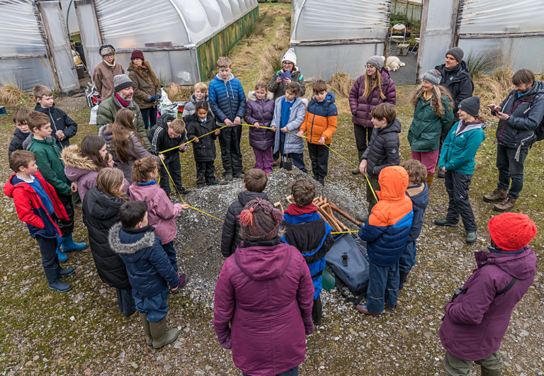
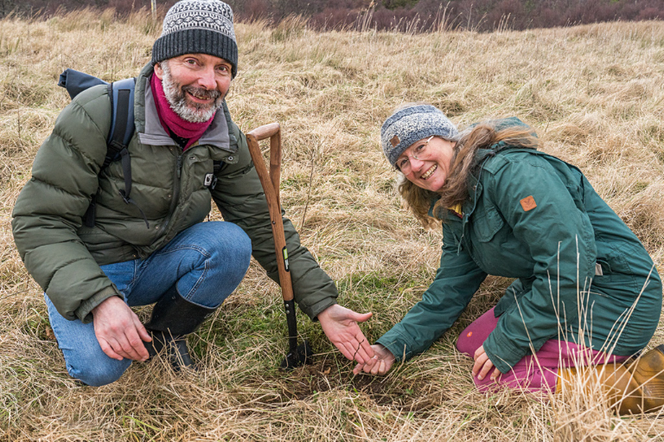
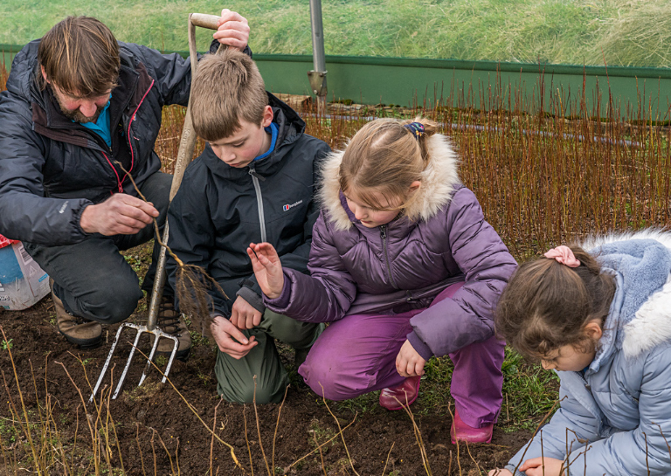
NRF 502209
Biodiversity Net Gain:
Biodiversity as a crucible for saving Scotland’s most threatened species.
Update January 2024
Prepared by Dr Aline Finger, afinger@rbge.org.uk
Field work:
Max Coleman was on a field trip to help the ceremonial planting of the first of potentially resilient NRF Ulmus glabra seedlings as well as other wych elm saplings at Little Assynt on Thursday 25th January 2024. 43 people attended, including 22 children from Lochinver Primary School. A write-up of the event is available as a Botanics blog post.
Tape indicating girth of Brahan Elm, Britain’s largest wych elm, that died from DED in 2021
Lochinver Primary School pupil planting a wych elm sapling
Max and Mandy Haggith planting 1 celebrational NRF Ulmus glabra tree
© Chris Puddephatt, chris@jacksonphotography.co.uk
Lifting wych elms at the Little Assynt tree nursery
© Chris Puddephatt, chris@jacksonphotography.co.uk
© Chris Puddephatt, chris@jacksonphotography.co.uk
© Chris Puddephatt, chris@jacksonphotography.co.uk

Slide 4
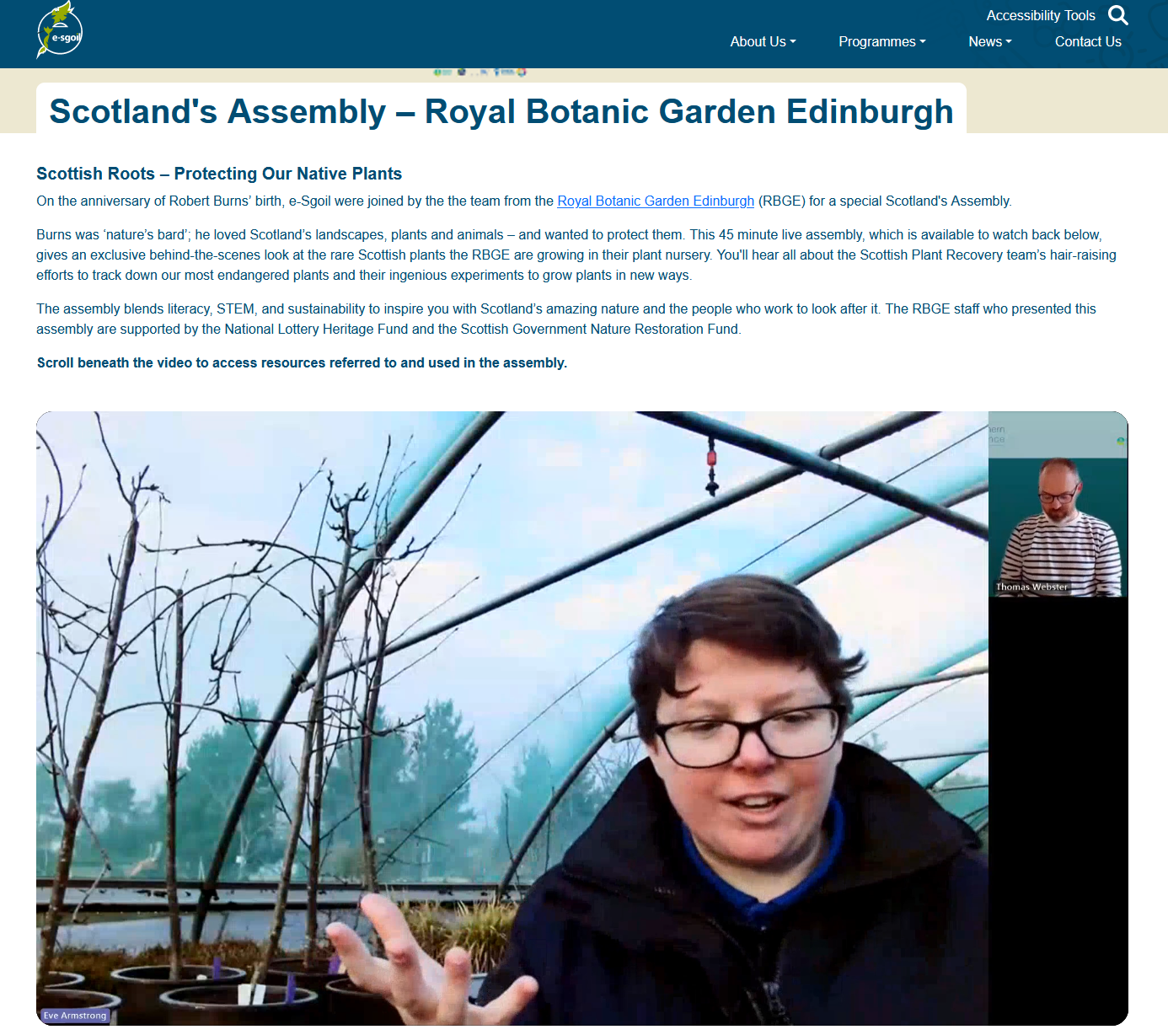
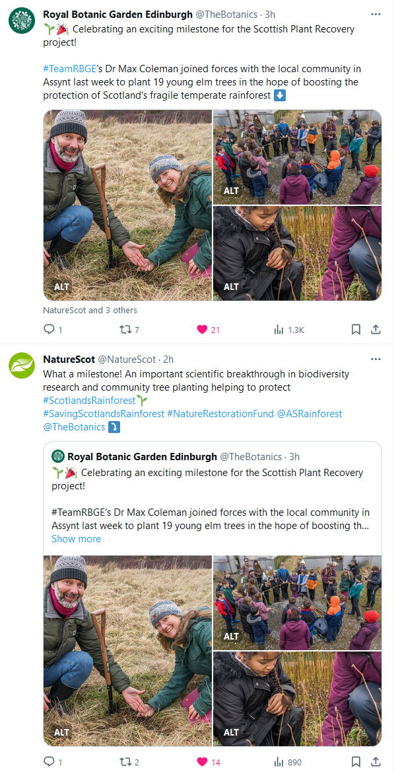
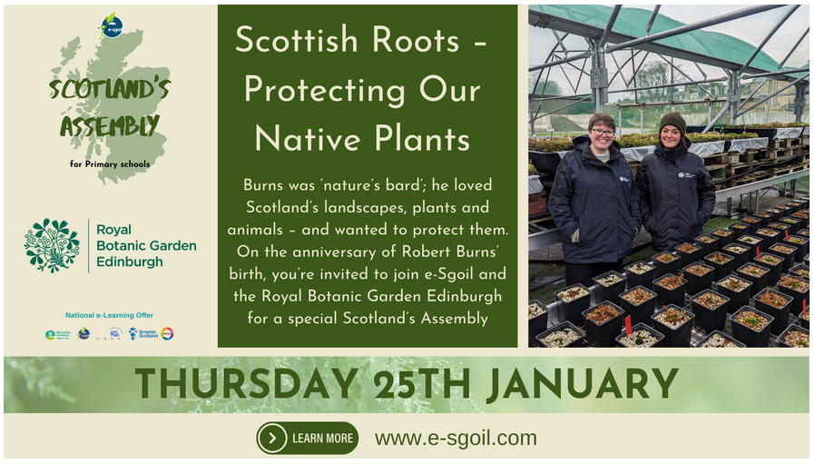
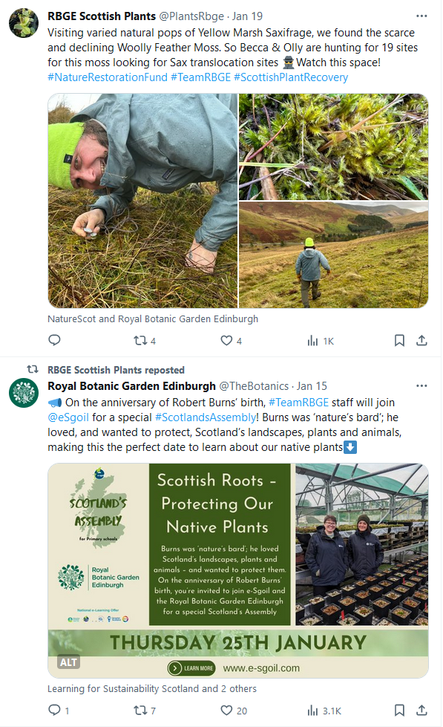
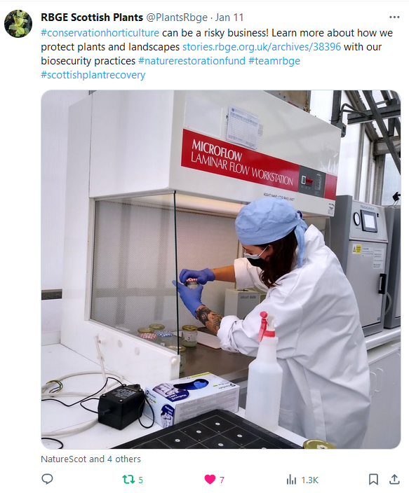
NRF 502209
Biodiversity Net Gain:
Biodiversity as a crucible for saving Scotland’s most threatened species.
Update January 2024
Prepared by Dr Aline Finger, afinger@rbge.org.uk
Communication, press and publications:
Project gets a mention in an article about the Botanics, The Scotsman on 7th January ‘24
New Botanic Stories blog available on the Assynt wych elm event: https://stories.rbge.org.uk/archives/38488
We continued to create weekly social media posts.
We facilitated an online assembly at the nursery where Eve Armstrong shared stories, visuals and activities to celebrate the work of the Scottish Plant Recovery team. About 10 schools visited the nursery virtually, from Falkirk, Westray, Barra, Lewis, Edinburgh and more. Becca appeared as a special guest. A recording is available at https://e-sgoil.com/scotlands-assembly-royal-botanic-garden-edinburgh/
Article in Hort Week on wych elm planting at Assynt (26.01.24)
Plans for February 2024:
Continue maintenance of nursery plants
Continue genotyping Ulmus glabra samples
Genotyping Melampyrum sylvaticum samples
Hardwood cuttings for Ulmus glabra
Prepare Ulmus glabra pollinations
Ulmus glabra visit final planting sites prior to planting in spring, for detailed planning, incl. biosecurity assessments
Online Assembly presenting the Scottish Plant Recovery project
Some of our latest social media posts

