Slide 1
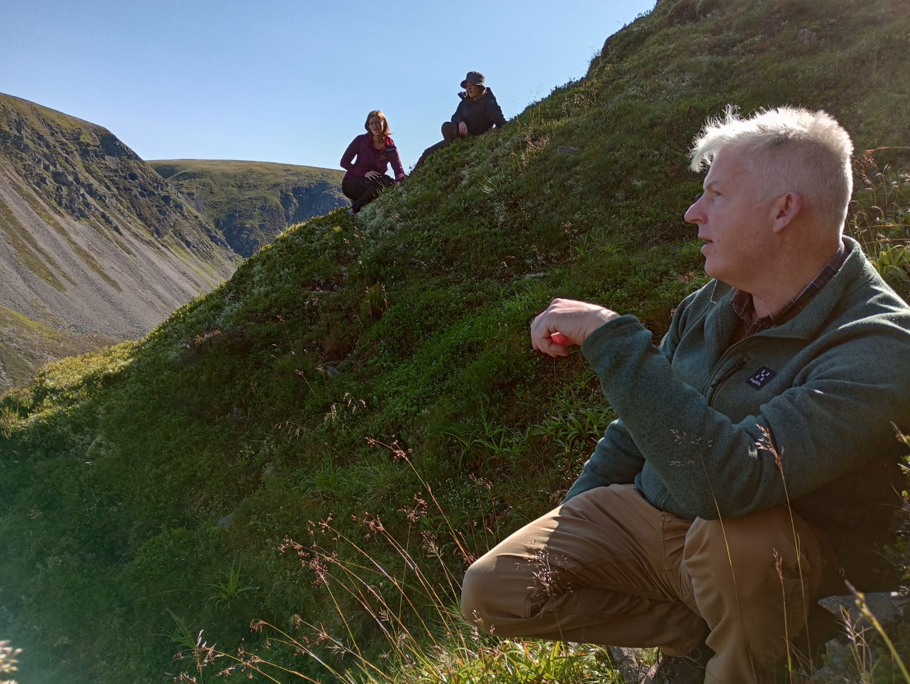



NRF 502209
Biodiversity Net Gain:
Biodiversity as a crucible for saving Scotland’s most threatened species.
Update July 2023
Prepared by Dr Aline Finger, afinger@rbge.org.uk
General:
Partner meeting: Thomas Macdonald joined us to a field trip at Glenfeshie to discuss previous translocations and a strategy for new sites for different species
Ongoing work has been done on a restoration biosecurity strategy in collaboration with Dr Ruth Mitchell and the Plant Health Centre
New contact has been established with Peter Livingstone from Eadha Enterprises to possibly collaborate on Hedlundia work
Collation of available information on horticulture has continued
Collation of information on species ecology and habitat requirements: documents are constantly being updated as soon as we receive new information on a species
More partners / interested groups have joined the project, now 37
Regular, minuted RBGE meetings (generally Mondays 9.45-11.45) are being held to ensure effective workflow and communication
Project partner Thomas Macdonald (Glenfeshie) in the field with RBGE
Current list of external partners / interested parties

Slide 2
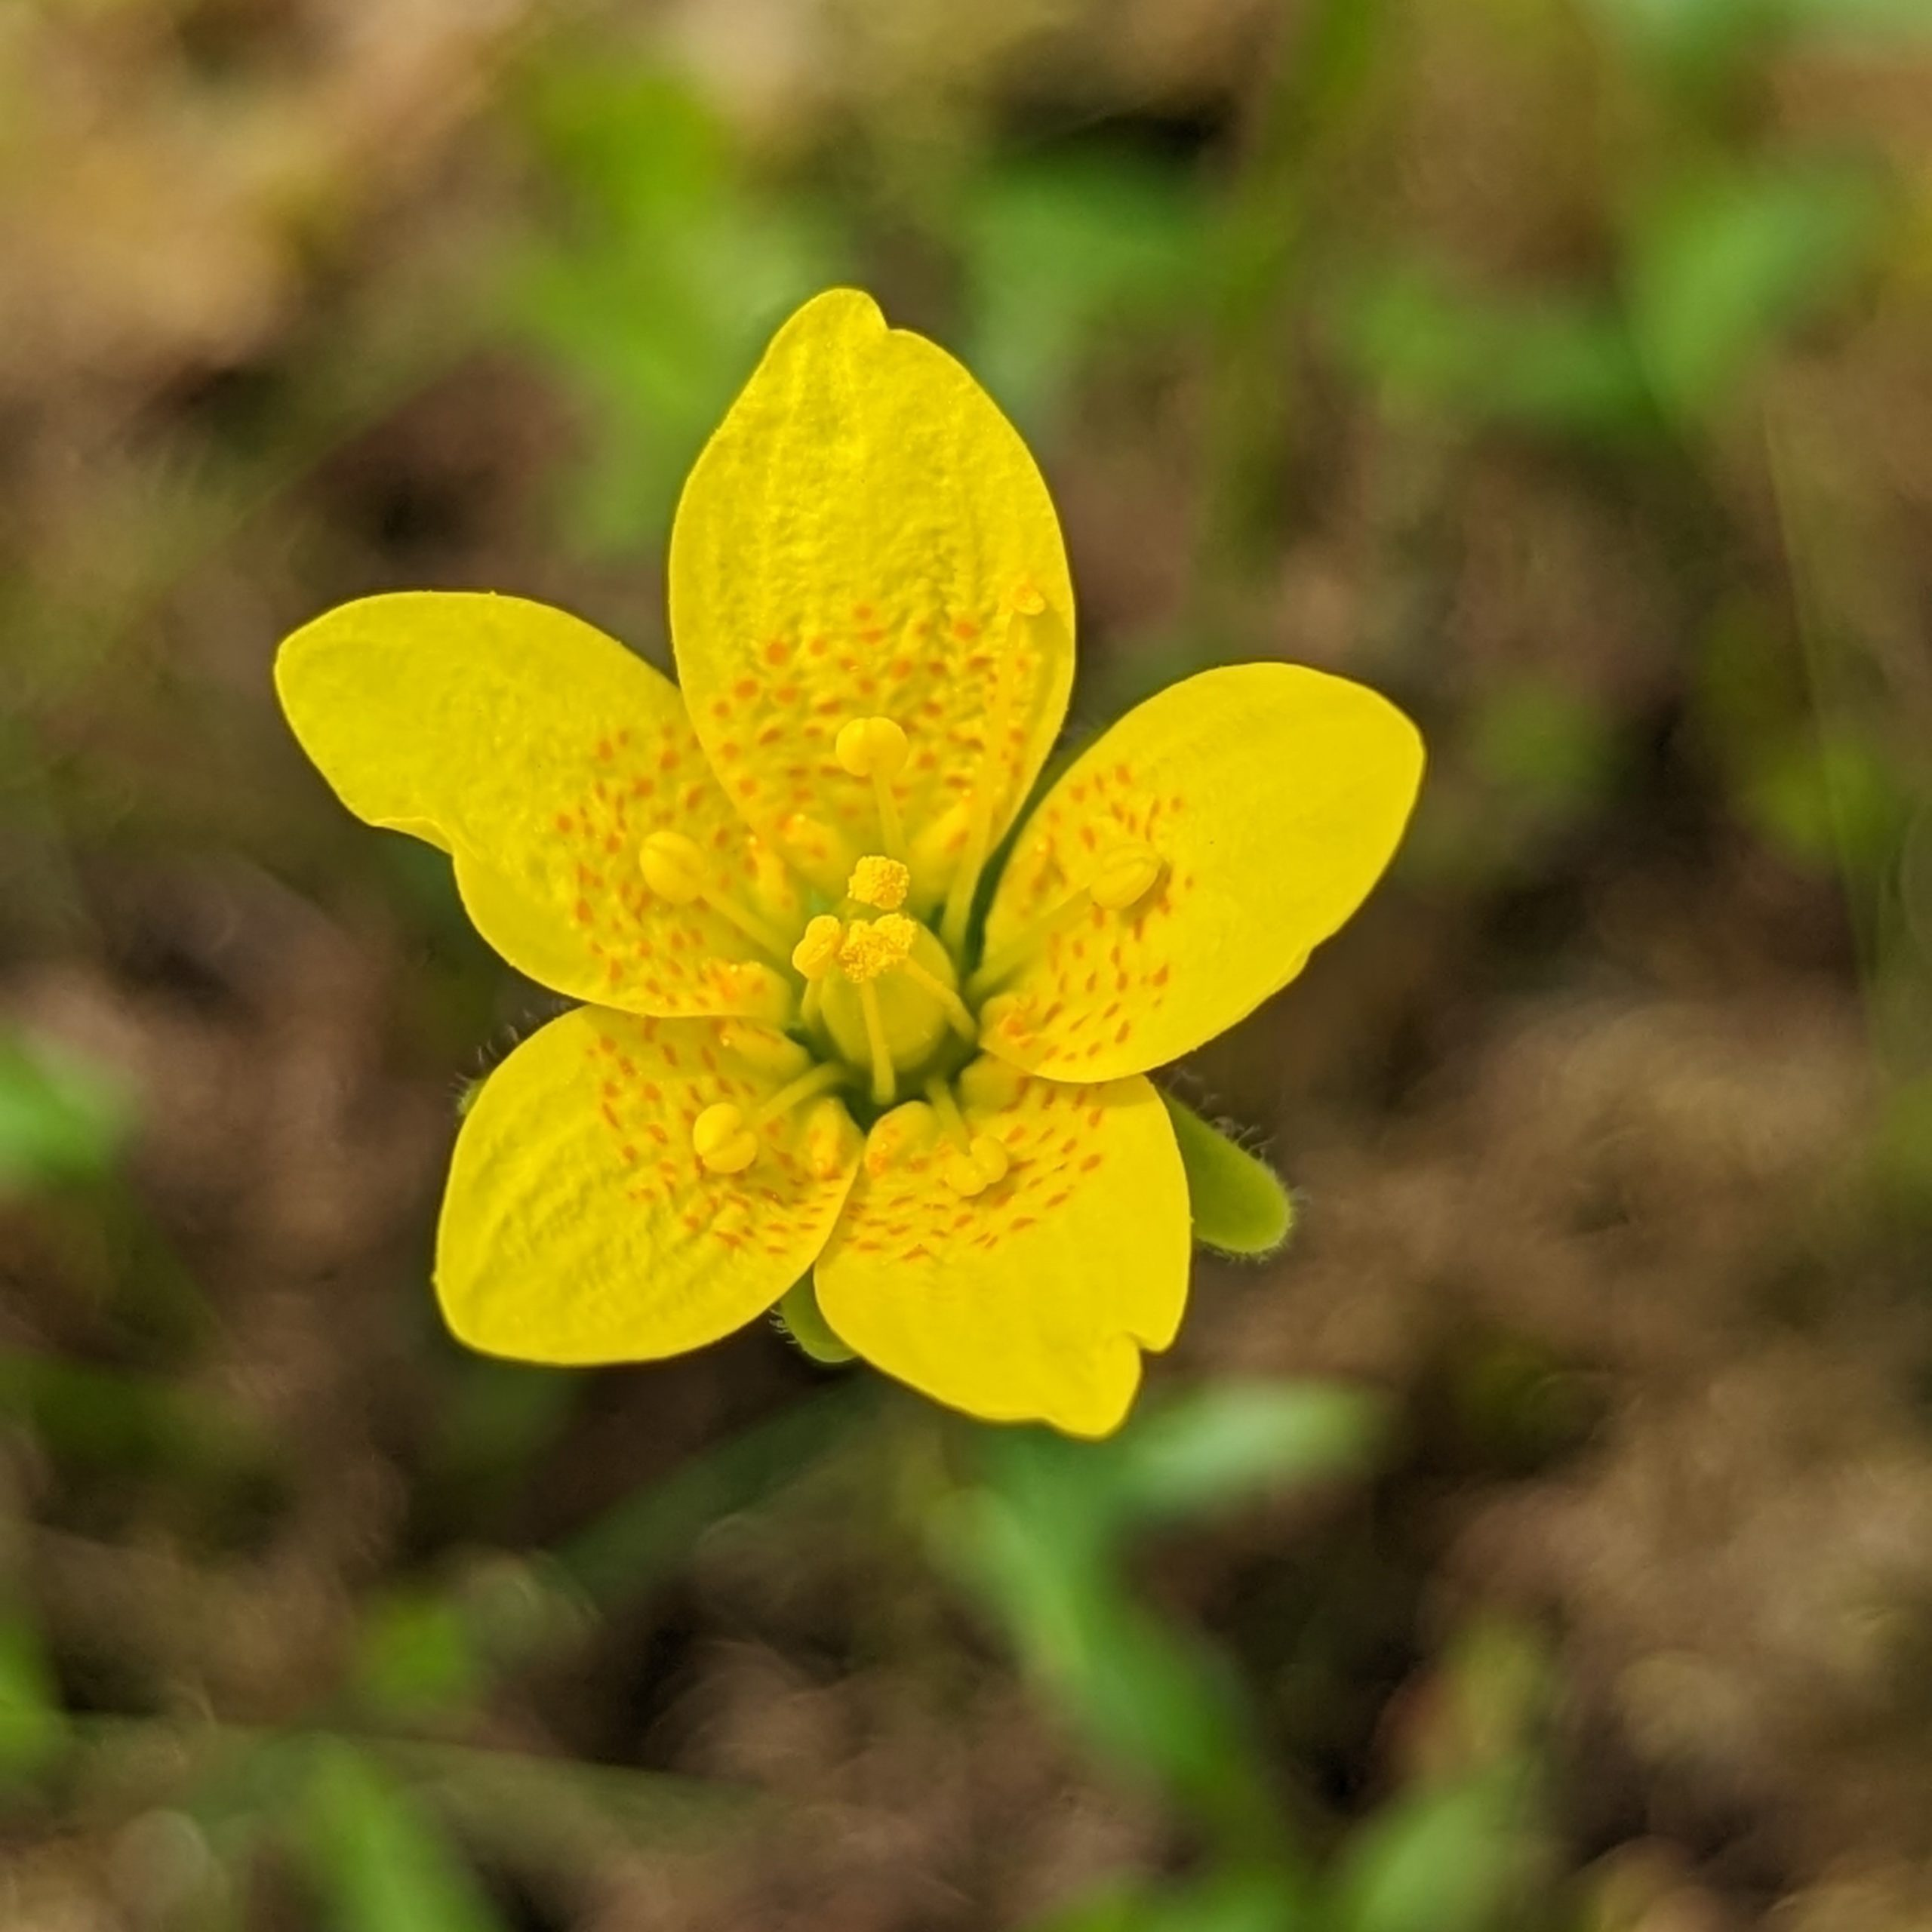
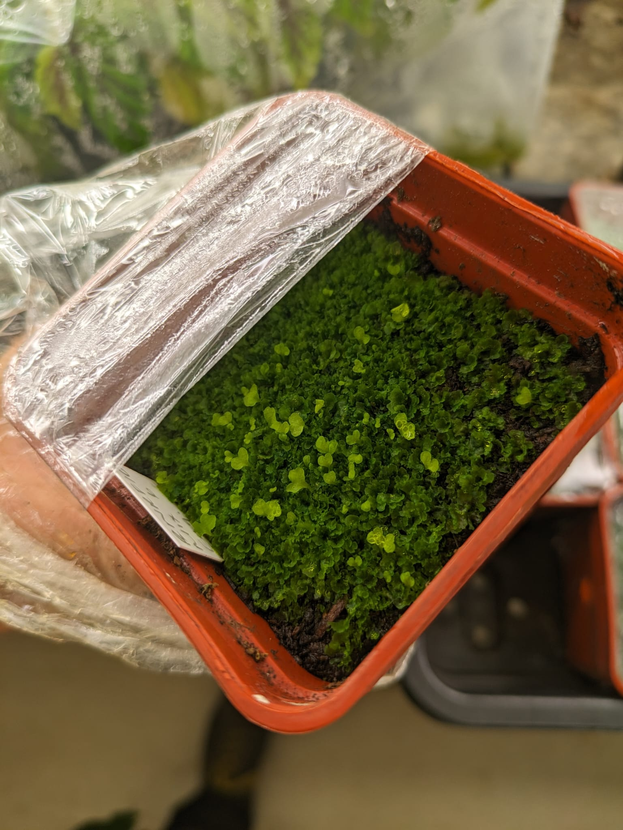
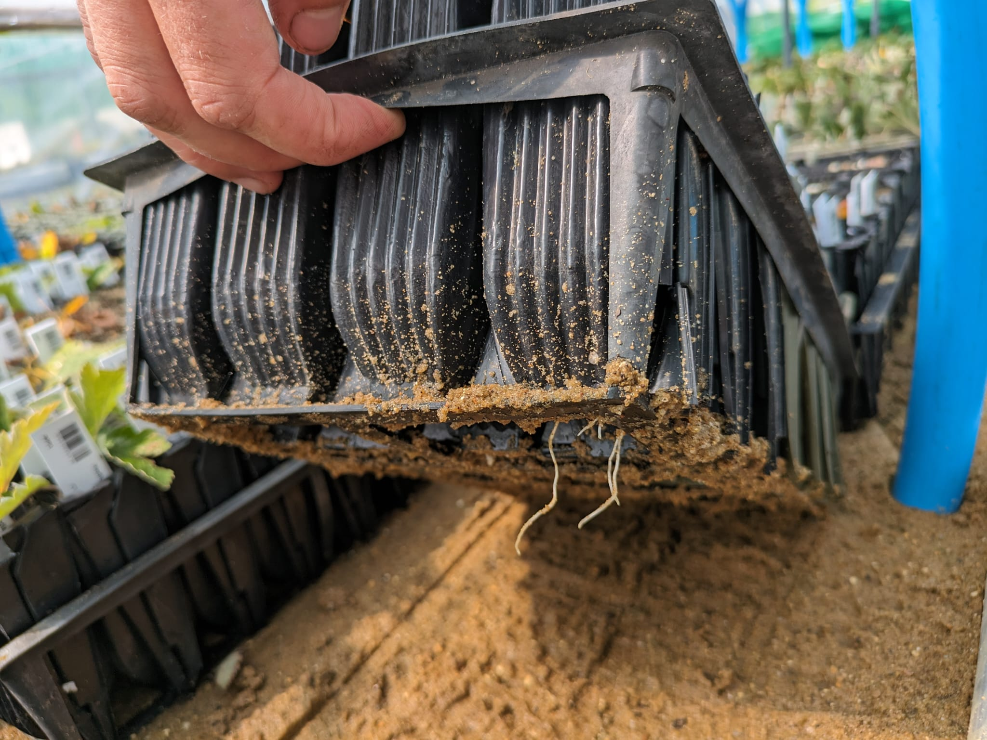
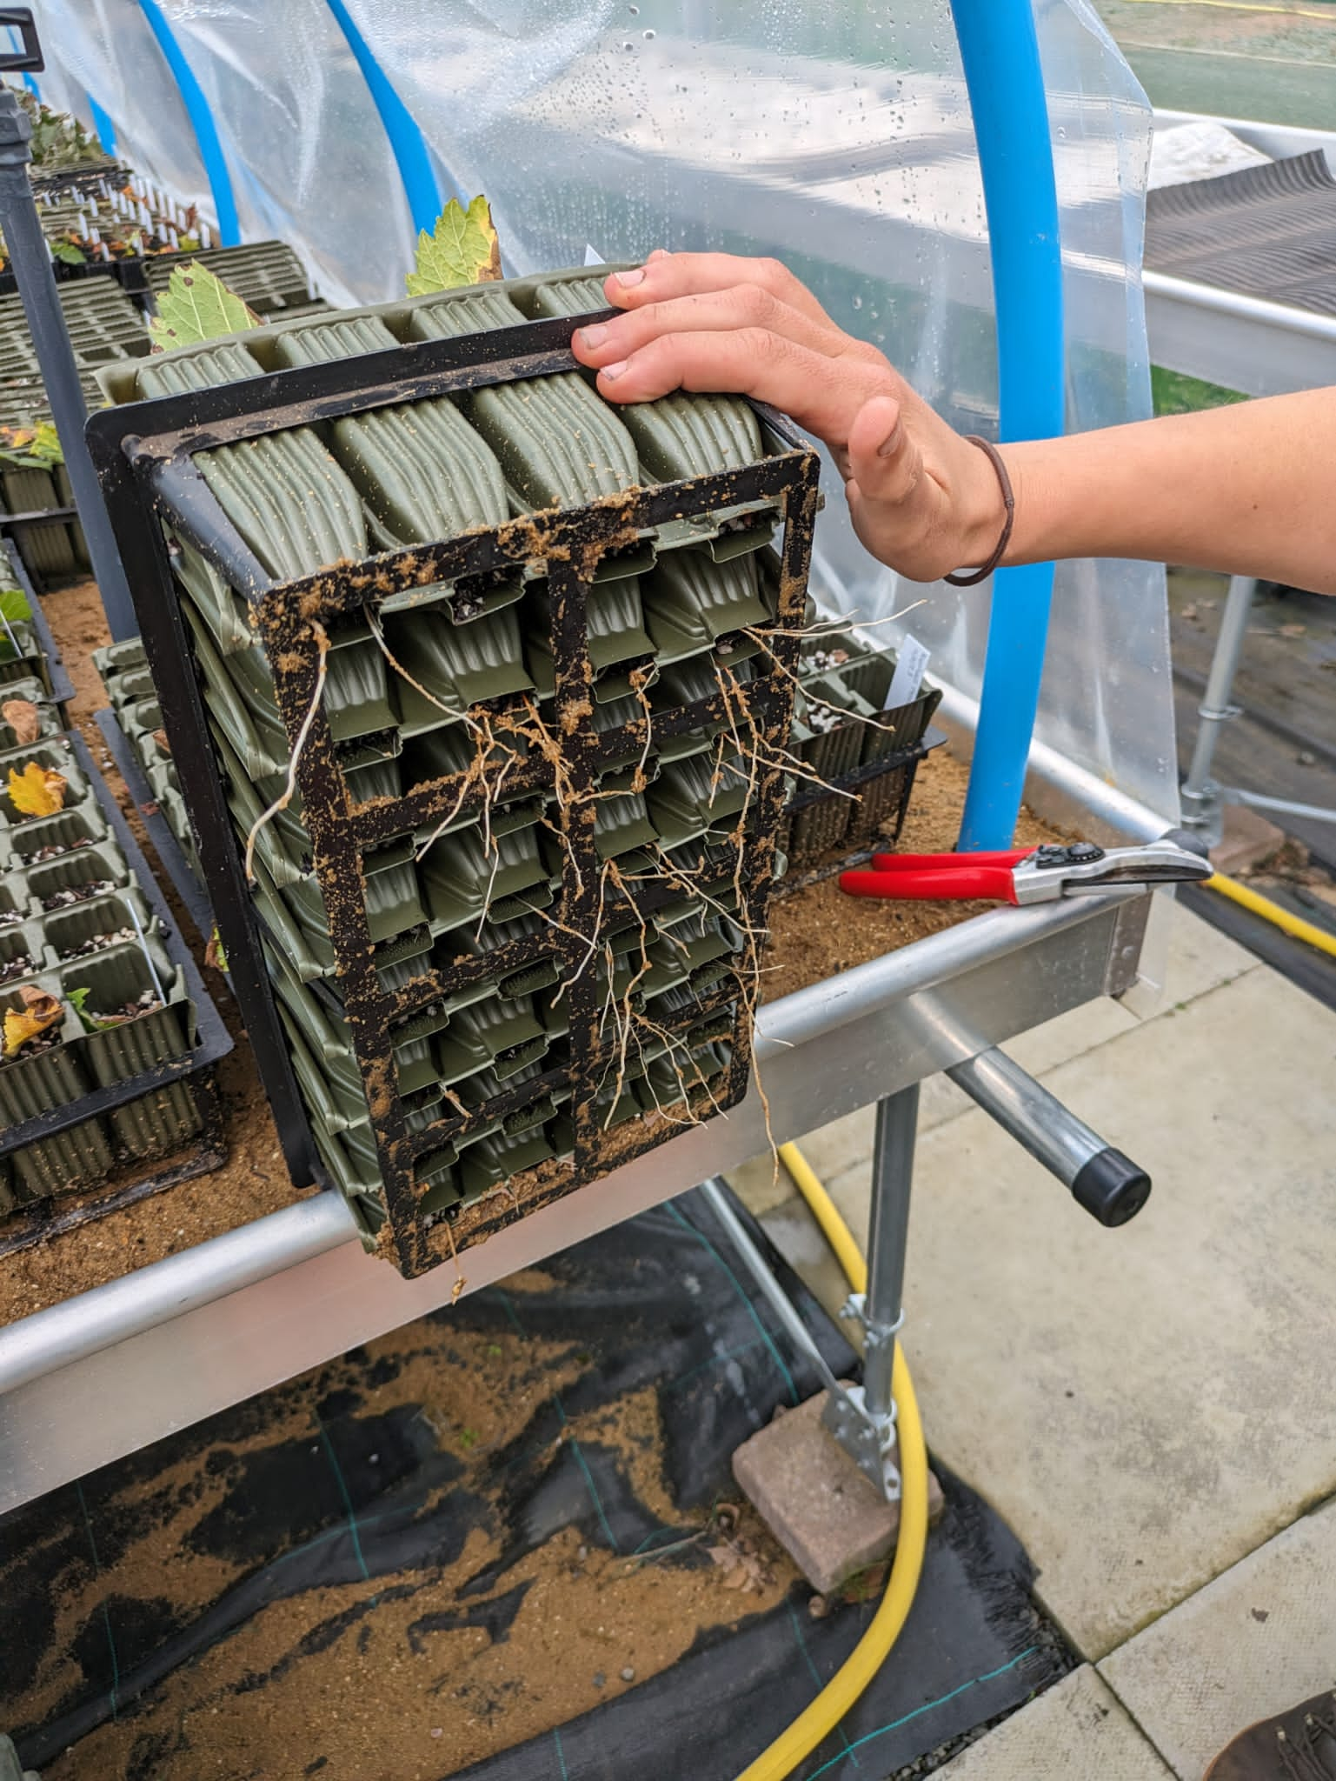
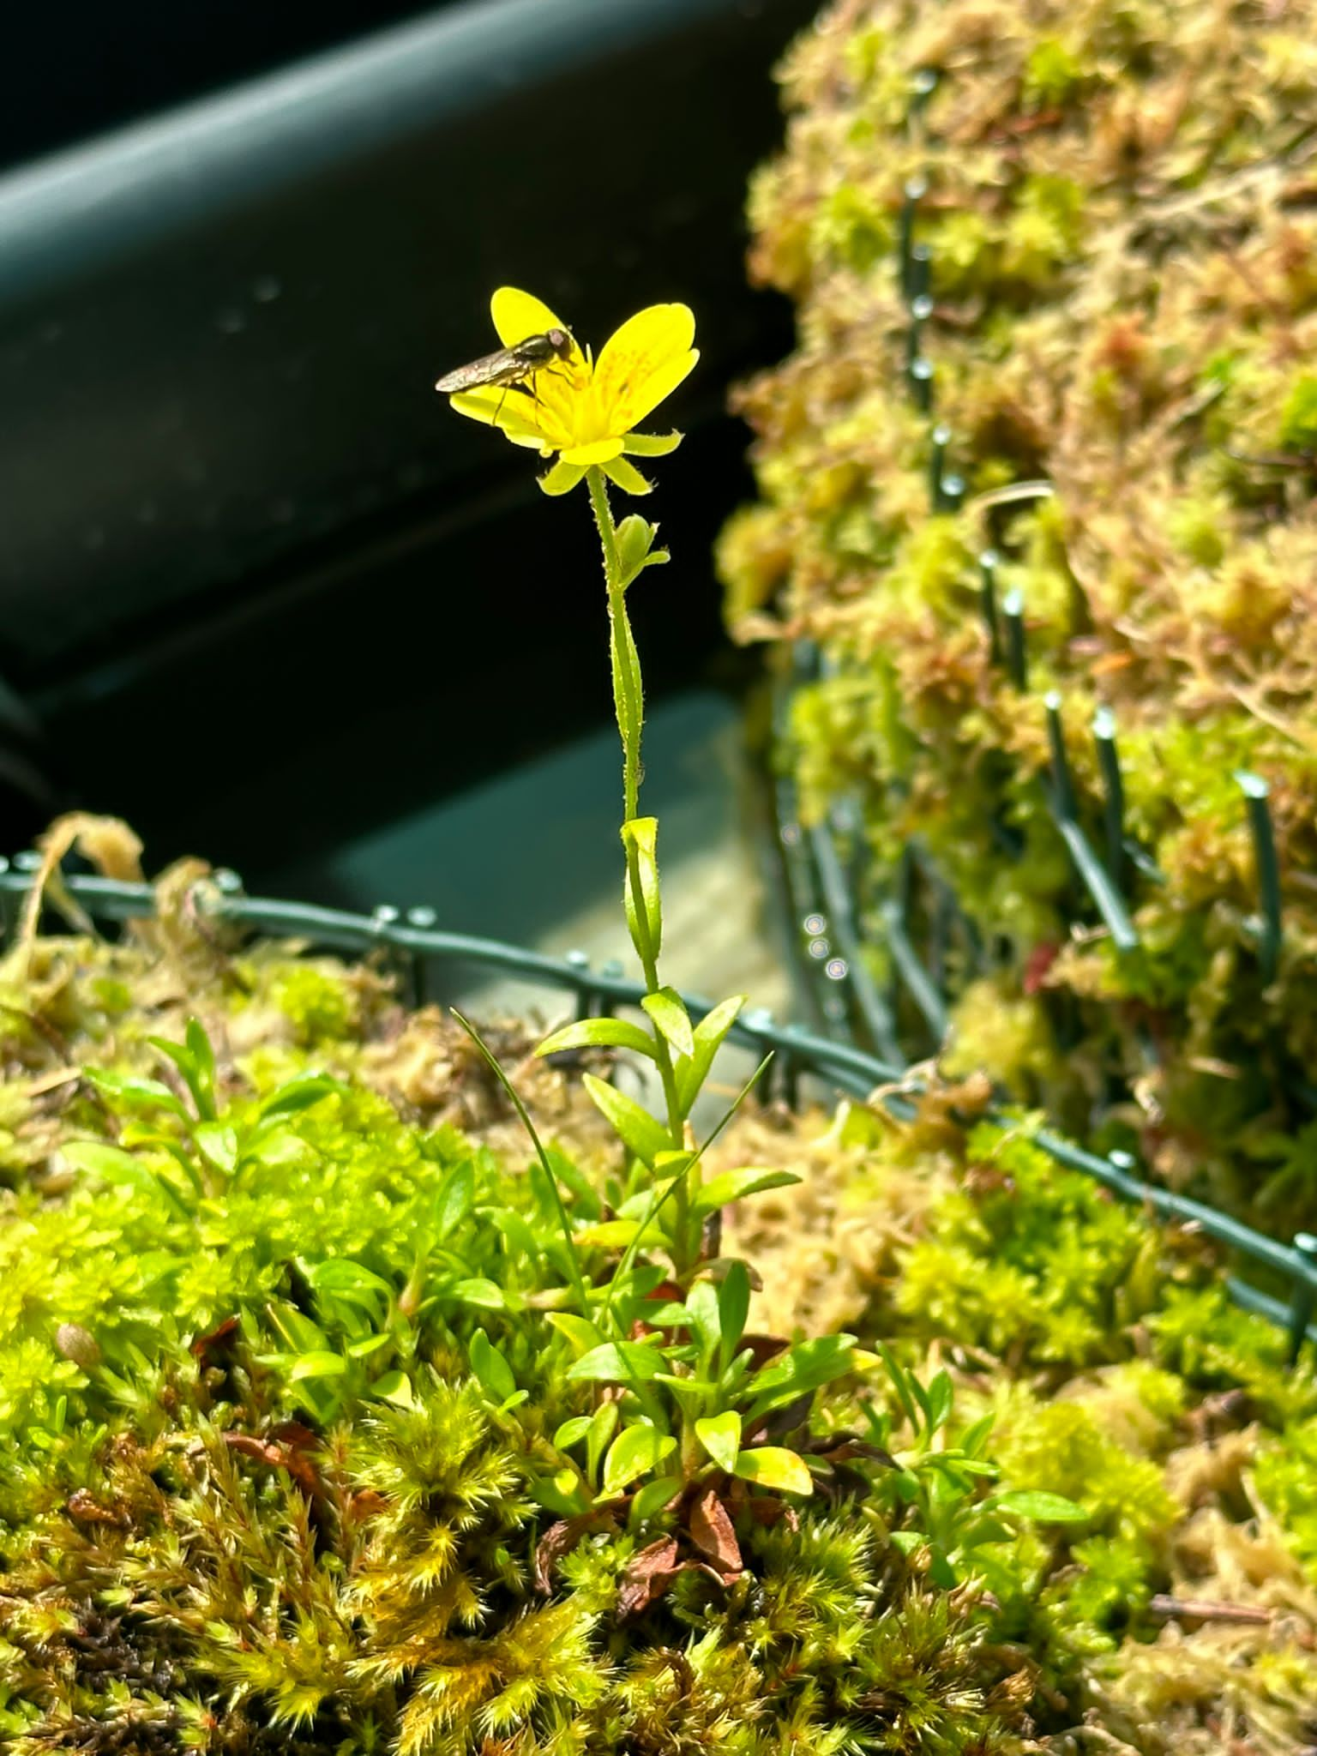
NRF 502209
Biodiversity Net Gain:
Biodiversity as a crucible for saving Scotland’s most threatened species.
Update July 2023
Prepared by Dr Aline Finger, afinger@rbge.org.uk
Nursery and lab:
Hedlundia complex: micro-propagation material requires continuous, regular cleaning
Ulmus glabra and Hedlundia cuttings have started to grow and produce roots
Saxifraga hirculus flowering in the nursery, open pollination allowing for cross-pollination
Woodsia ilvensis sporophytes are growing
Current number of plants in ex-situ collection:
Ulmus glabra: 377 seeds sown (259 germinated) + >1,748 cuttings
Hedlundia / Sorbus complex: 290 micro-prop samples (~15 produced leaves) + 143 cuttings
Cicerbita alpina: 209
Woodsia ilvensis: 447 + spores developing
Polygonatum verticillatum: 822
Saxifraga hirculus: 51 plugs + 100 seeds sown
Melampyrum sylvaticum: ~3500
Saxifraga hirculus flowering in the nursery
Woodsia ilvensis crossed spores are developing
Ulmus glabra and Hedlundia cuttings have started to produce first roots

Slide 3
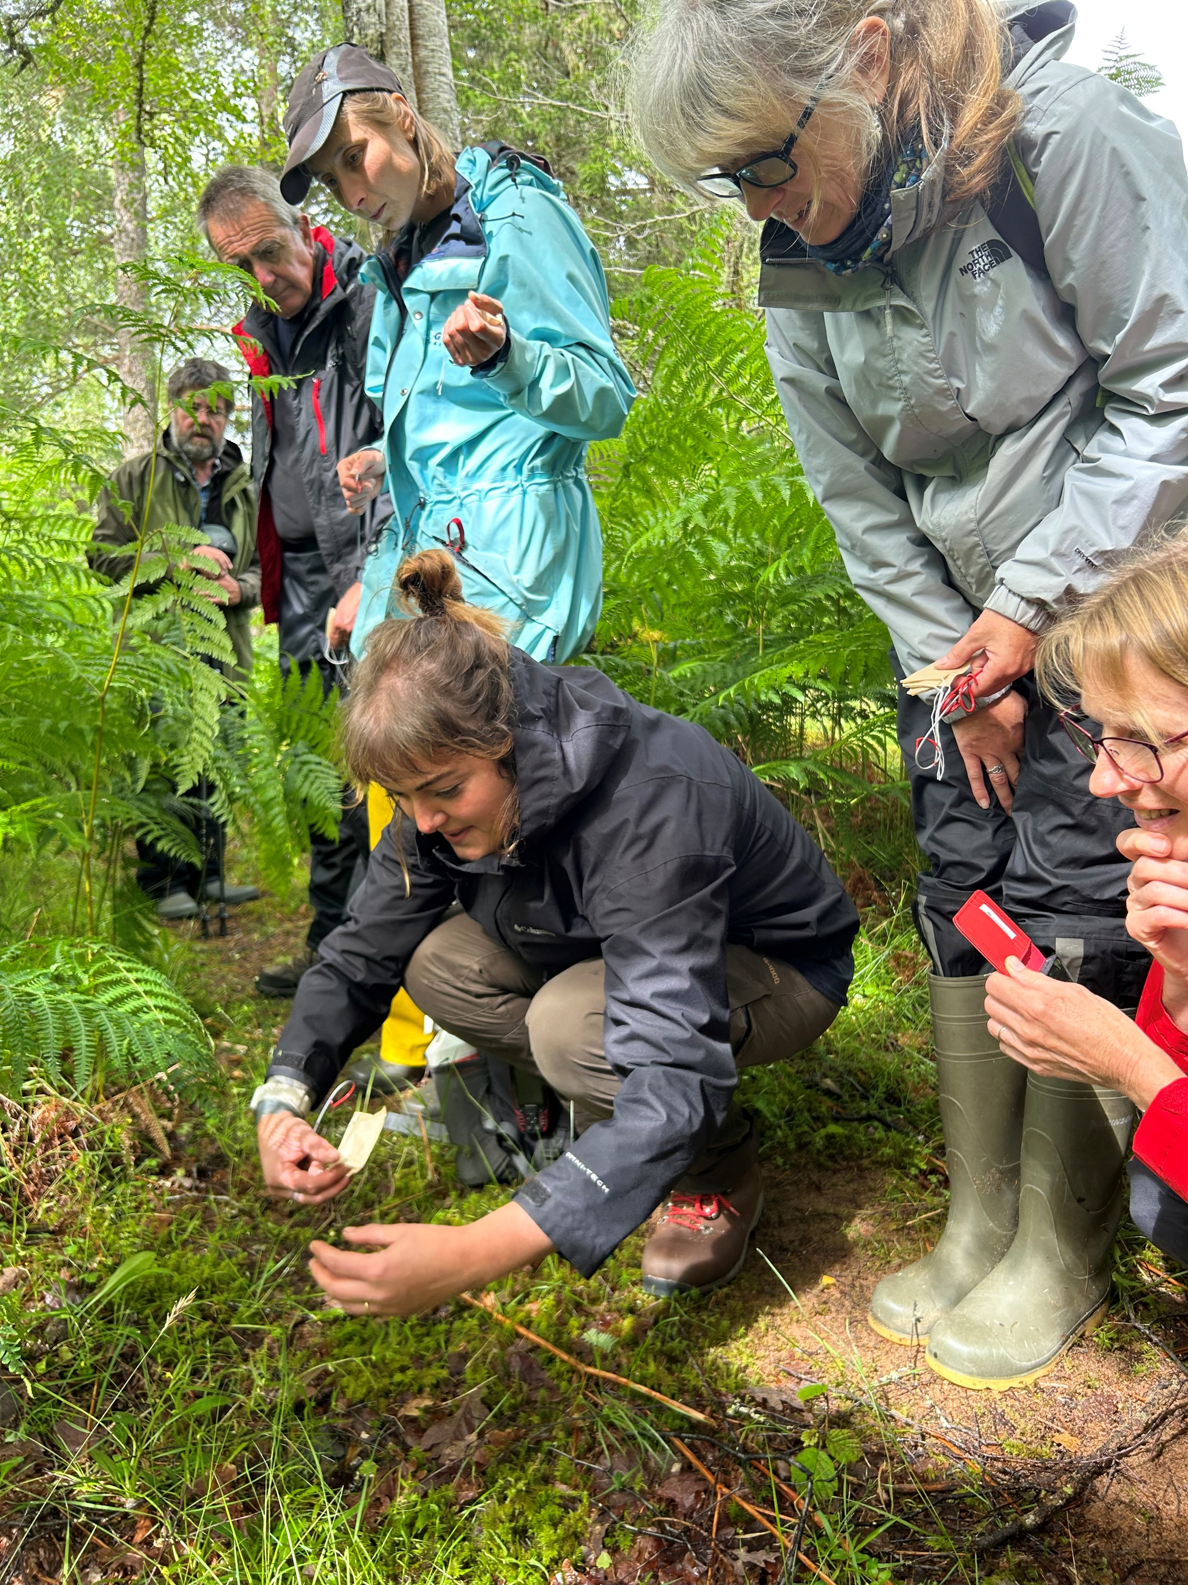
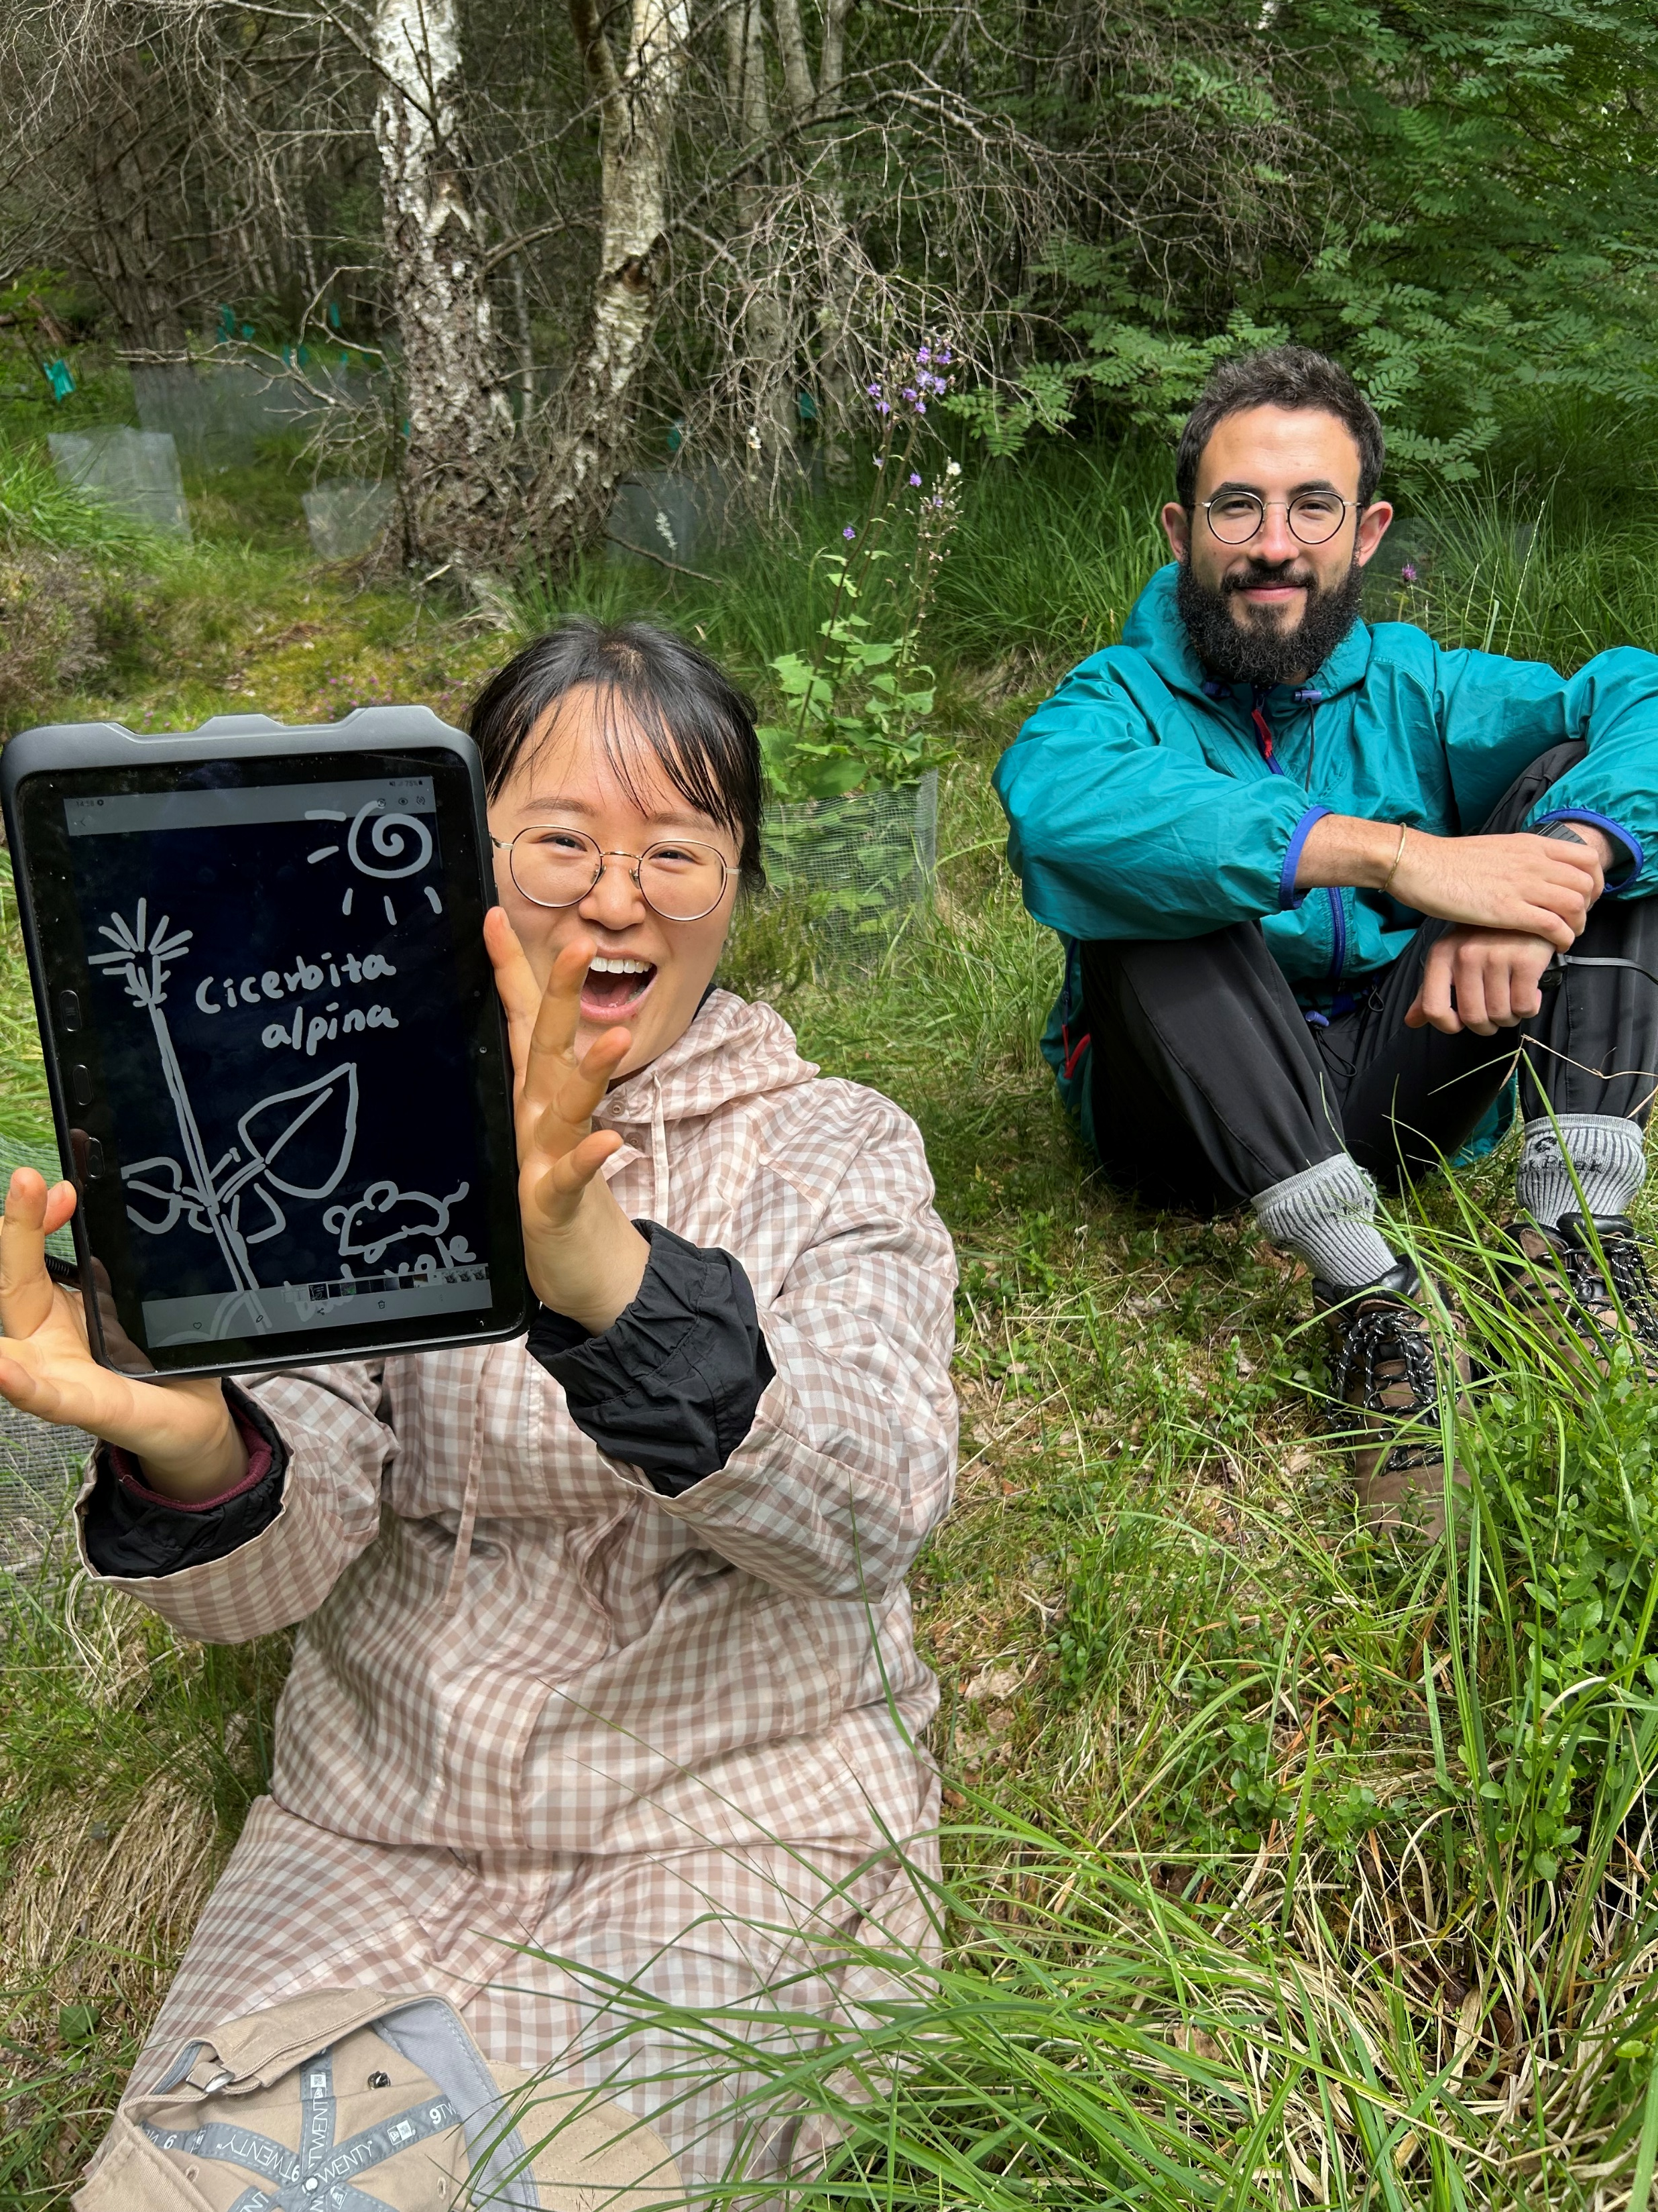
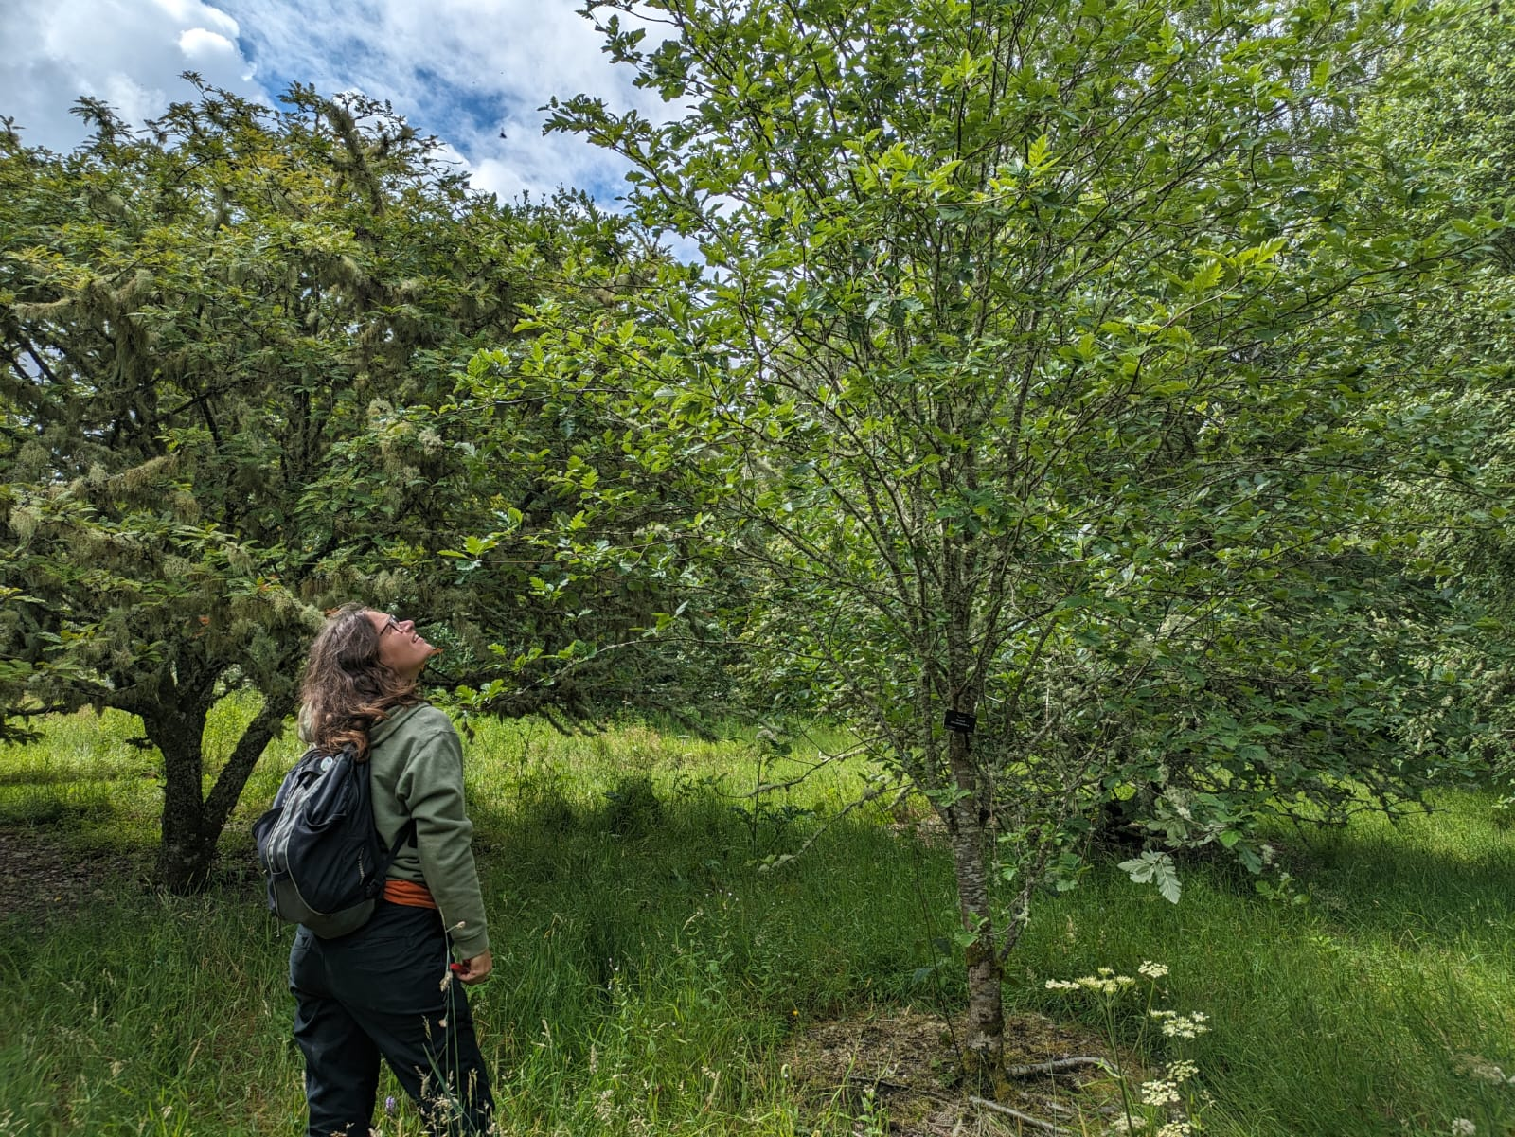
NRF 502209
Biodiversity Net Gain:
Biodiversity as a crucible for saving Scotland’s most threatened species.
Update July 2023
Prepared by Dr Aline Finger, afinger@rbge.org.uk
Field work:
Visit to Arkaig, Bridge of Ericht, West Affric to check on Melampyrum sylvaticum seeds and explore potential planting sites
Hedlundia ex-situ collections have been visited and cuttings taken
Visits to Mar Lodge, Glenlochay and Glenfeshie to check Cicerbita alpina 2021 translocations and explore new planting sites
Partners in Switzerland have collected Melampyrum sylvaticum seed for us
Becca Drew bagging Melampyrum sylvaticum seeds with members of the Arkaig Forest Community Group
Volunteers Jungmin Lee and Diego Sanchez in front of 2021 Cicerbita alpina plantings at Mar Lodge
Emma Beckinsale and Rachel Robinson taking Hedlundia cuttings from ex-situ collections across Scotland

Slide 4
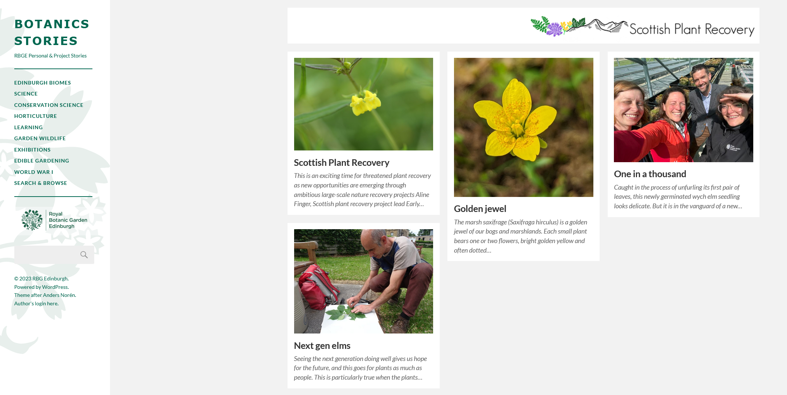
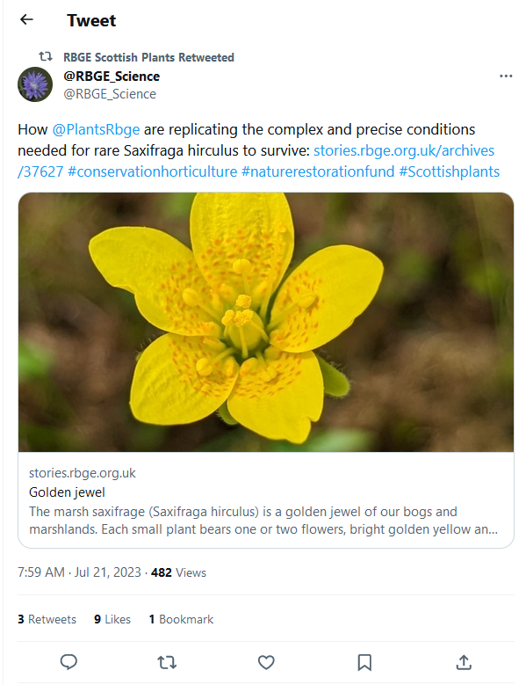
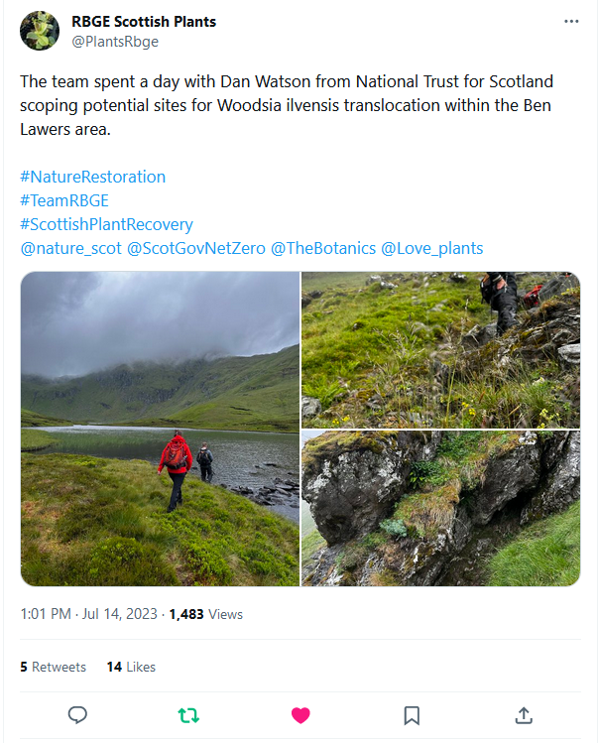
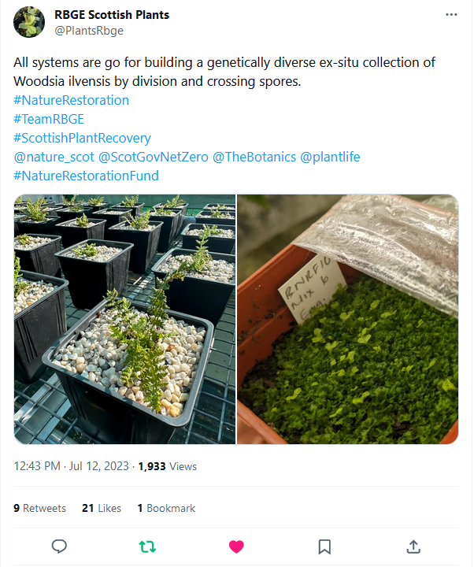
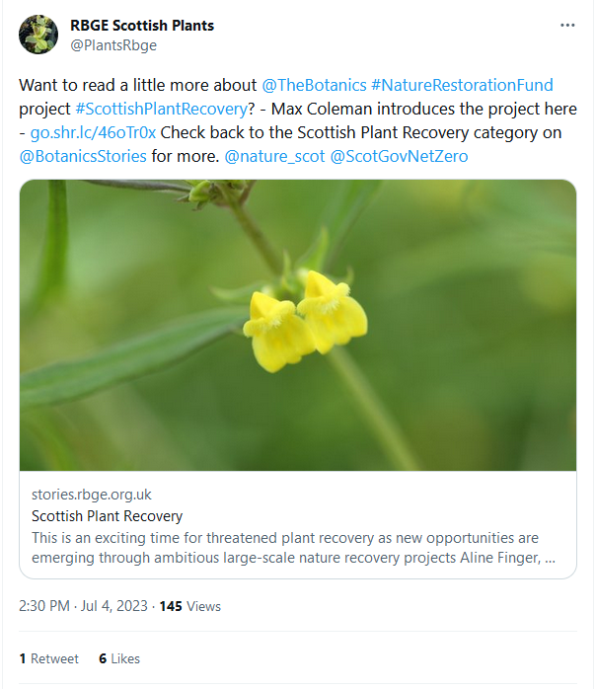
NRF 502209
Biodiversity Net Gain:
Biodiversity as a crucible for saving Scotland’s most threatened species.
Update July 2023
Prepared by Dr Aline Finger, afinger@rbge.org.uk
NRF Botanic Stories blogs
Communication, press and publications:
A new Botanics Stories blog by Becca Drew-Galloway has appeared on the Saxifraga hirculus: https://stories.rbge.org.uk/archives/37627
We continued to create 1-3 project relevant social media posts per week, appearing on each Twitter, Instagram, Facebook
Aline Finger talked to freelance reporter Anthea Batsakis about the project, no release dates known yet
Landward indicated their interest in producing a follow-up story on the Ulmus glabra project
Max Coleman has written chapter for a Ulmus glabra book edited by KEW. A photographer spent time in the Nursery and took pictures.
Plans for July 2023:
Continue propagation, weeding, maintenance of existing plants
Collect foreign plant collections
Start microsatellite work for Ulmus glabra and Hedlundia
Work on project specific webpage
Continue expanding biosecurity and isolation areas in the nursery
Finalise and process Melampyrum sylvaticum seed collections
Site visits for Ulmus glabra planting sites and DNA collections in collaboration with Euan Bowditch
https://stories.rbge.org.uk/archives/category/scottish-plant-recovery
Some of our latest social media posts

