Slide 1
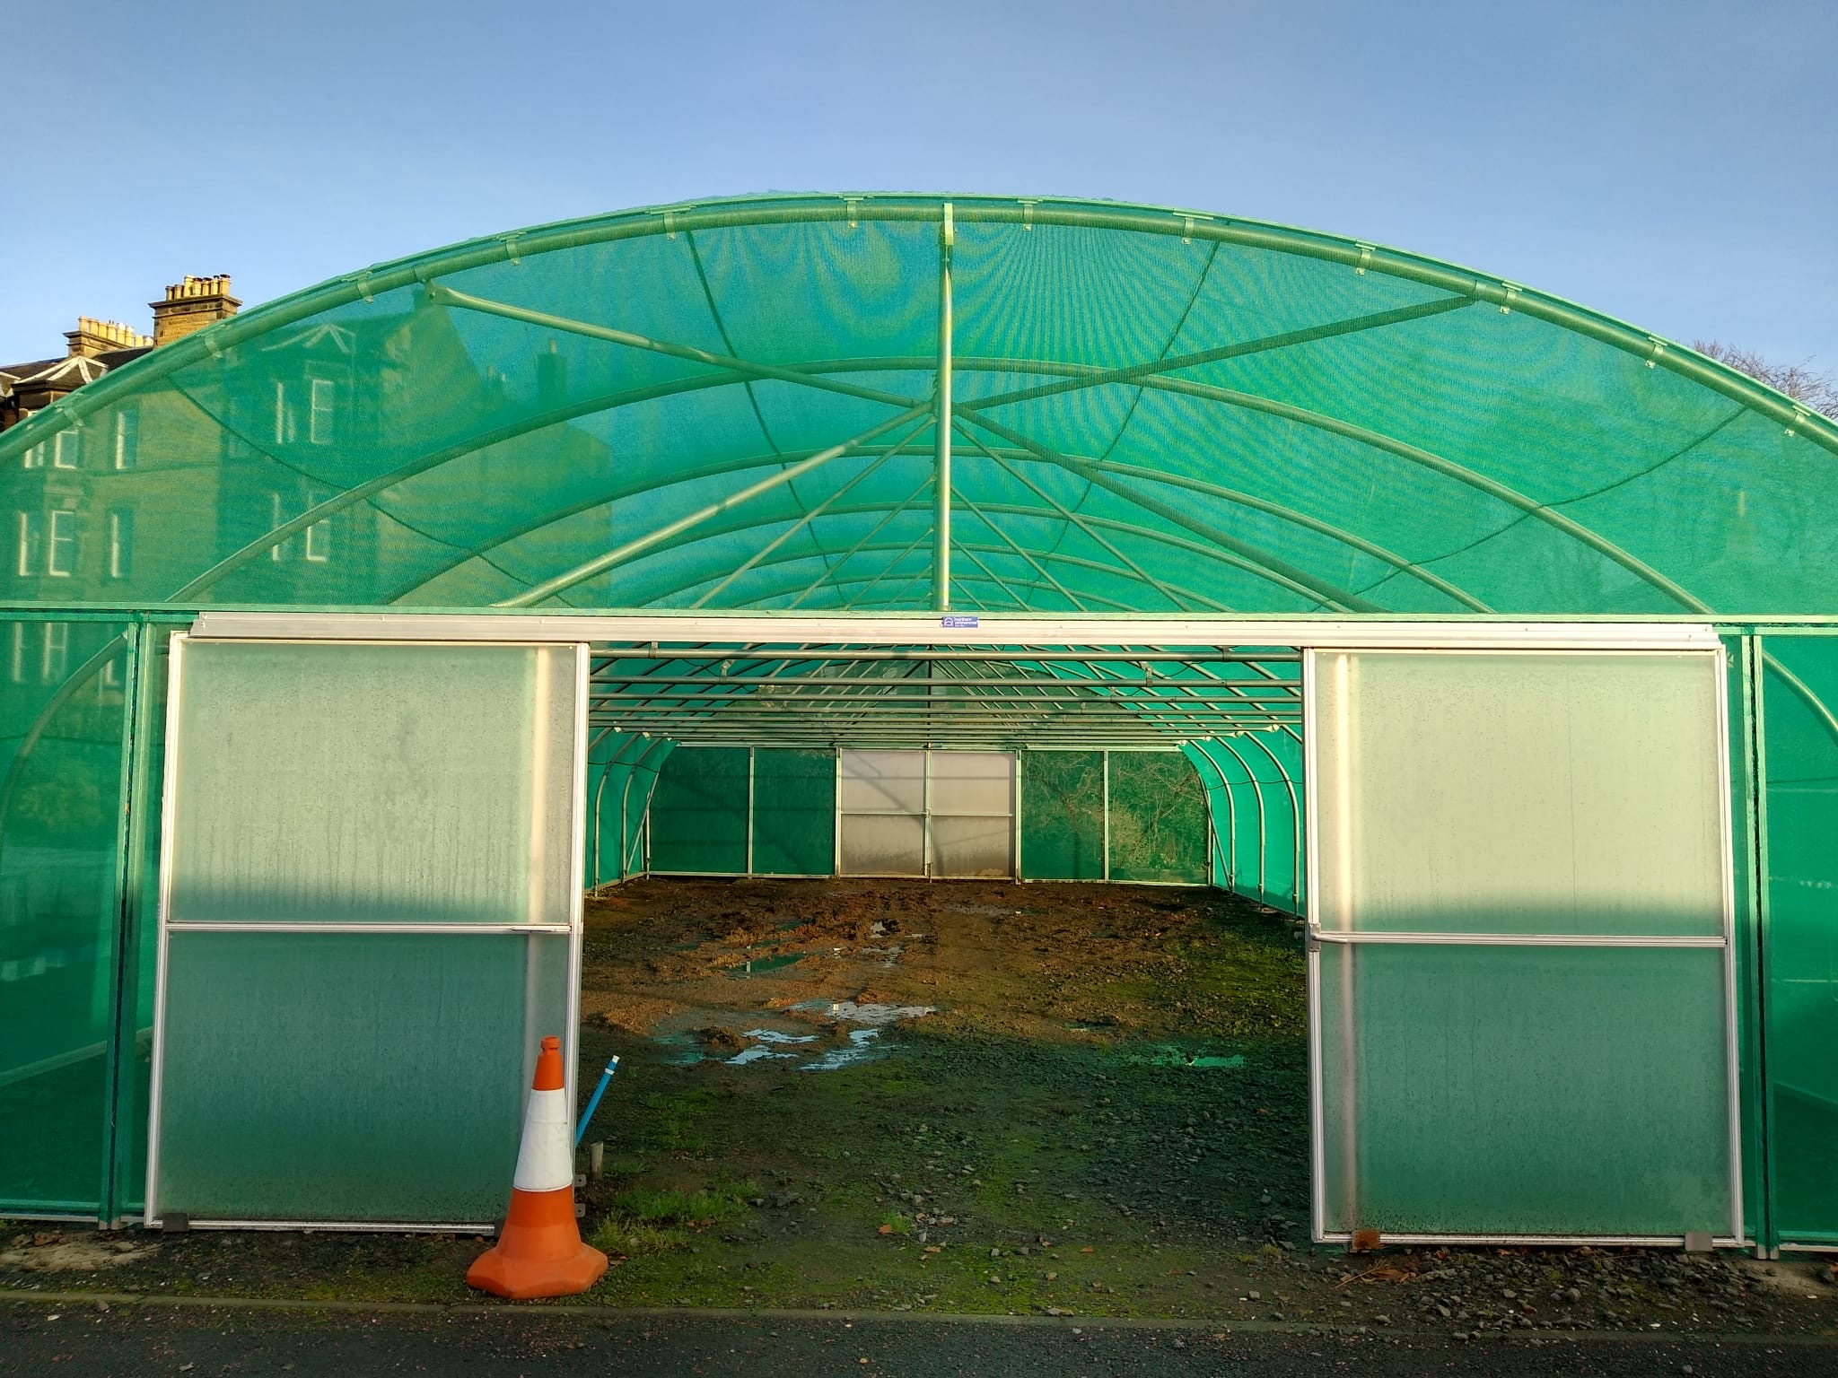
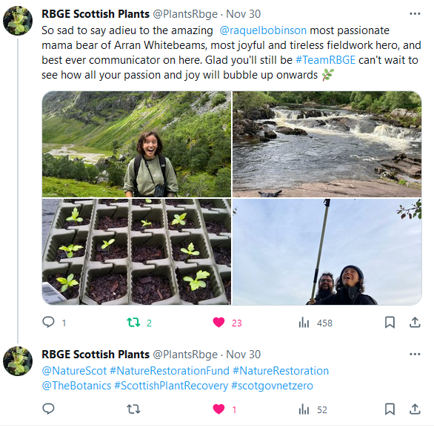
NRF 502209
Biodiversity Net Gain:
Biodiversity as a crucible for saving Scotland’s most threatened species.
Update November 2023
Prepared by Dr Aline Finger, afinger@rbge.org.uk
General:
A Hedlundia strategy meeting was held to discuss best propagation methods and planting sites
Regular, minuted RBGE meetings (generally Mondays 9.45-11.45) take place to ensure effective workflow and communication
New shade tunnel flooring still needed (biosecurity and maintenance reasons) before it can be used
A Melampyrum sylvaticum / wood ant meeting was held with the Woodland Trust and James Hutton Institute as part of the NRF 502225 Arkaig Landscape Restoration project but also to explore the option of planting other NRF species at Arkaig.
3rd Steering Group Meeting was held on the 24th November
In partnership with the Assynt Community Group a symbolic NRF elm seedling will be planted in Assynt in January 2024
Rachel Robinson had her last day of her 8month horticulture contract on 30th November
Partnership with Assynt Community Group
New NRF tunnel built but still requiring flooring

Slide 2
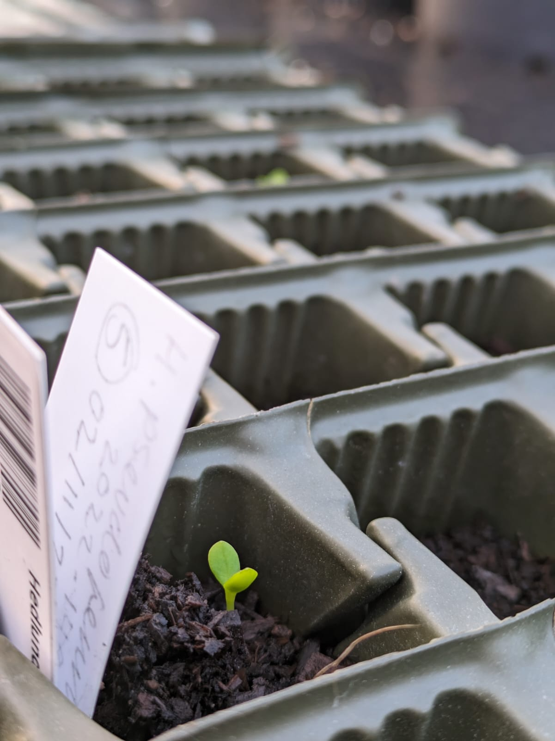
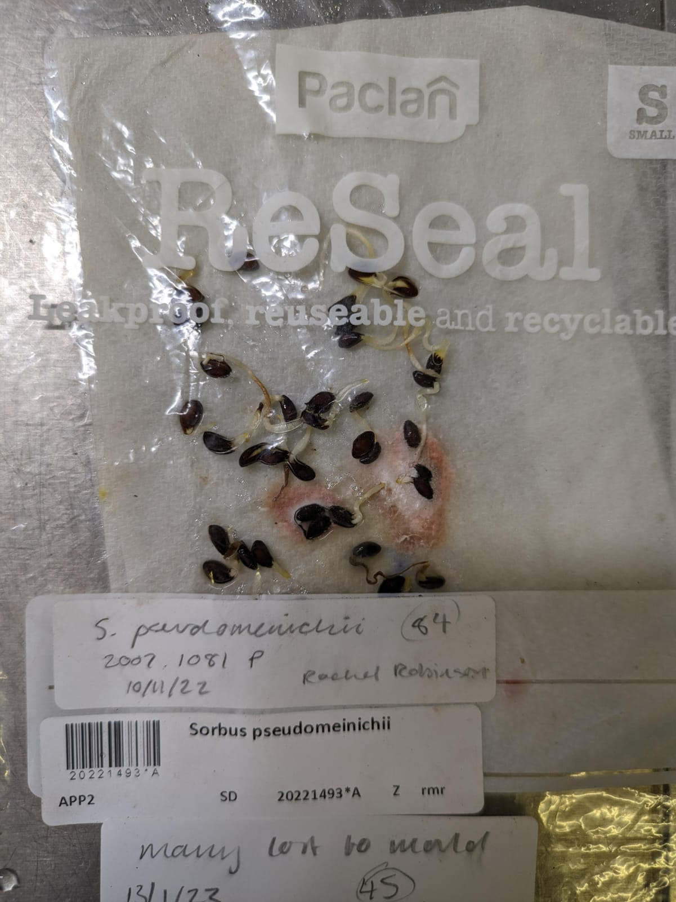
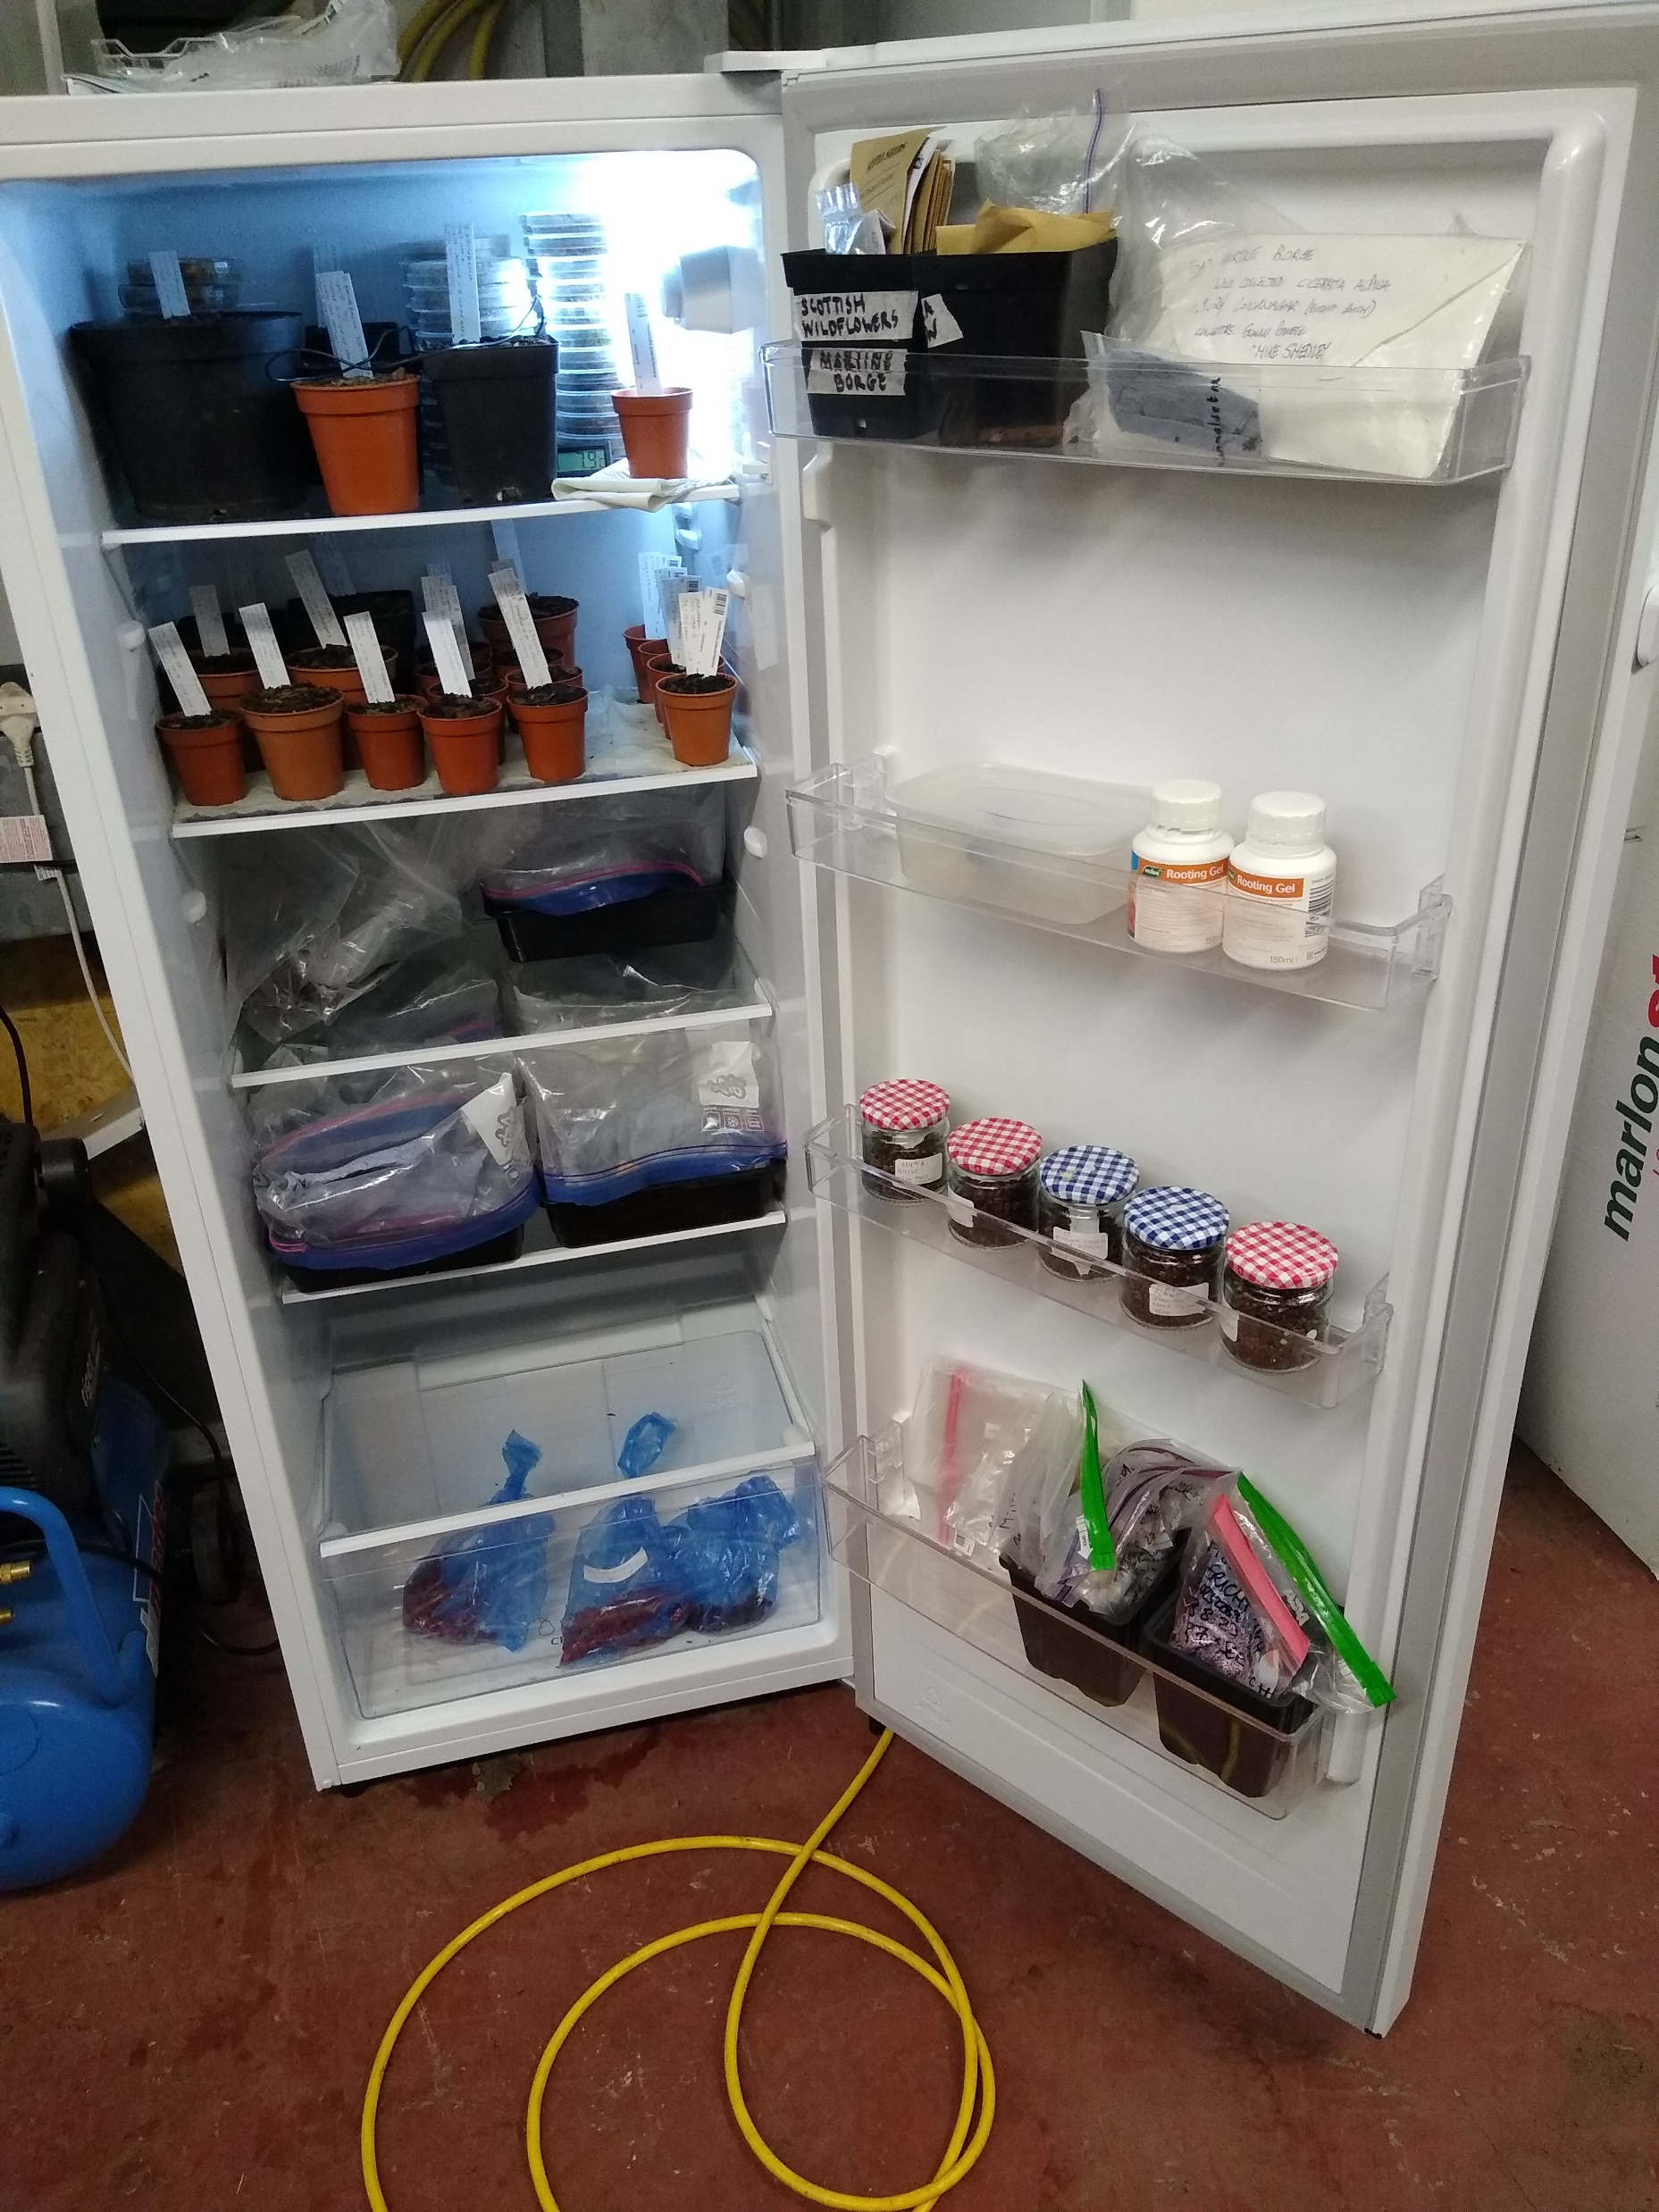
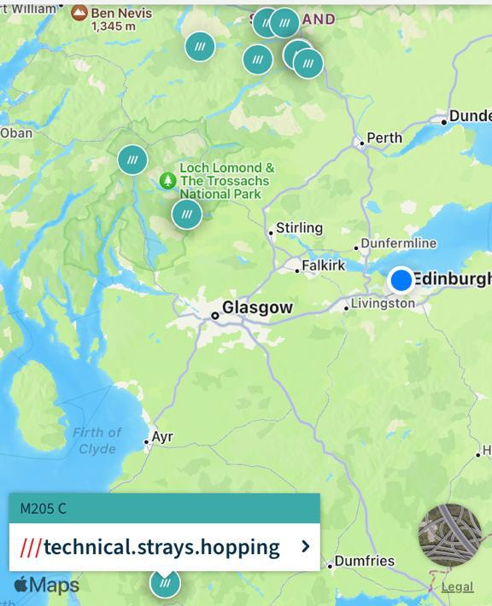
NRF 502209
Biodiversity Net Gain:
Biodiversity as a crucible for saving Scotland’s most threatened species.
Update November 2023
Prepared by Dr Aline Finger, afinger@rbge.org.uk
Nursery and lab:
Ulmus glabra DNA extractions and genotyping has been continued
Hedlundia seeds collected in 2022 have started to germinate
Current number of plants in ex-situ collection:
Ulmus glabra: 273 seedlings + some softwood cuttings
Hedlundia / Sorbus complex: Few micro-prop samples and cuttings surviving + 91 seedlings (H. preudofennica: 19, H. arranensis: 16, H. pseudominicci: 56) +
2612 seed cleaned and placed into stratification
Malus sylvestris: Seed from 16 trees, 4,407 stratified + 25,000 dried and stored
Cicerbita alpina: 209 plants + 9725 seed sown (Scottish, Swiss + Norwegian)
Woodsia ilvensis: 447 plants + healthy sporophytes
Polygonatum verticillatum: 820 plants + 8886 seed sown (Scottish, Swiss + Norwegian)
Saxifraga hirculus: 51 plugs + 28 foreign seedlings
Melampyrum sylvaticum: 3,500 plants + 460 Scottish, 900 Swiss, 40 Norwegian seed
Hedlundia seeds transferred to pots and growing
Hedlundia seed sown in 2022 germinating
Map of Malus sylvestris collections
Stockpiles in the NRF fridge

Slide 3
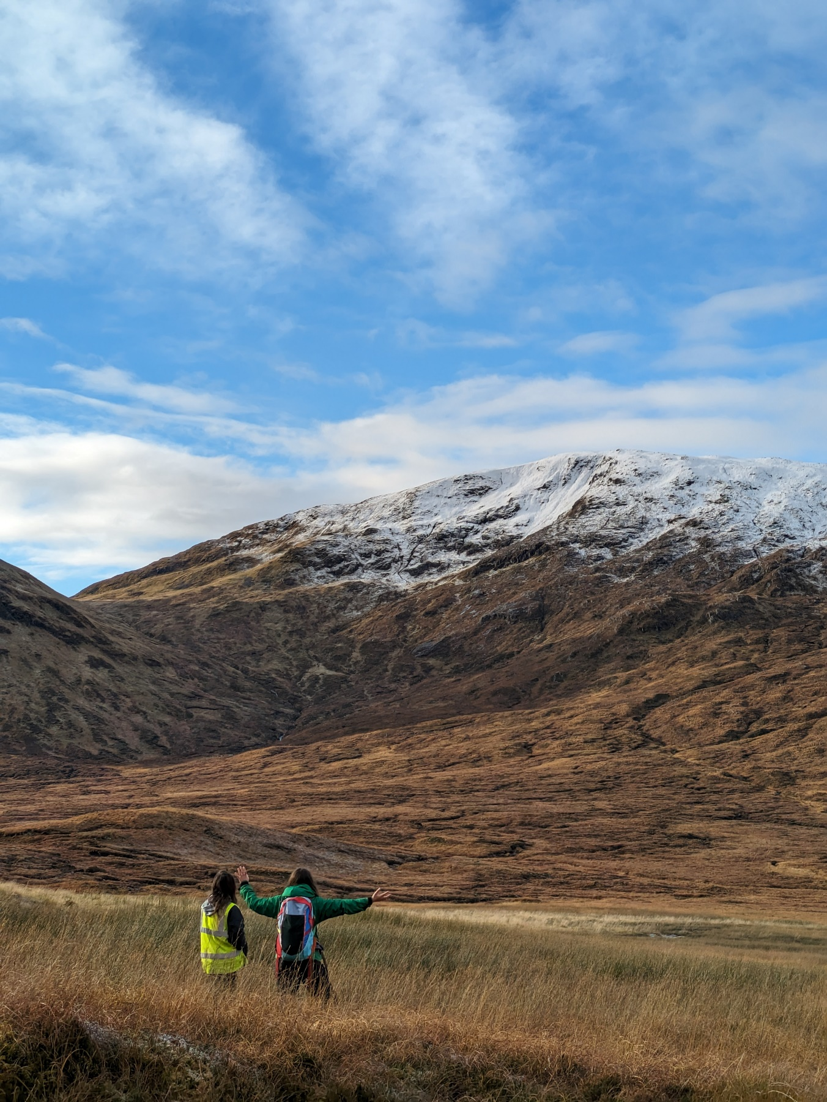
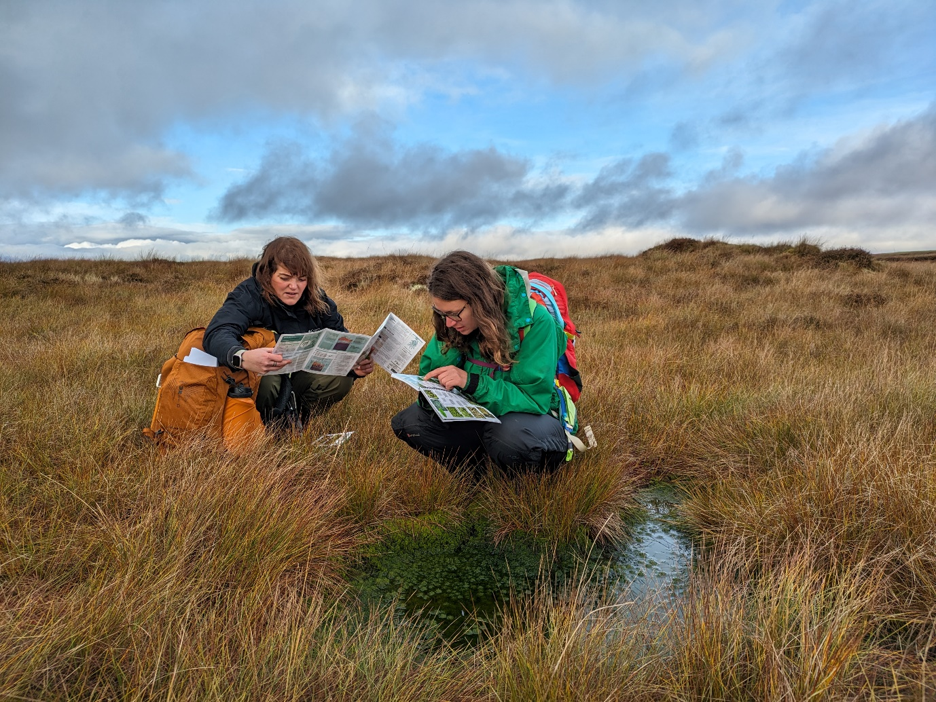
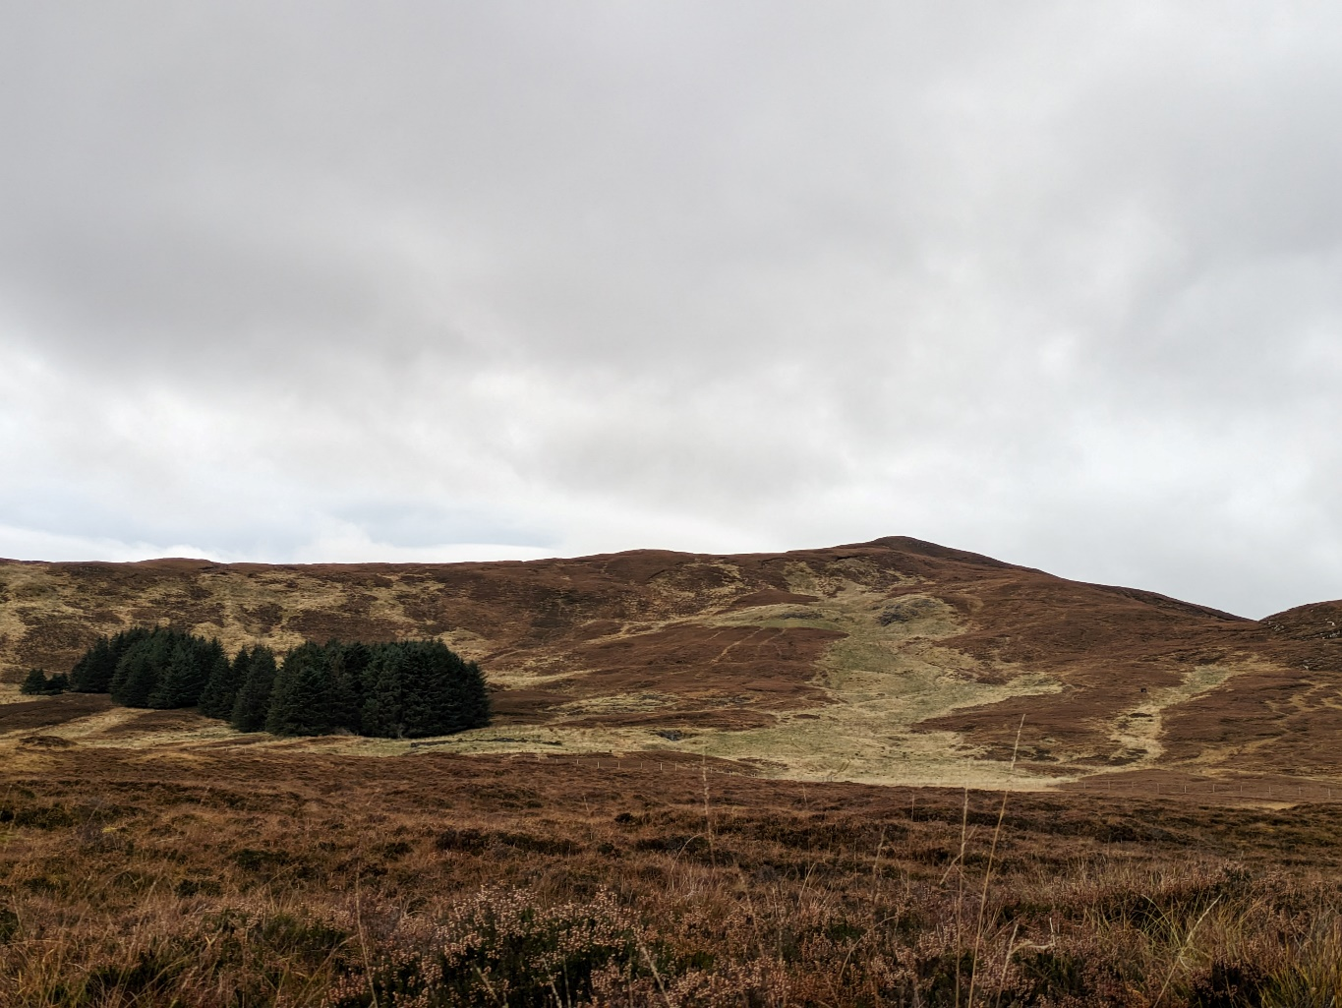
NRF 502209
Biodiversity Net Gain:
Biodiversity as a crucible for saving Scotland’s most threatened species.
Update November 2023
Prepared by Dr Aline Finger, afinger@rbge.org.uk
Glen Garry (FSL) suitable planting sites for several species
Field work:
Trip to the Ochills to explore potential Saxifraga hirculus planting sites
Glen Garry, FLS land, suitable for Ulmus glabra and potential for Saxifraga hirculus and Malus sylvestris
Visit to Arran, Drumadoon, to explore Hedlundia planting sites
Trip to Glenashdale to explore Ulmus glabra planting sites in areas with DED present
3 trips to Assynt to determine Ulmus glabra planting sites and visit the Little Assynt Nursery as well as potential Saxifraga hirculus planting site at Inchnadamph
Becca and Emma exploring the Ochils for suitable Saxifraga hirculus planting sites
Assynt site suitable for Ulmus glabra and Saxifraga hirculus

Slide 4
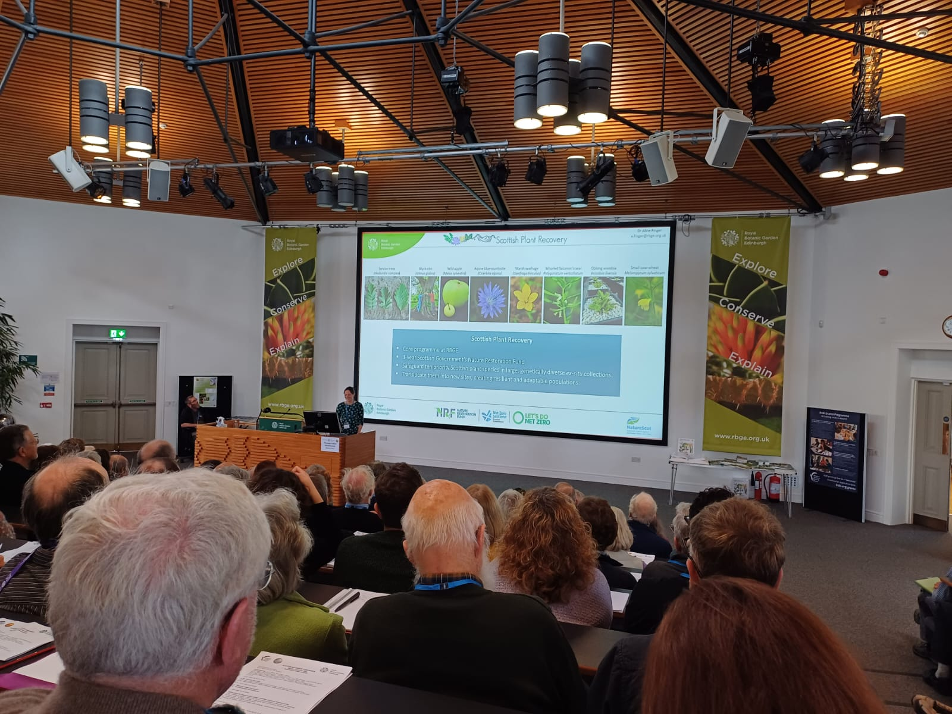
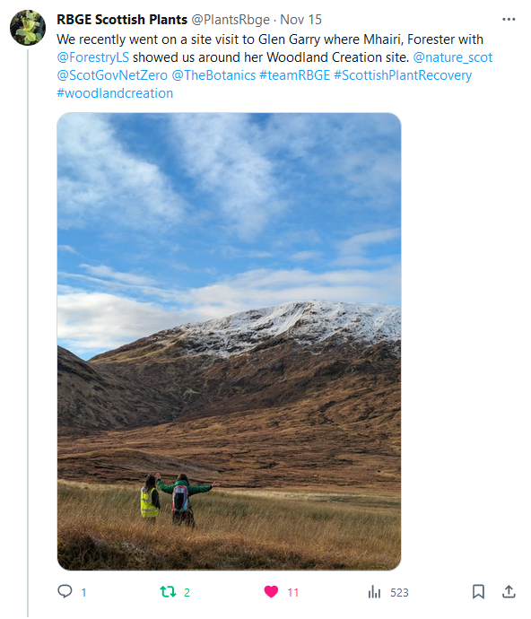
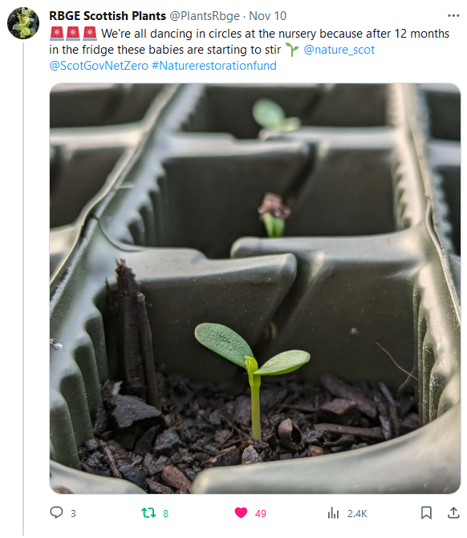
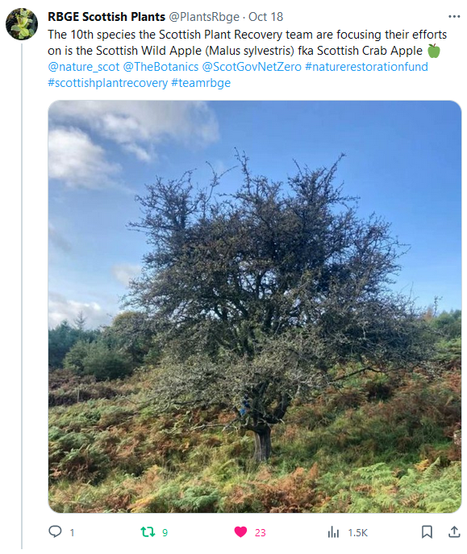
NRF 502209
Biodiversity Net Gain:
Biodiversity as a crucible for saving Scotland’s most threatened species.
Update November 2023
Prepared by Dr Aline Finger, afinger@rbge.org.uk
Communication, press and publications:
We continued to create weekly social media posts.
Project presentation at BSBI conference on 04.11.23, ~200 people attending
Project presentation to the Tain District Field Club on 14.11.23
New Botanic Stories blogs available (https://stories.rbge.org.uk/archives/category/science/scottish-plant-recovery)
Rainforest elm: https://stories.rbge.org.uk/archives/38020
Plans for December 2023:
Continue maintenance of existing plants
Continue DNA extractions for Ulmus glabra
Start DNA extractions for Melampyrum sylvaticum
Microsatellite development Polygonatum verticillatum, Hedlundia
Hardwood cuttings for Ulmus glabra
BSBI presentation
Some of our latest social media posts

