Slide 1
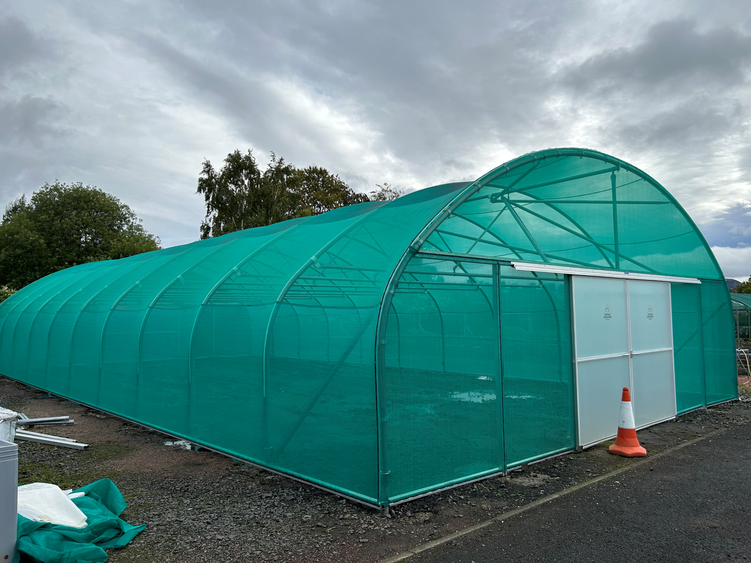
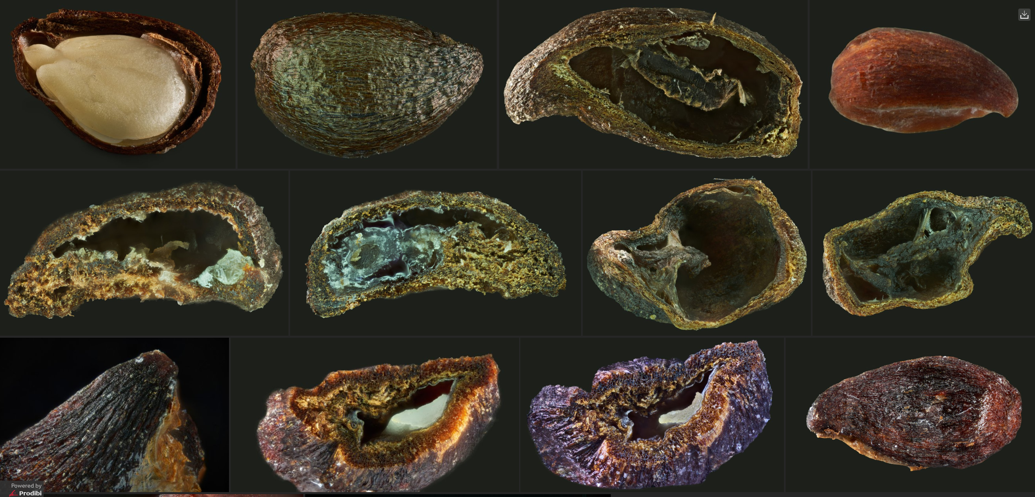
NRF 502209
Biodiversity Net Gain:
Biodiversity as a crucible for saving Scotland’s most threatened species.
Update October 2023
Prepared by Dr Aline Finger, afinger@rbge.org.uk
General:
Meet with NatureScot to discuss fencing of individual Hedlundia trees on Arran
Two volunteers have been recruited to help with project nursery tasks
Photographer Fran Principe-Gillespie continues to produce microphotography
Matt Elliott and Ruth Mitchell (JHI) presented a poster at the CIEEM conference on biosecurity and conservation planting on 3rd October 2023 mentioning the NRF work
New shade tunnel has been built, but still requires flooring
A Hedlundia strategy meeting was held to discuss best propagation methods for 2024, micro-propagation, cross-pollinations and planting sites
Regular, minuted RBGE meetings (generally Mondays 9.45-11.45) are being held to ensure effective workflow and communication
New shade tunnel complete but still requiring flooring
Microphotography by Fran Principe-Gillespie, seed viability

Slide 2
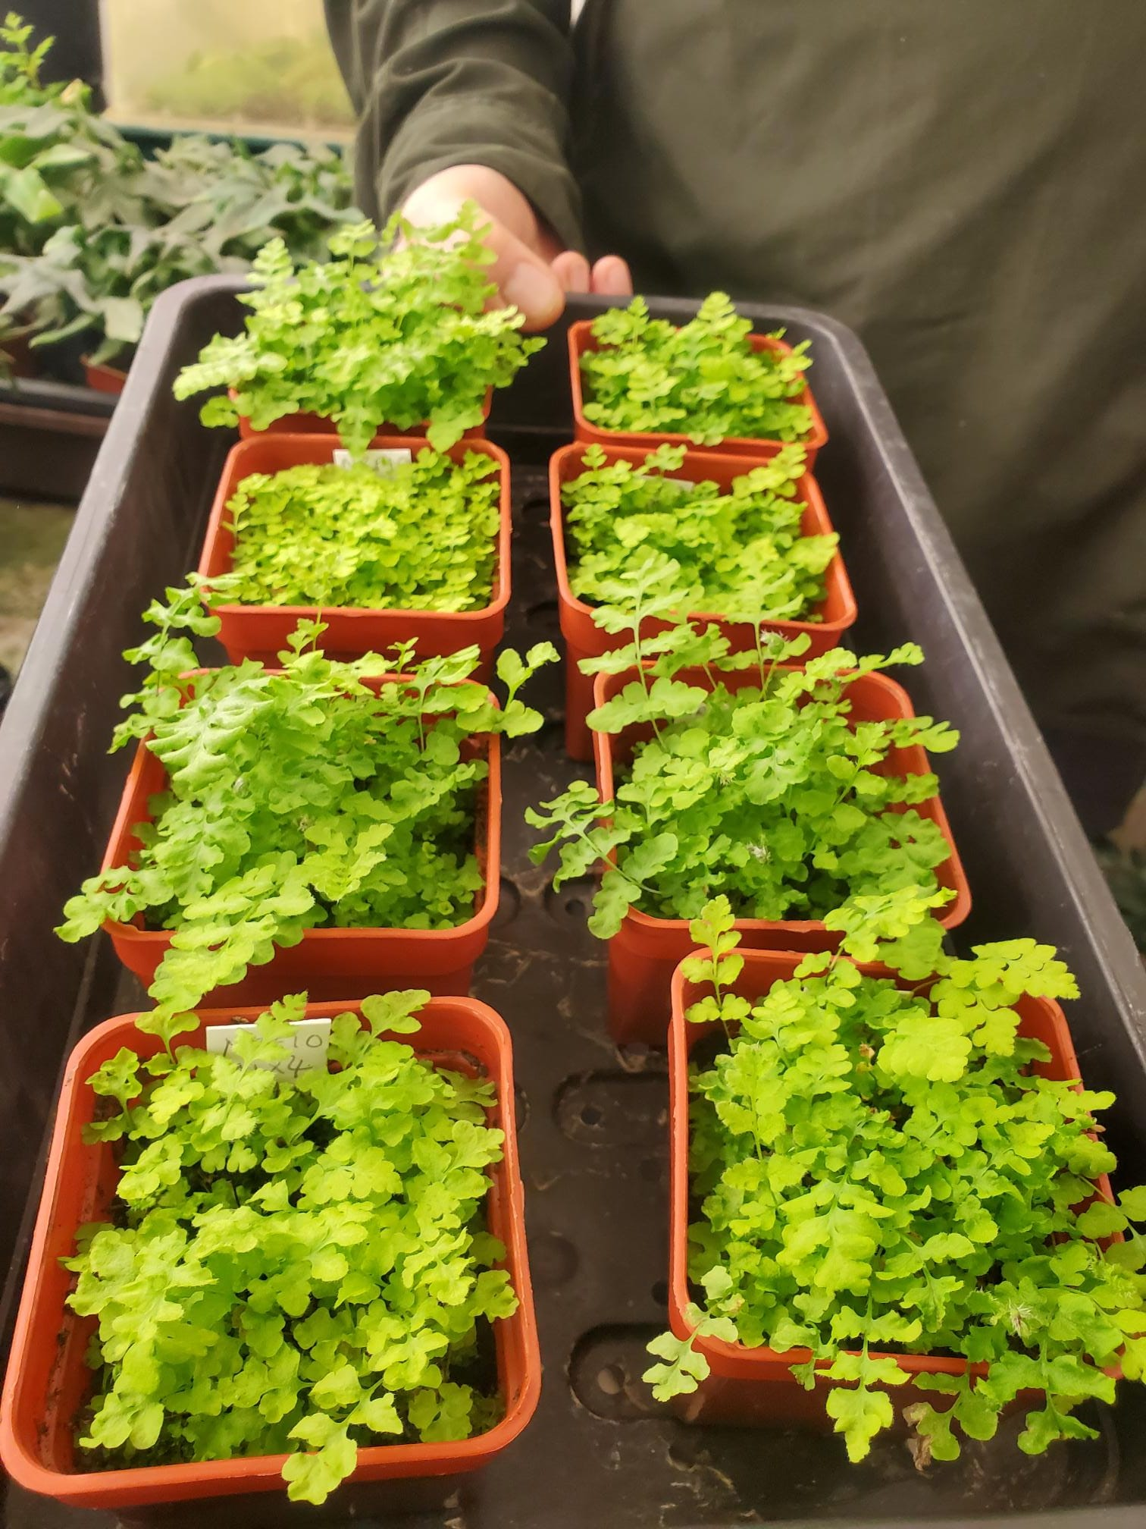
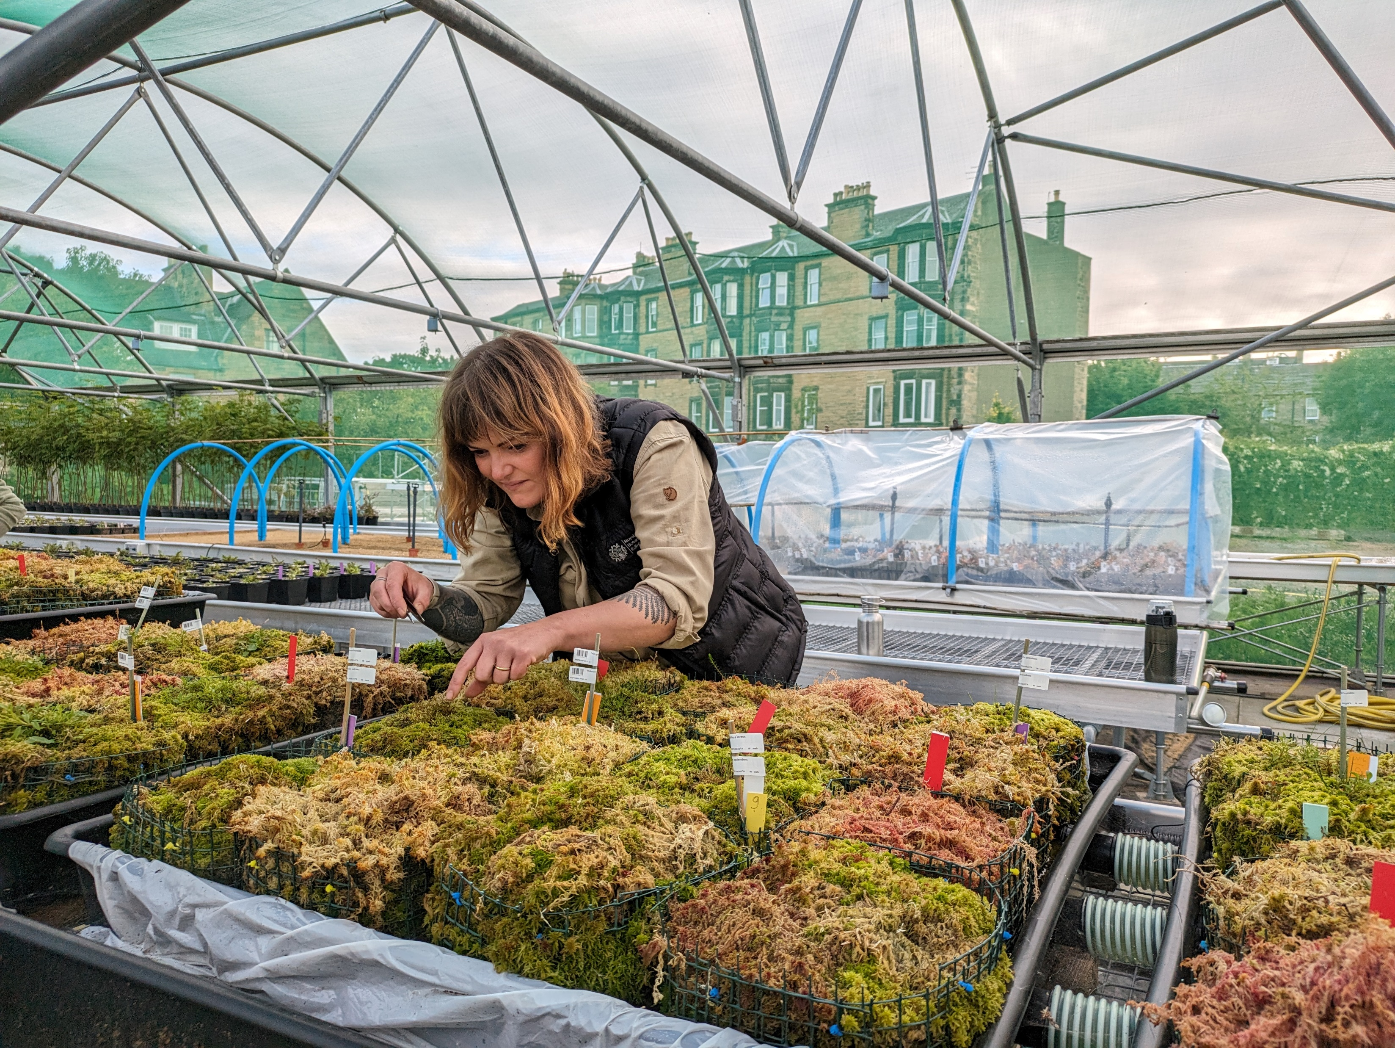
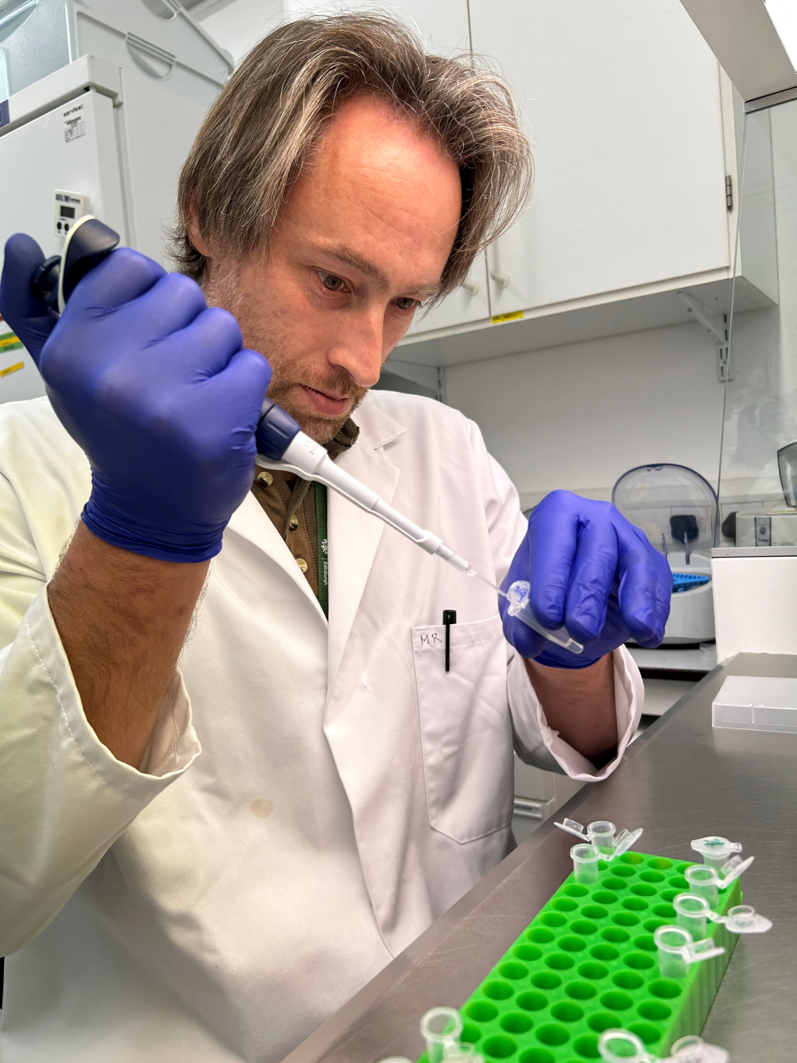
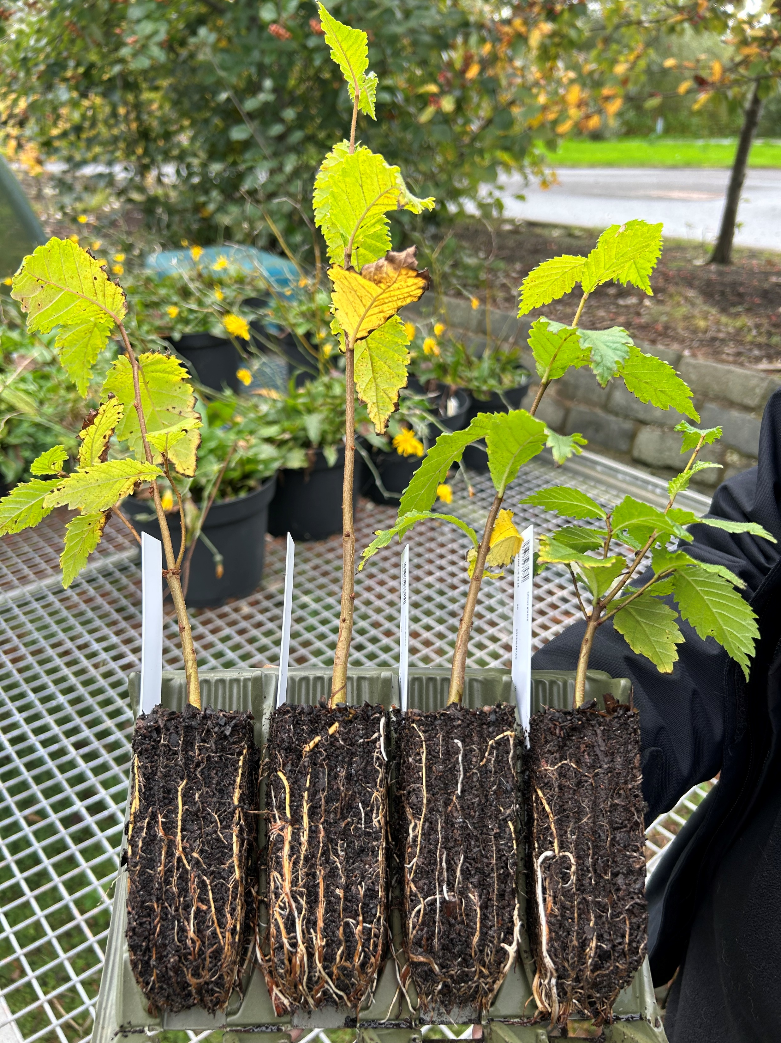
NRF 502209
Biodiversity Net Gain:
Biodiversity as a crucible for saving Scotland’s most threatened species.
Update October 2023
Prepared by Dr Aline Finger, afinger@rbge.org.uk
Nursery and lab:
Ulmus glabra DNA extractions and genotyping have started
Seeds of all species are being processed, and continuous cleaning of micro-propagation material
Current number of plants in ex-situ collection:
Ulmus glabra: 273 seedlings + >1,748 cuttings, currently 5% take rate
Hedlundia / Sorbus complex: 290 micro-prop samples (~15 produced leaves) + 1,509 cuttings, very low take rate
Cicerbita alpina: 209 plants, Scottish + 2,900 Swiss seeds + Norwegian seed
Woodsia ilvensis: 447 plants, gametophytes developing, new spores sown
Polygonatum verticillatum: 822 plants, Scottish + 2,740 Swiss seeds + 20 Norwegian seed
Saxifraga hirculus: 51 plugs, 28 seedlings
Melampyrum sylvaticum: 3,500 plants, 460 Scottish + 860 Swiss seeds + 40 Norwegian seed
Crossed Woodsia ilvensis gametophytes are continuing to grow well, producing large numbers of healthy sporophytes
Euan Bowditch doing lab work for Ulmus glabra genetic analysis
Ulmus glabra continuing to growing well in root trainers
The Saxifraga hirculus ‘cascade’ has been doubled in size and is now also hosting threatened mosses

Slide 3
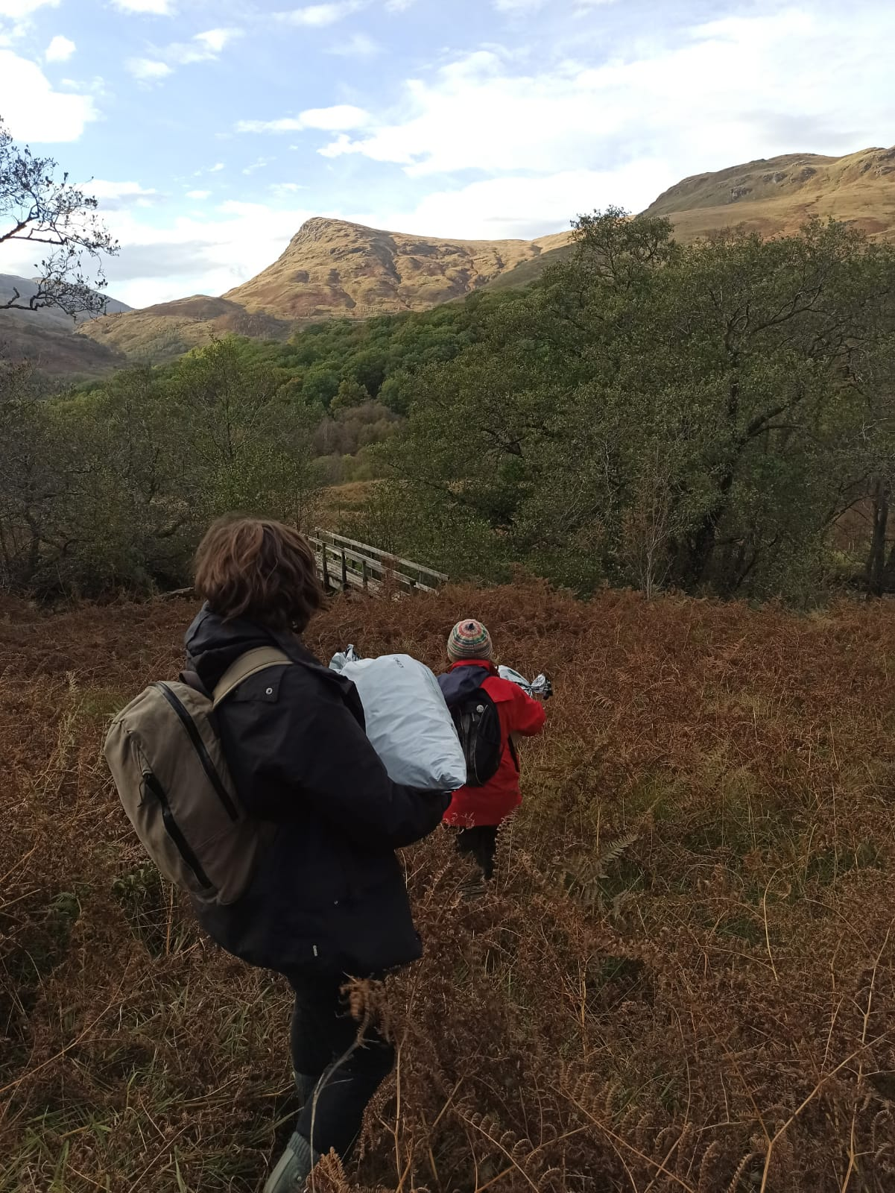
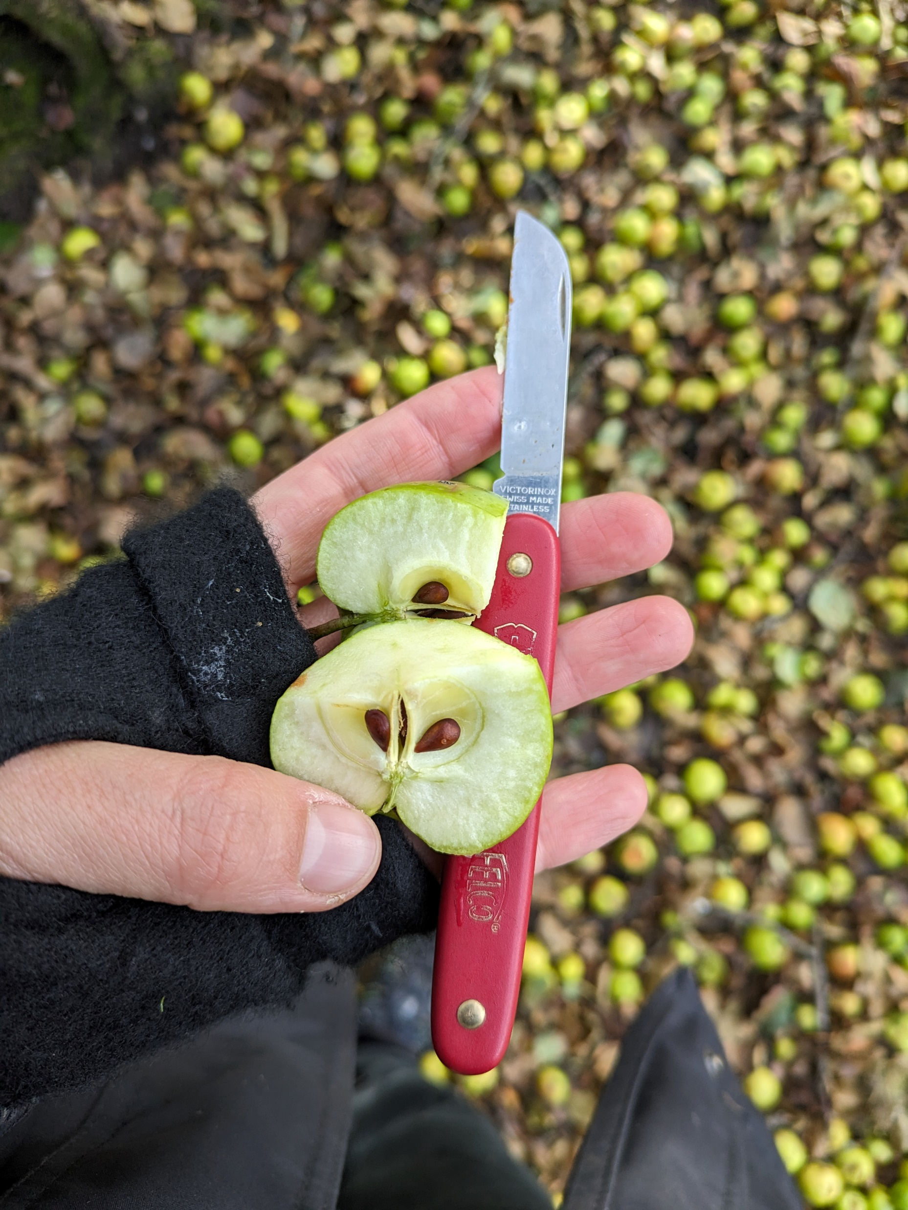
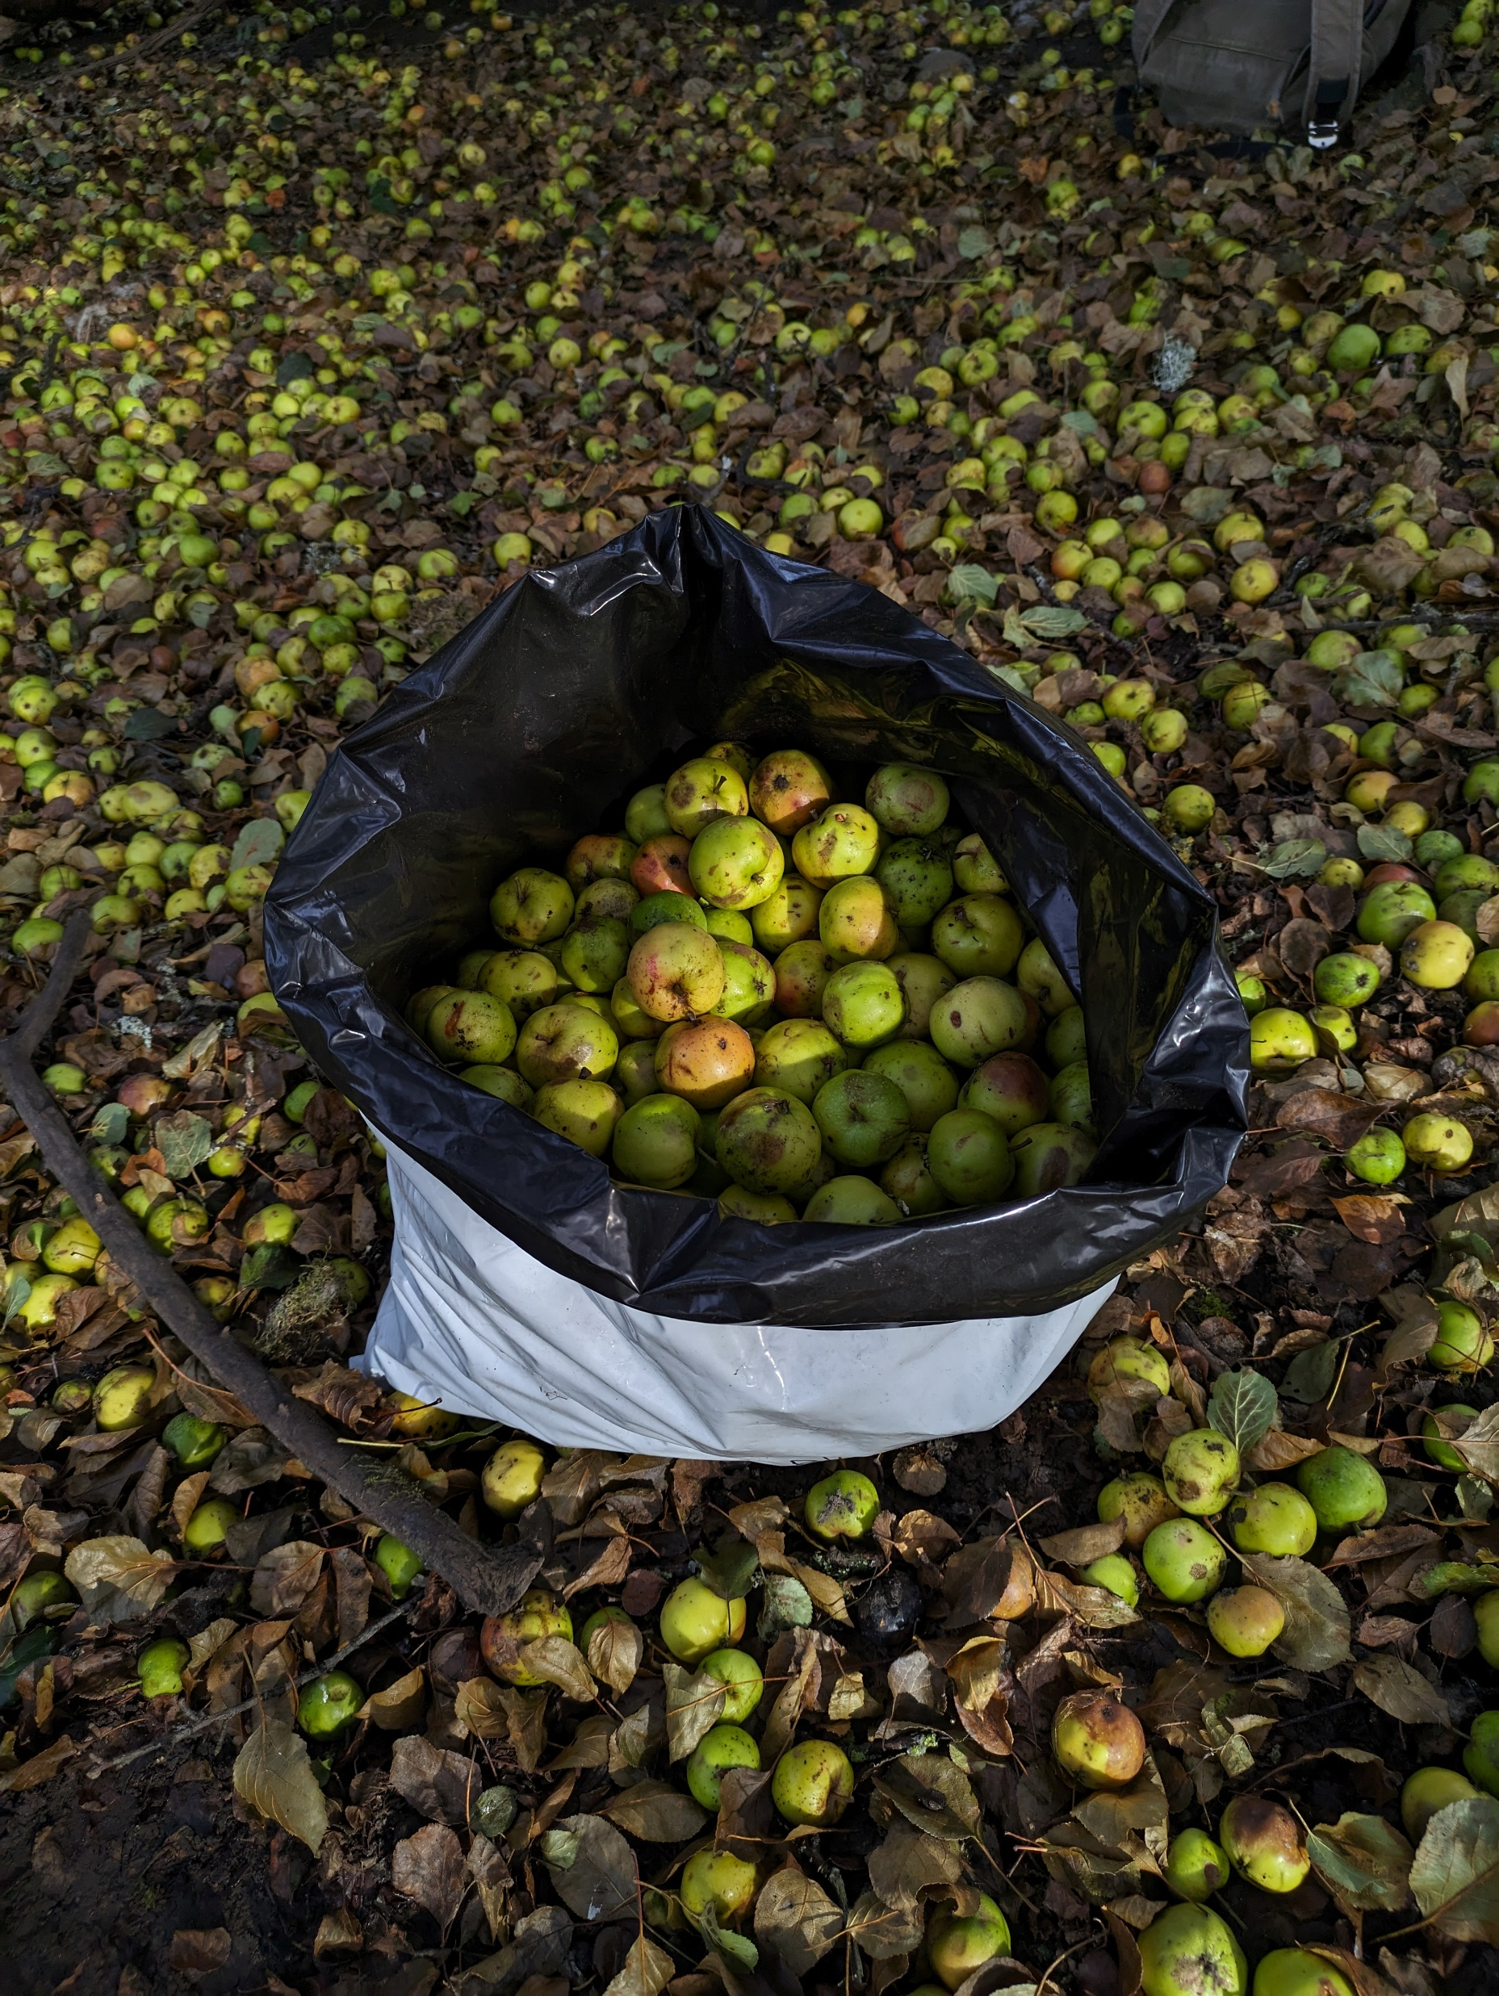
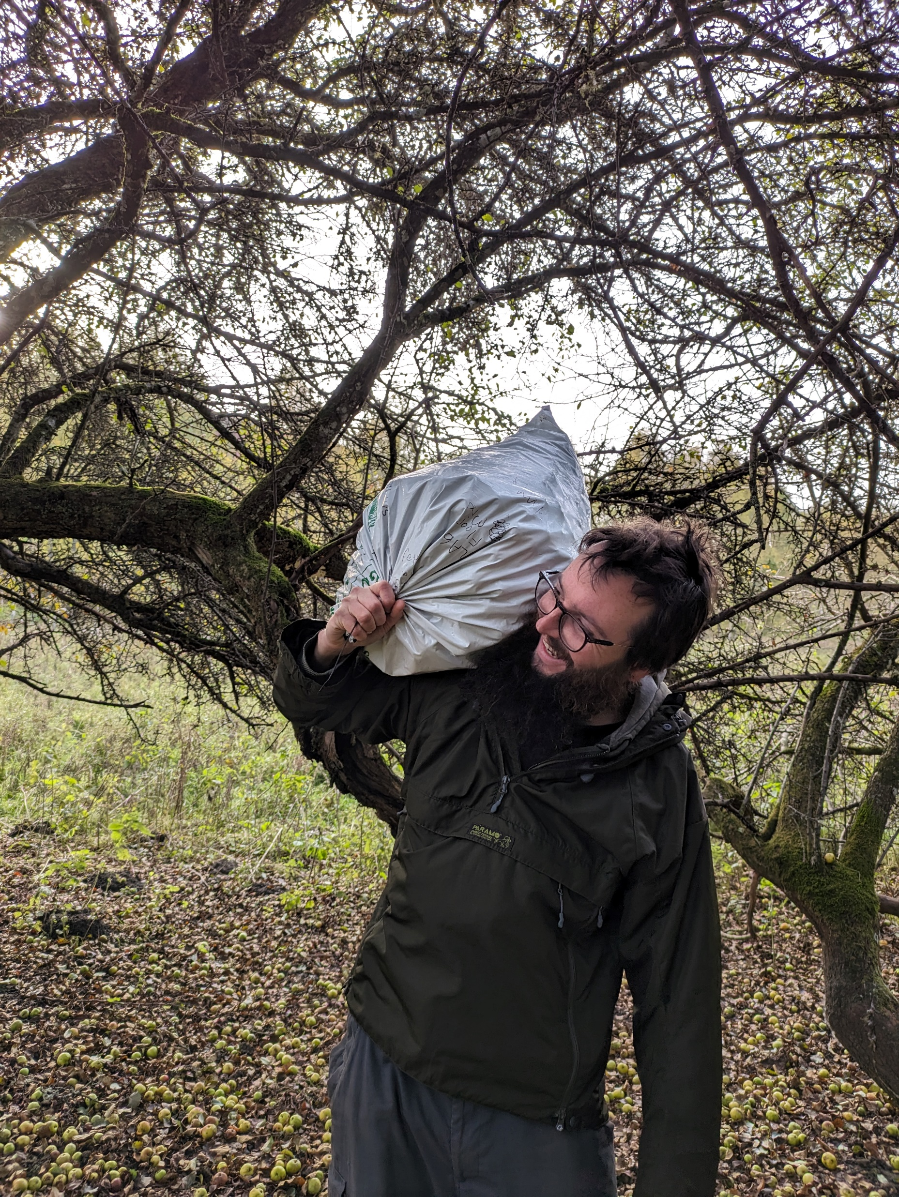
NRF 502209
Biodiversity Net Gain:
Biodiversity as a crucible for saving Scotland’s most threatened species.
Update October 2023
Prepared by Dr Aline Finger, afinger@rbge.org.uk
Field work:
Malus sylvestris seed collections to six locations have been undertaken to collect seed from ‘pure’ wild trees. These will be processed in the nursery and grown on for germination in spring.
Collecting Malus sylvestris seed at Glen Falloch
Malus sylvestris apple cut open revealing viable looking seed
Malus sylvestris producing large amounts of fruit
Volunteer Partick helping to carry collected apples back to RBGE

Slide 4
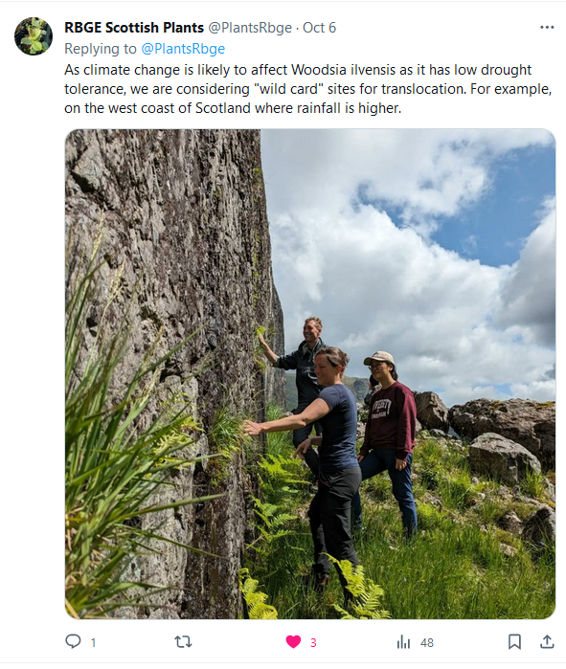
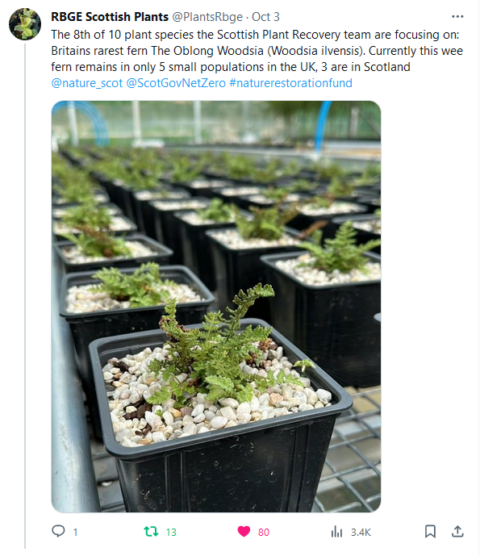
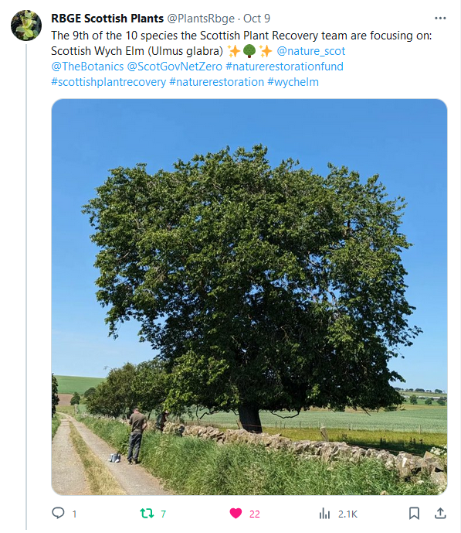
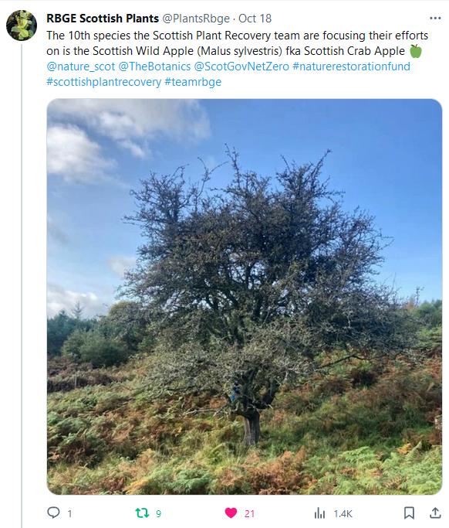
NRF 502209
Biodiversity Net Gain:
Biodiversity as a crucible for saving Scotland’s most threatened species.
Update October 2023
Prepared by Dr Aline Finger, afinger@rbge.org.uk
Communication, press and publications:
We continued to create weekly social media posts.
New Botanic Stories blogs available (https://stories.rbge.org.uk/archives/category/science/scottish-plant-recovery)
Ulmus glabra: https://stories.rbge.org.uk/archives/37831
Malus sylvestris: https://stories.rbge.org.uk/archives/37839
Foreign seed collections: https://stories.rbge.org.uk/archives/37930
Plans for November 2023:
Continue propagation, weeding, maintenance of existing plants
Continue DNA extractions for Ulmus glabra
Work on project specific webpage
Continue to process and store all seed collected from all species
Some of our latest social media posts

