Slide 1
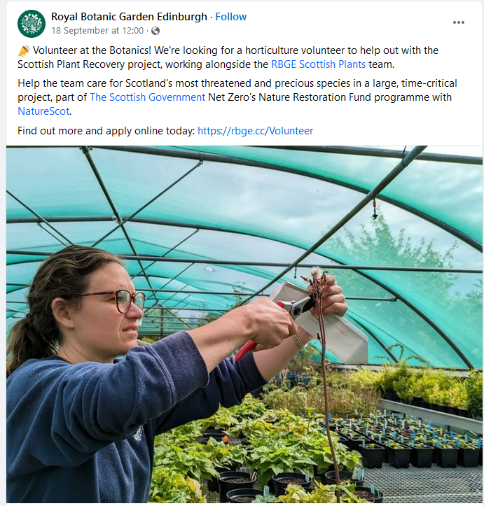
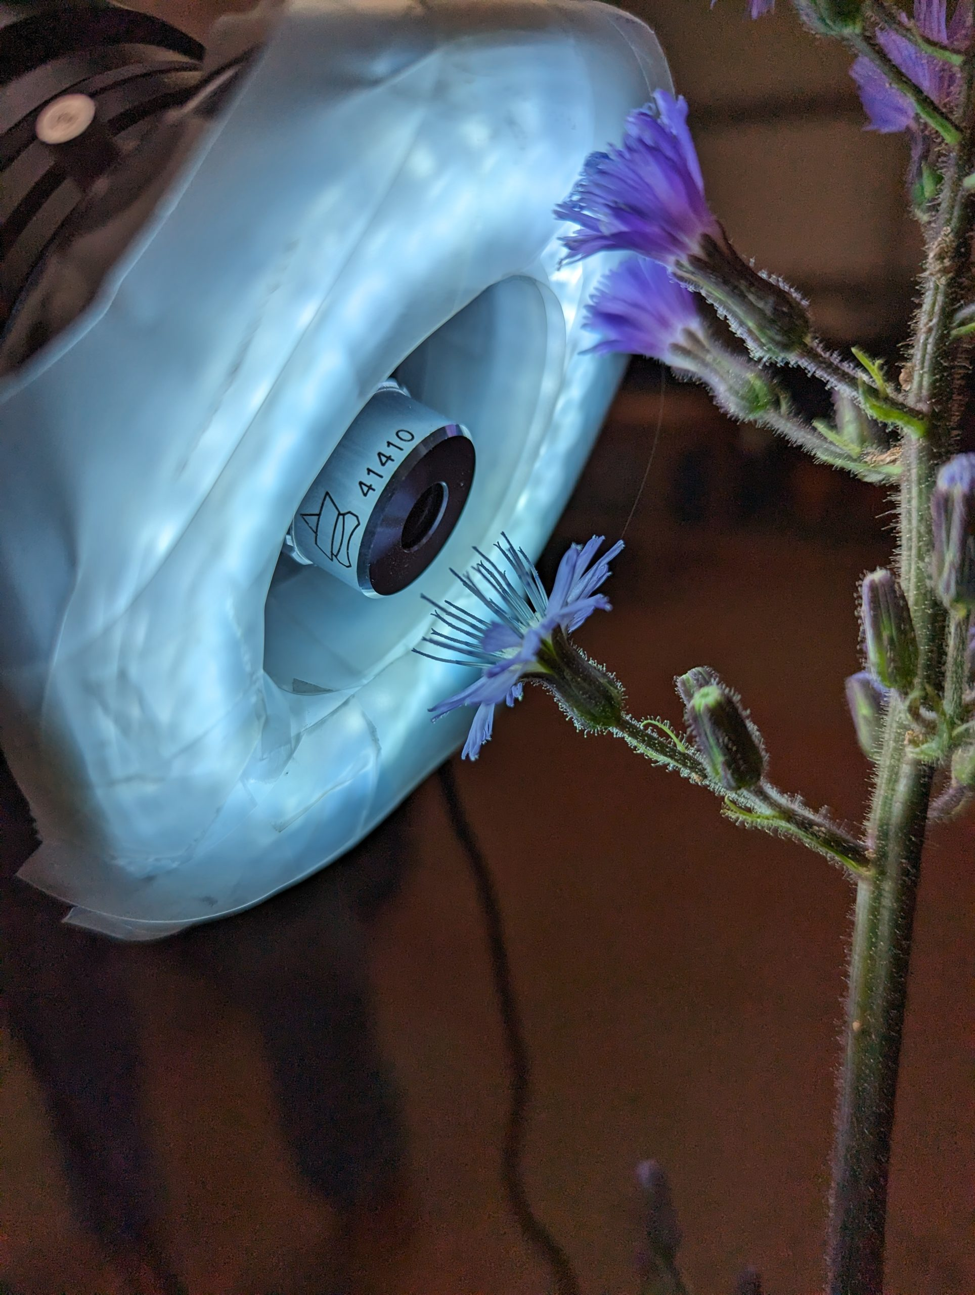
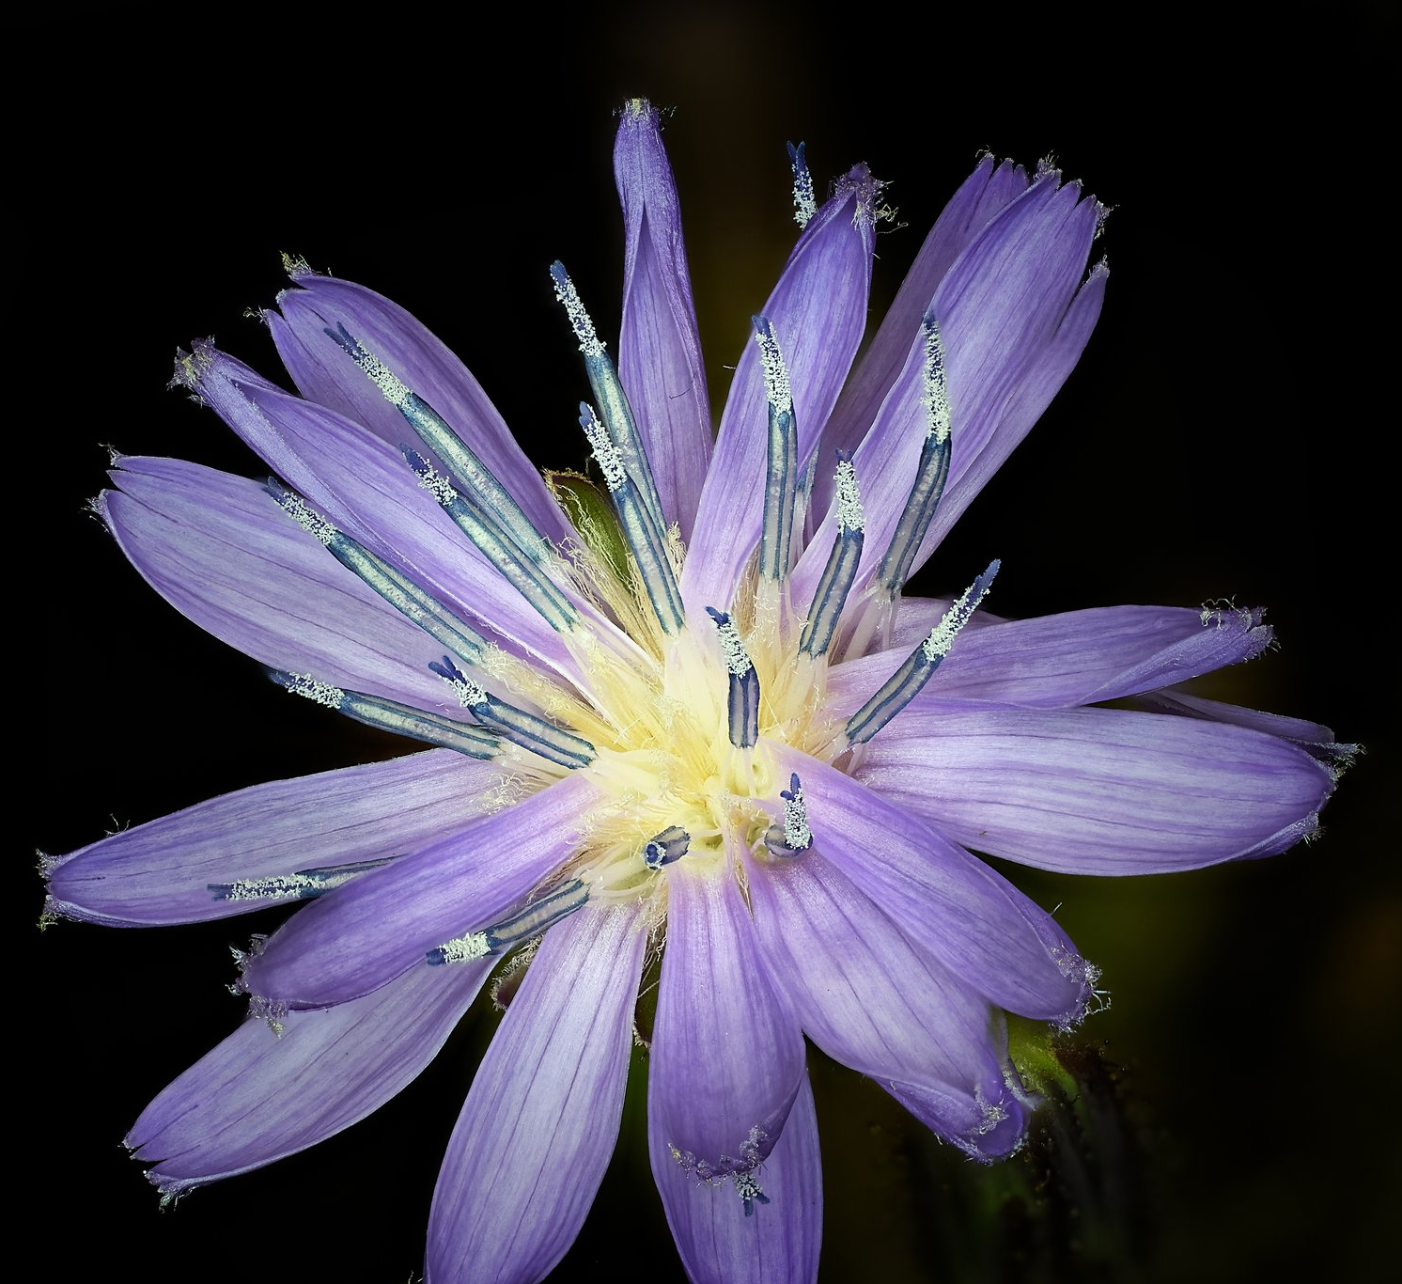
NRF 502209
Biodiversity Net Gain:
Biodiversity as a crucible for saving Scotland’s most threatened species.
Update September 2023
Prepared by Dr Aline Finger, afinger@rbge.org.uk
General:
Partner meetings were held at RBGE and Killin to meet the landowner of Glenlochay and discuss ongoing collaborations
We have posted an advert to recruit a volunteer to help with project nursery tasks
Photographer Fran Principe-Gillespie has started taking high quality detailed images of all 10 species at the different stages of development over the course of 1 year
EBAP has visited the Nursery on 20.09.23
The project has been presented during the RBGE Trustee meeting, including attendees from Scottish Government, on 27.09.23
A 2nd elm translocation strategy meeting was held to narrow down planting sites and discuss planting strategy
More partners / interested groups have joined the project
Regular, minuted RBGE meetings (generally Mondays 9.45-11.45) are being held to ensure effective workflow and communication
Recruiting volunteers
Microphotography by Fran Principe-Gillespie

Slide 2
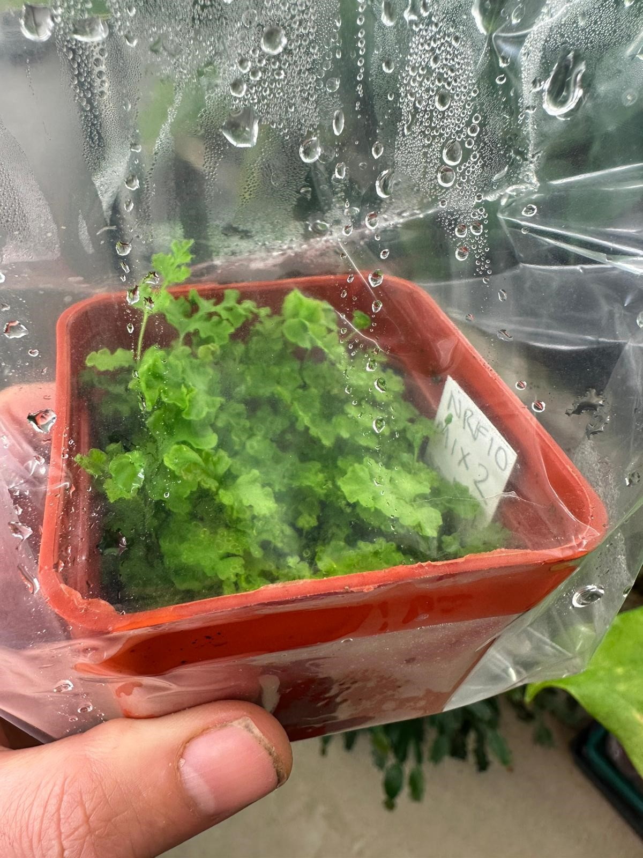
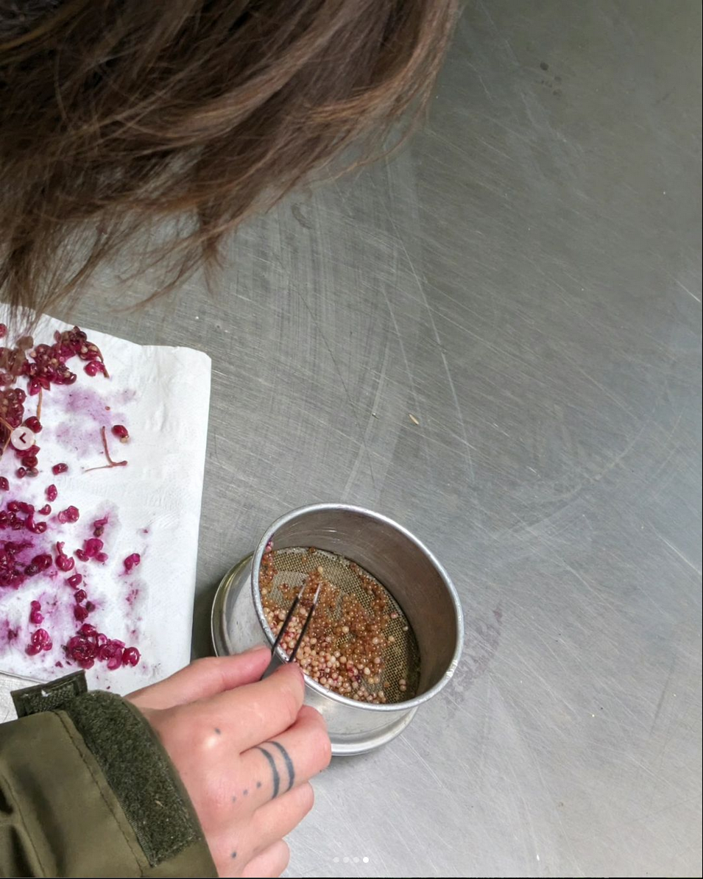
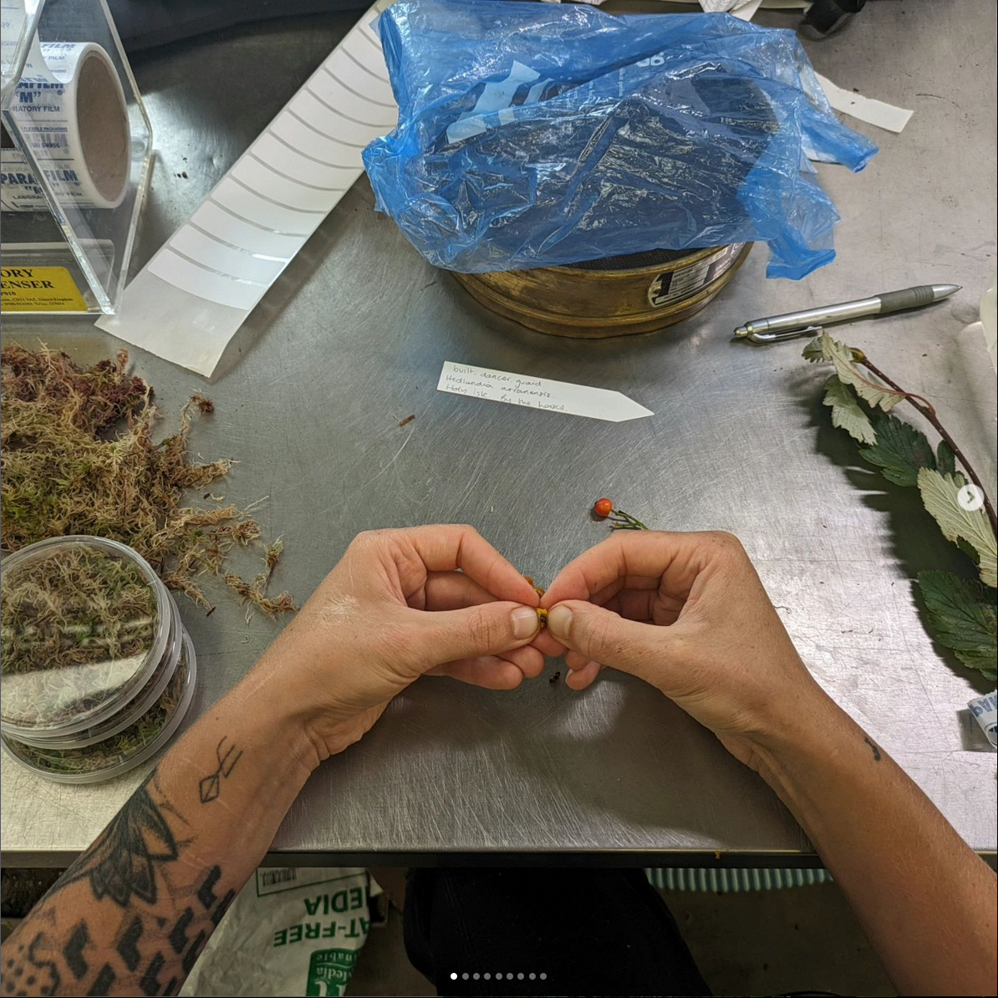
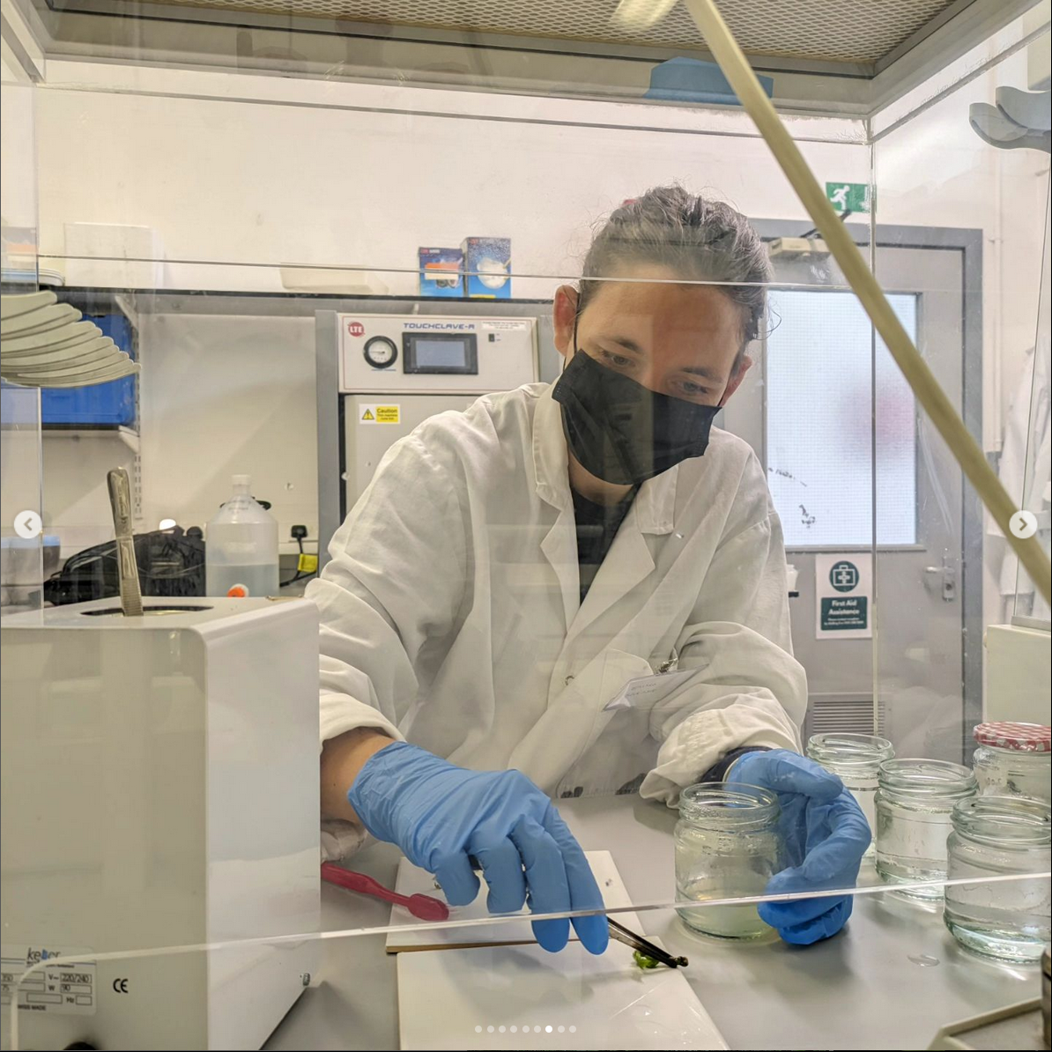
NRF 502209
Biodiversity Net Gain:
Biodiversity as a crucible for saving Scotland’s most threatened species.
Update September 2023
Prepared by Dr Aline Finger, afinger@rbge.org.uk
Nursery and lab:
New shade tunnel build has started
Seeds of all species are being processed, and continuous cleaning of micro-propagation material
Current number of plants in ex-situ collection:
Ulmus glabra: 273 seedlings + >1,748 cuttings, currently 5% take rate
Hedlundia / Sorbus complex: 290 micro-prop samples (~15 produced leaves) + 1,509 cuttings
Cicerbita alpina: 209 plants, Scottish + 2,900 Swiss seeds
Woodsia ilvensis: 447 plants, gametophytes developing, new spores sown
Polygonatum verticillatum: 822 plants, Scottish + 2,740 Swiss seeds
Saxifraga hirculus: 51 plugs, 28 seedlings
Melampyrum sylvaticum: 3,500 plants, 460 Scottish + 860 Swiss seeds
Crossed Woodsial ilvensis gametophytes are continuing to grow well
Becca Drew processing and cleaning Polygonatum verticillatum seed
Rachel Robinson processing and cleaning Hedlundia seed
Emma Beckinsale taking care of Hedlundia micro-propagation material in the lab
Hedlundia micro-prop material continuing to grow in the lab

Slide 3
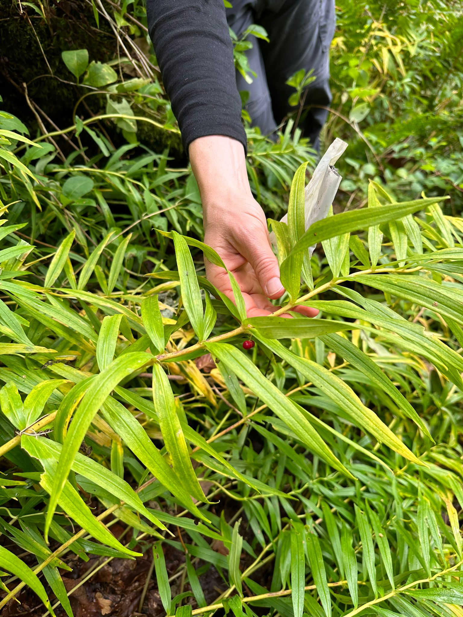
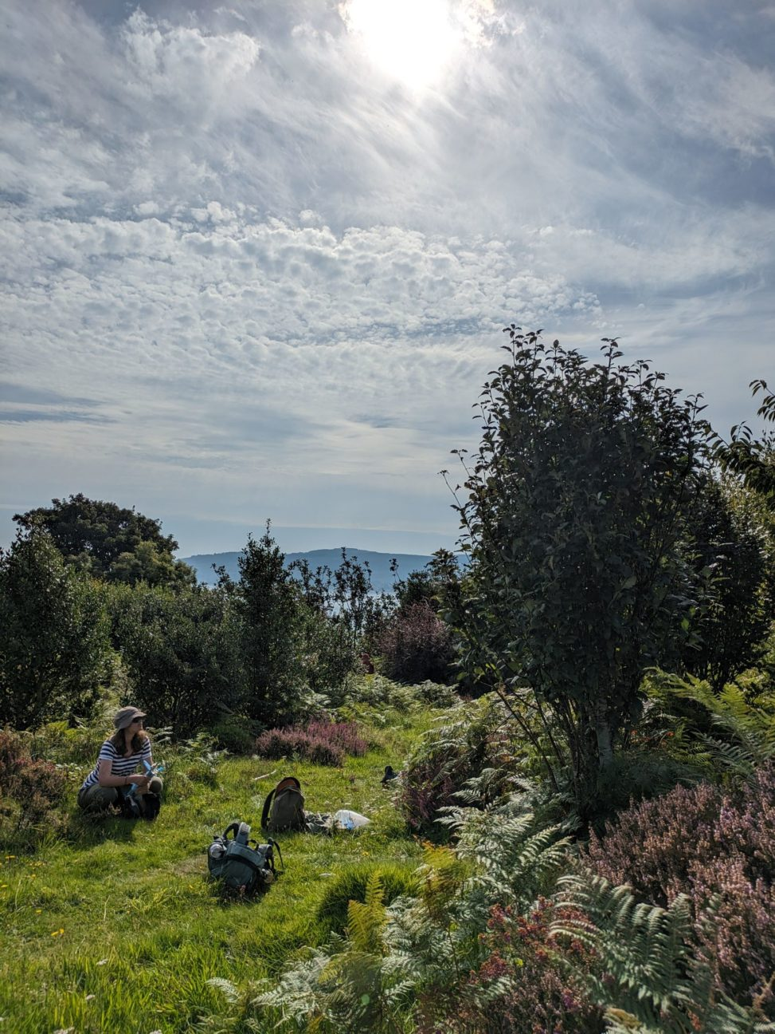
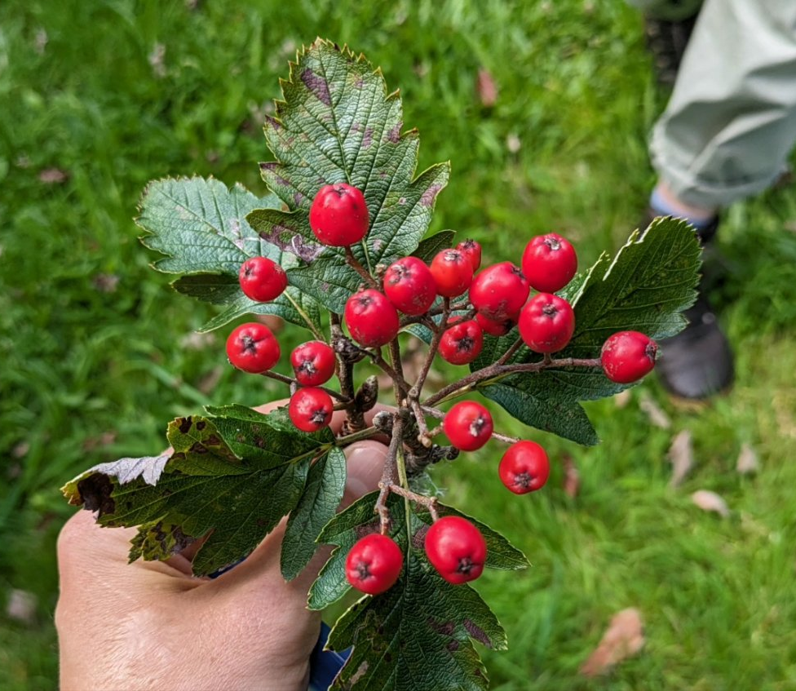
NRF 502209
Biodiversity Net Gain:
Biodiversity as a crucible for saving Scotland’s most threatened species.
Update September 2023
Prepared by Dr Aline Finger, afinger@rbge.org.uk
Field work:
Polygonatum verticillatum soil samples have been collected as well as seed from Den of Airlie
Hedlundia collections on Arran as well as ex-situ collections
Ulmus glabra field trip to collect more DNA samples from Scottish Borders
Saxifraga hirculus Perthshire seed collections
Project partners Duncan Halley (NINA), RSPB Neil Cowie, James Adams, Ellie Dimambro-Denson have collected seed of Cicerbita alpina, Melampyrum sylvaticum and Polygonatum verticillatum from Norway
Collecting Polygonatum verticillatum seed
Hedlundia seed collections on Arran, Holy Isle and in ex-situ collections

Slide 4
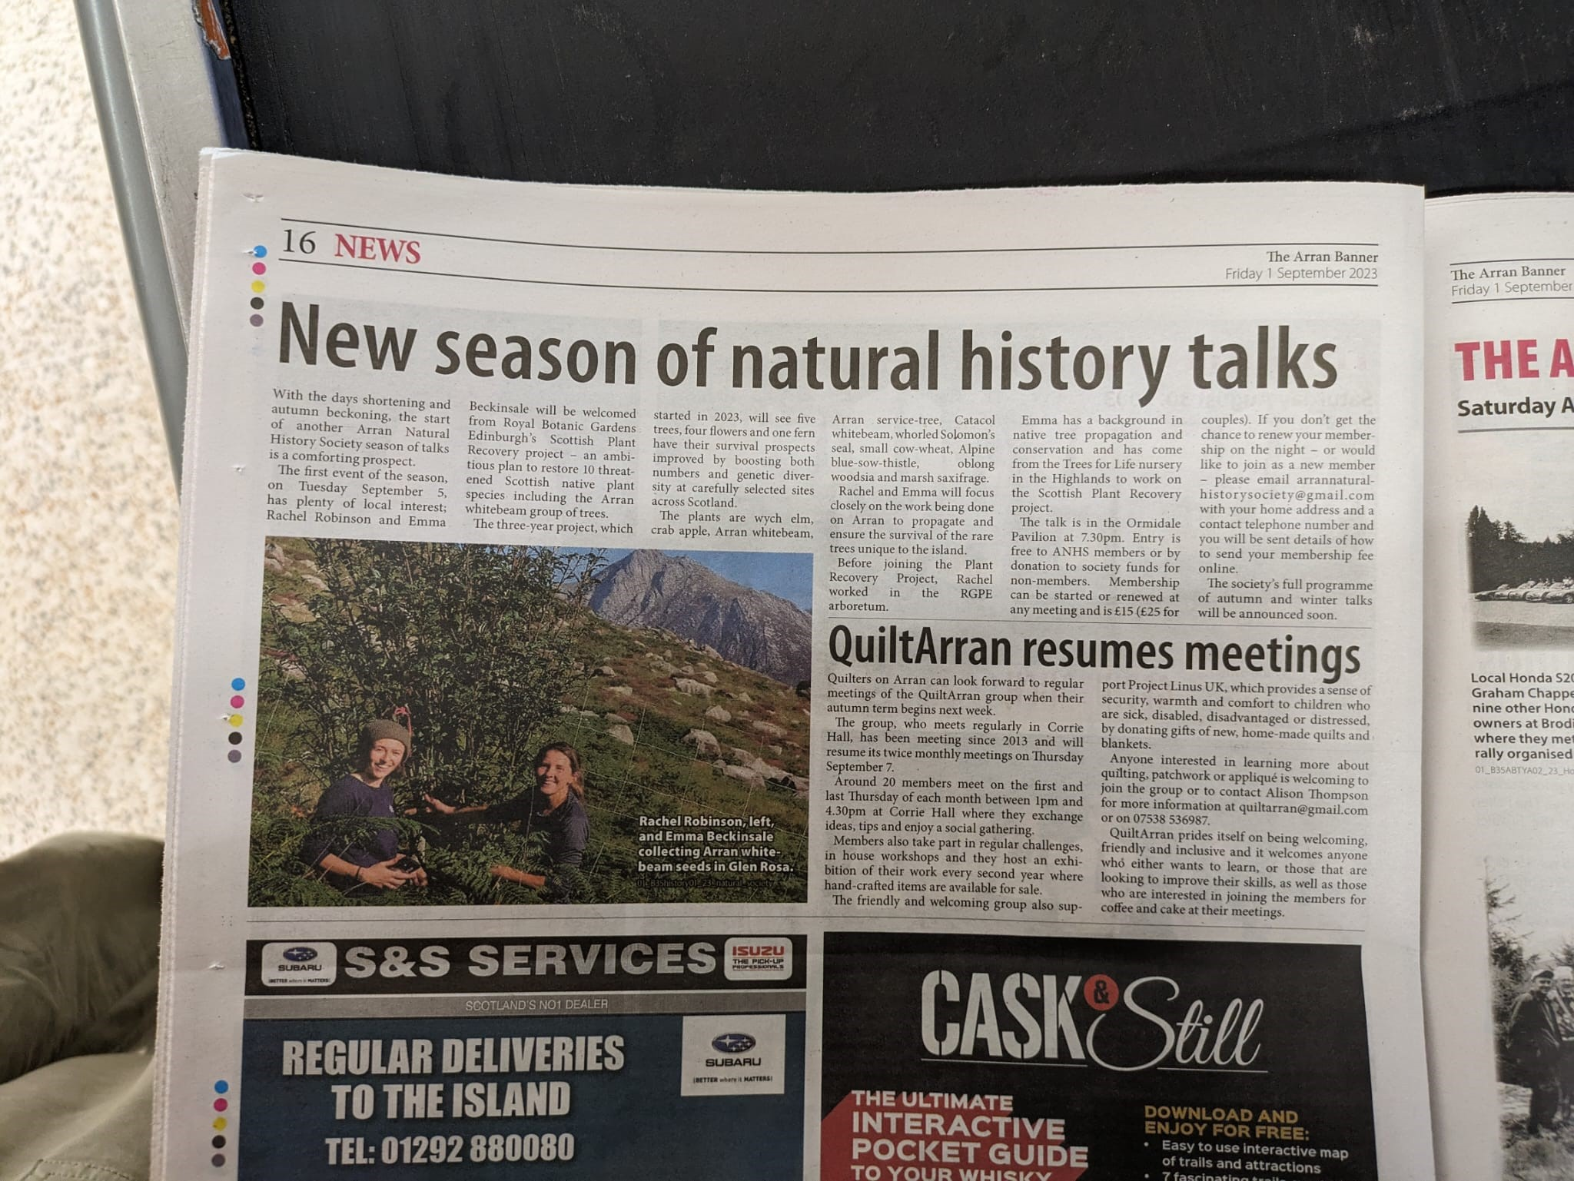
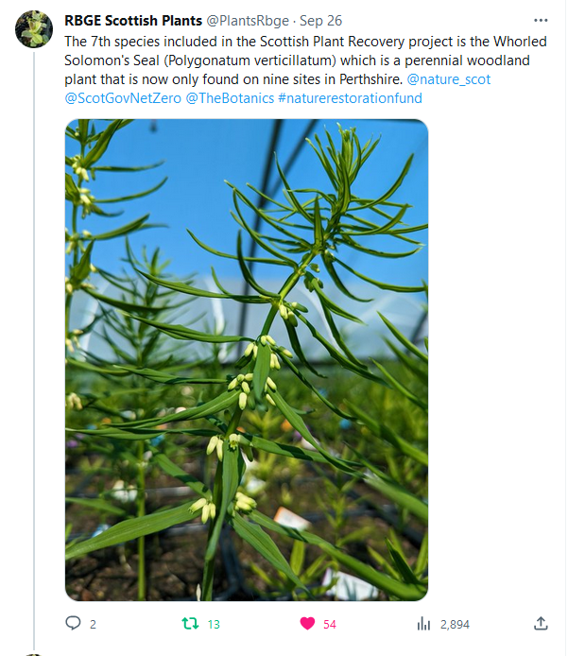
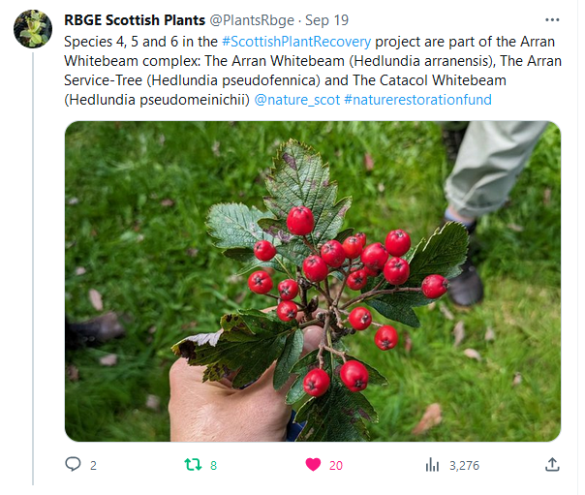
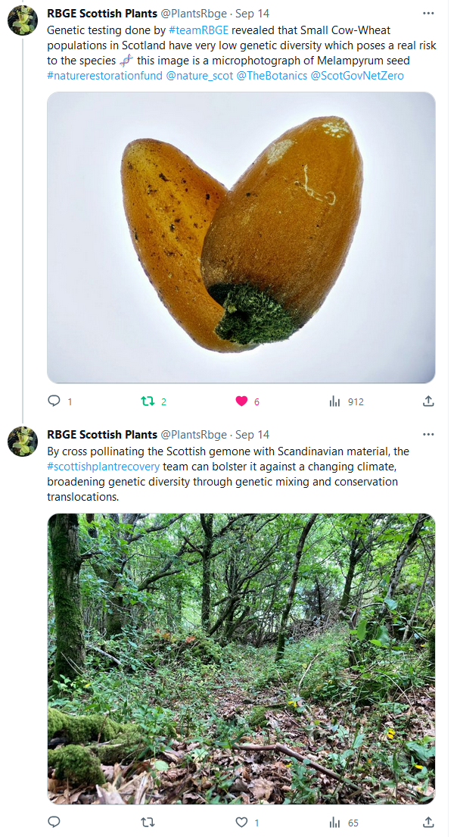
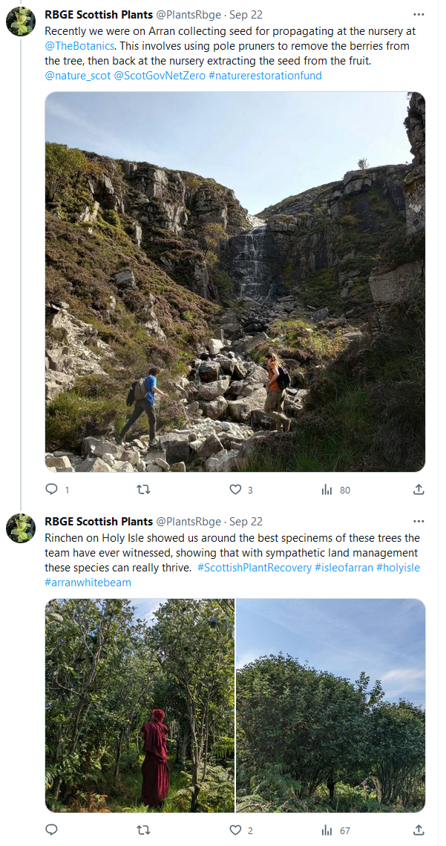
NRF 502209
Biodiversity Net Gain:
Biodiversity as a crucible for saving Scotland’s most threatened species.
Update September 2023
Prepared by Dr Aline Finger, afinger@rbge.org.uk
Communication, press and publications:
We continued to create weekly social media posts
During the Climate Week we ran an ‘Instagram Takeover’ to show the work involved behind the scenes: https://www.instagram.com/stories/highlights/18004740049893525/
Becca presented the project to the Worshipful Company of Gardeners on 07.09.2023
Emma and Rachel’s Hedlundia seed collection trip and presentation to the Arran Natural History Society on 05.09.23 was featured in The Arran Banner
Matt Elliott mentioned the project in a talk at the British Society for Plant Pathology conference on 08.09.23
New Botanic Stories blogs available (https://stories.rbge.org.uk/archives/category/science/scottish-plant-recovery)
Woodsia ilvensis: https://stories.rbge.org.uk/archives/37815
Hedlundia: https://stories.rbge.org.uk/archives/37797
Hedlundia taxonomy: https://stories.rbge.org.uk/archives/37679
Conservation photography: https://stories.rbge.org.uk/archives/37751
Plans for October 2023:
Continue propagation, weeding, maintenance of existing plants
Start DNA extractions for Ulmus glabra
Work on project specific webpage
Continue to process and store all seed collected from all species
Continue processing foreign seed collections
Start NatureScot conservation translocation permits for Ulmus glabra
Meet with NatureScot to discuss fencing of Hedlundia on Arran
Some of our latest social media posts
The Arran Banner promoting the project and talk

